Slide 1
HUG1I2 Konsep Pengembangan Sains dan Teknologi Pertemuan 3: Technology Concept and Development
Author-Tim Dosen
Prodi S1 Teknik Informatika

Slide 2
What is Technology ? (Continued)
In the broadest sense, technology extends our abilities to change the world: to cut, shape, or put together materials; to move things from one place to another; to reach farther with our hands, voices, and senses. (Benchmarks for Science Literacy, AAAS, 1993)
Technology is the process by which humans modify nature to meet their needs and wants. (Technically Speaking: Why All Americans Need to Know More About Technology, NAE/NRC, 2002)

Slide 3
The following next 4 pages taken from Barbara Parker, Introduction to Globalization & Business, London, SAGE, 2005.

Slide 4
Technology
Science is exploration for the sake of knowing and for creating a body of knowledge
Technology is the application of science, usually in the interests of improving human life
product technologies
process technologies
Notes:
What are product technologies? Tangibles, things we can see, hear, feel, touch.
What are process technologies? New ways of doing things, new processes. In your studies of individual companies, you are seeing both product and process technologies. For example, in the cellular phone industry we see product breakthroughs as telephones get smaller, better, clearer, but the process of using them also is getting easier as telecommunication services improve.
In manufacturing, a process improvement you might recognize is JIT inventory systems that order parts needed so they arrive just as they are needed. A process technology change in organizational management is empowerment which is expected to involve more people in thinking and organizational learning.
When looking at technology, it is important to remember that there are both process and product breakthroughs.

Slide 5
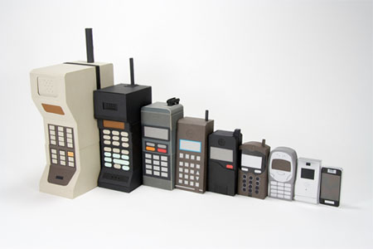
Example of Product Technology
https://agisnurholis318.wordpress.com/2011/09/23/perkembangan-teknologi-telepon-seluler/

Slide 6
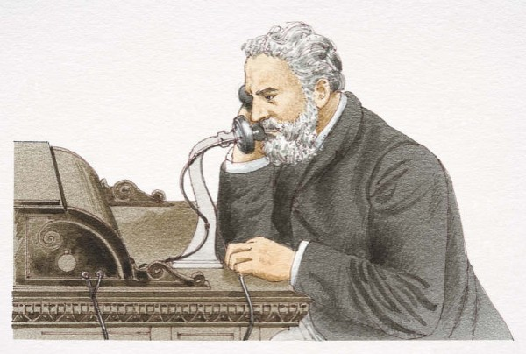
Example of Process Technology
http://wawanplaza.com/tag/sejarah-perkembangan-teknologi-komunikasi
http://guntursigarlangit.blogspot.com/2014/04/perkembangan-teknologi-terkini.html

Slide 7
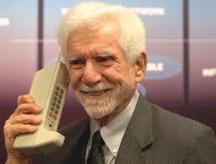
And the cycle starts over …
https://wahyunn1243.wordpress.com/2014/08/13/perkembangan-atau-kemajuan-teknologi/

Slide 8
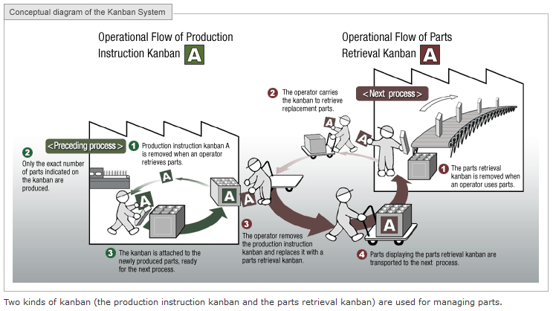
Another example of process technology: Just-In-Time Inventory
http://www.toyota-global.com/company/vision_philosophy/toyota_production_system/just-in-time.html

Slide 9
www.indonesia.travel
http://inet.detik.com/read/2014/12/05/165837/2769045/398/teknologi-nano-bikin-baju-ini-anti-kotor

Slide 10
Technology Can Be
Low tech
High tech
Some combination
Each approach provides opportunities for organizational advantage
Notes:
Low tech—show the weasel ball—made in China--China and Hong Kong generate 60% of the world’s $31 billion toys annually from “Where the furbies come from,” 1998, December 18, The Economist, pp. 95-7.
High tech—computer birthday card
Some combination—show Freestyle radio
The time it takes to develop a new technology varies by industry. Internet technology seemed to develop almost overnight, and consumers embraced it readily, but Mercer Mgmt Consulting indicates that it takes from 5–15 years for consumers to embrace new electronic technologies. Examples: cable TV was introduced in the 1960s and was at about 60% penetration by 1996; VCRs were introduced in the late 1970s and had 90% penetration by 1996; PCs were introduced in the early 1980s and had about 44% penetration by 1996; cell phones were introduced in 1985 and had 30% penetration by 1996, but steep growth was between 1992–6 (from New Technologies take time. 1999, Apr 19. Business Week, p. 8.
How approaches provide opportunities for organizational advantage:
Go to film clip on Avon which shows how Avon combines high and low tech approaches to market in agrarian areas of Brazil.
Questions to ask as they view the film:
How is Avon combining high and low tech product and process technologies to sell cosmetics in rural Brazil?
You’re looking for
high tech/low tech process/products

Slide 11
Low tech
centerfirecentral.com
Made in China
China and Hong Kong generate 60% of the world’s $31 billion toys annually
http://www.weaselballs.com/

Slide 12
Technological Breakthroughs in Products and Processes
are occurring rapidly
in almost all industries
all nations
all businesses
all lives
Is this a boon or a bane? Both
Notes:
Boon = rahmat/kebaikan
Bane = kutukan

Slide 13
Technological Changes
Generate both opportunities and threats
Are difficult to predict in a global world because they:
occur rapidly
often have unintended consequences
are replaced/refined by people worldwide; changes occur “out of sight”
Stimulate profound societal change in business and other spheres
Make managerial and personal life more challenging
Notes:
Threat: about 97% of what you know today will be obsolete in 50 years because by the time you are 75 you will only be relying on about 3% of what you are learning now
The challenge is to keep up.

Slide 14
Five Historical Commonalities of Technological Development
The work of humans has been supplemented, substituted, or amplified by technological change. This process now affects knowledge work.
The importance of technology has increased over time.
The rate of innovation has increased markedly over time.
Innovations and breakthroughs often occur in clusters.
Technological change spills over into personal lives.

Slide 15
Classification of theories of technology
The theories attempt to address the relationship between technology and society and prompt questions about agency, determinism/autonomy, and teleonomy.
Social theories
Descriptive vs critical theories
Group theories
Analytic theories
http://en.wikipedia.org/wiki/Theories_of_technology
Notes:
If forced, one might categorize them into social and group theories. Additionally, one might distinguish between descriptive and critical theories. Descriptive theories attempt to address the definition and substance of technology, the ways it has emerged, changed and its relation to the human/social sphere. More substantively it addresses the extent of which technology is autonomous and how much force it has in determining human practice or social structure. Critical theories of technology often take a descriptive theory as their basis and articulate concerns, examining what way the relationship can be changed. The authors mentioned in this article are those that have some concern with technology or media, though they often borrow from one another and of course build upon seminal theorists that preceded them.

Slide 16
Social theory: Descriptive approaches
1. Social construction of technology (SCOT), technology does not determine human action, but that human action shapes technology.
2. Actor-network theory (ANT) - heterogeneous network of humans and non-humans as equal interrelated actors.
3. Structuration theory - structures as rules and resources organized as properties of social systems.
Notes:
Social construction of technology (SCOT) - argues that technology does not determine human action, but that human action shapes technology. Key concepts include:
interpretive flexibility: "Technological artifacts are culturally constructed and interpreted ... By this we mean not only that there is flexibility in how people think of or interpret artifacts but also that there is flexibility in how artifacts are designed."
Relevant social group: shares a particular set of meanings about an artifact
'Closure' and stabilization: when the relevant social group has reached a consensus
Wider context: "the sociocultural and political situation of a social group shapes its norms and values, which in turn influence the meaning given to an artifact"
Key authors include MacKensie and Wajcman (1985) & Pinch and Bijker (1992).Actor-network theory (ANT) - posits a heterogeneous network of humans and non-humans as equal interrelated actors. It strives for impartiality in the description of human and nonhuman actors and the reintegration of the natural and social worlds. For example, Latour (1992) argues that instead of worrying whether we are anthropomorphizing technology, we should embrace it as inherently anthropomorphic: technology is made by humans, substitutes for the actions of humans, and shapes human action. What is important is the chain and gradients of actors' actions and competences, and the degree to which we choose to have figurative representations. Key concepts include the inscription of beliefs, practices, relations into technology, which is then said to embody them. Key authors include Latour (1997) and Callon (1999).
Structuration theory - defines structures as rules and resources organized as properties of social systems. The theory employs a recursive notion of actions constrained and enabled by structures which are produced and reproduced by that action. Consequently, in this theory technology is not rendered as an artifact, but instead examines how people, as they interact with a technology in their ongoing practices, enact structures which shape their emergent and situated use of that technology. Key authors include DeSantis and Poole (1990), and Orlikowski (1992).
Systems theory - considers the historical development of technology and media with an emphasis on inertia and heterogeneity, stressing the connections between the artifact being built and the social, economic, political and cultural factors surrounding it. Key concepts include reverse salients when elements of a system lag in development with respect to others, differentiation, operational closure, and autopoietic autonomy. Key authors include Thomas P. Hughes (1992) and Luhmann (2000).
Activity theory

Slide 17
Social theory: Descriptive approaches
4. Systems theory - considers the historical development of technology and media with an emphasis on inertia and heterogeneity, stressing the connections between the artifact being built and the social, economic, political and cultural factors surrounding it.
5. Activity theory
Notes:
Social construction of technology (SCOT) - argues that technology does not determine human action, but that human action shapes technology. Key concepts include:
interpretive flexibility: "Technological artifacts are culturally constructed and interpreted ... By this we mean not only that there is flexibility in how people think of or interpret artifacts but also that there is flexibility in how artifacts are designed."
Relevant social group: shares a particular set of meanings about an artifact
'Closure' and stabilization: when the relevant social group has reached a consensus
Wider context: "the sociocultural and political situation of a social group shapes its norms and values, which in turn influence the meaning given to an artifact"
Key authors include MacKensie and Wajcman (1985) & Pinch and Bijker (1992).Actor-network theory (ANT) - posits a heterogeneous network of humans and non-humans as equal interrelated actors. It strives for impartiality in the description of human and nonhuman actors and the reintegration of the natural and social worlds. For example, Latour (1992) argues that instead of worrying whether we are anthropomorphizing technology, we should embrace it as inherently anthropomorphic: technology is made by humans, substitutes for the actions of humans, and shapes human action. What is important is the chain and gradients of actors' actions and competences, and the degree to which we choose to have figurative representations. Key concepts include the inscription of beliefs, practices, relations into technology, which is then said to embody them. Key authors include Latour (1997) and Callon (1999).
Structuration theory - defines structures as rules and resources organized as properties of social systems. The theory employs a recursive notion of actions constrained and enabled by structures which are produced and reproduced by that action. Consequently, in this theory technology is not rendered as an artifact, but instead examines how people, as they interact with a technology in their ongoing practices, enact structures which shape their emergent and situated use of that technology. Key authors include DeSantis and Poole (1990), and Orlikowski (1992).
Systems theory - considers the historical development of technology and media with an emphasis on inertia and heterogeneity, stressing the connections between the artifact being built and the social, economic, political and cultural factors surrounding it. Key concepts include reverse salients when elements of a system lag in development with respect to others, differentiation, operational closure, and autopoietic autonomy. Key authors include Thomas P. Hughes (1992) and Luhmann (2000).
Activity theory

Slide 18
Group theory
Social presence theory, the social impact of a communication medium depend on the social presence it allows communicators to have
Media richness theory, the amount of information communicated differs with respect to a medium's richness.
Media naturalness theory
Media synchronicity theory
The Social Identity model of Deindividuation Effects (SIDE)
Time, interaction, and performance theory
Notes:
There are also a number of technology related theories that address how (media) technology affects group processes. Broadly, these theories are concerned with the social effects of communication media. Some (e.g., media richness) are concerned with questions of media choice (i.e., when to use what medium effectively). Other theories (social presence, SIDE, media naturalness) are concerned with the consequences of those media choices (i.e., what are the social effects of using particular communication media).
Social presence theory (Short, et al., 1976) is a seminal theory of the social effects of communication technology. Its main concern is with telephony and telephone conferencing (the research was sponsored by the British Post Office, now British Telecom). It argues that the social impact of a communication medium depend on the social presence it allows communicators to have. Social presence is defined as a property of the medium itself: the degree of acoustic, visual, and physical contact that it allows. The theory assumes that more contact will increase the key components of "presence": greater intimacy, immediacy, warmth and inter-personal rapport. As a consequence of social presence, social influence is expected to increase. In the case of communication technology, the assumption is that more text-based forms of interaction (e-mail, instant messaging) are less social, and therefore less conducive to social influence.
Media richness theory (Daft & Lengel, 1986) shares some characteristics with social presence theory. It posits that the amount of information communicated differs with respect to a medium's richness. The theory assumes that resolving ambiguity and reducing uncertainty are the main goals of communication. Because communication media differ in the rate of understanding they can achieve in a specific time (with "rich" media carrying more information), they are not all capable of resolving uncertainty and ambiguity well. The more restricted the medium's capacity, the less uncertainty and equivocality it is able to manage. It follows that the richness of the media should be matched to the task so as to prevent over simplification or complication.
Media naturalness theory (Kock, 2001; 2004) builds on human evolution ideas and has been proposed as an alternative to media richness theory. Media naturalness theory argues that since our Stone Age hominid ancestors have communicated primarily face-to-face, evolutionary pressures have led to the development of a brain that is consequently designed for that form of communication. Other forms of communication are too recent and unlikely to have posed evolutionary pressures that could have shaped our brain in their direction. Using communication media that suppress key elements found in face-to-face communication, as many electronic communication media do, thus ends up posing cognitive obstacles to communication. This is particularly the case in the context of complex tasks (e.g., business process redesign, new product development, online learning), because such tasks seem to require more intense communication over extended periods of time than simple tasks.
Media synchronicity theory (MST, Dennis & Valacich, 1999) redirects richness theory towards the synchronicity of the communication.
The Social Identity model of Deindividuation Effects (SIDE) (Postmes, Spears and Lea 1999; Reicher, Spears and Postmes, 1995; Spears & Lea, 1994) was developed as a response to the idea that anonymity and reduced presence made communication technology socially impoverished (or "deindividuated"). It provided an alternative explanation for these "deindividuation effects" based on theories of social identity (e.g., Turner et al., 1987). The SIDE model distinguishes cognitive and strategic effects of a communication technology. Cognitive effects occur when communication technologies make "salient" particular aspects of personal or social identity. For example, certain technologies such as email may disguise characteristics of the sender that individually differentiate them (i.e., that convey aspects of their personal identity) and as a result more attention may be given to their social identity. The strategic effects are due to the possibilities, afforded by communication technology, to selectively communicate or enact particular aspects of identity, and disguise others. SIDE therefore sees the social and the technological as mutually determining, and the behavior associated with particular communication forms as the product or interaction of the two.
Time, interaction, and performance (TIP; McGrath, 1991) theory describes work groups as time-based, multi-modal, and multi-functional social systems. Groups interact in one of the modes of inception, problem solving, conflict resolution, and execution. The three functions of a group are production (towards a goal), support (affective) and well-being (norms and roles).

Slide 19
Next following 5 pages taken from:
PAUL TROTT
INNOVATION MANAGEMENT AND
NEW PRODUCT DEVELOPMENT
4th Edition

Slide 20
Linear models of innovation management

Slide 21
Interactive model of innovation
TECHNOLOGY
PUSH
latest science and technology
advances in society
idea
commercial
product
R&D
Manufacturing
Marketing
needs of society
and the market place
MARKET
PULL
Source: Rothwell & Zegweld (1985)

Slide 22
Open Innovation
Basic Research
New Product
Development
Internal
research
projects
Current market
And business model
Technology
In-licensing
Technology
acquisition
Venture investing
External research
project
(Chesbrough, 2003)

Slide 23
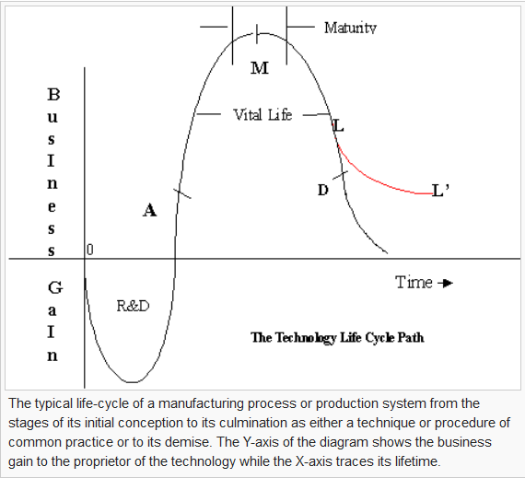
http://en.wikipedia.org/wiki/Technology_life_cycle

Slide 24
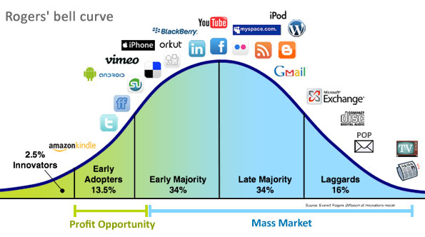
Technology Adoption Lifecycle
http://www.designdamage.com/tag/rogers-bell-curve/#axzz3QvCwFmsp

Slide 25
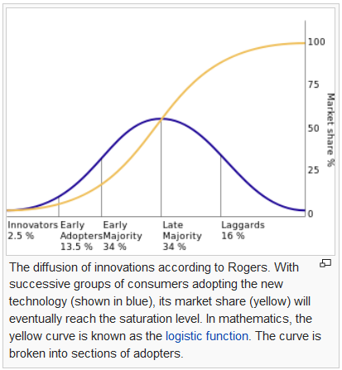
http://en.wikipedia.org/wiki/Diffusion_of_innovations

Slide 26
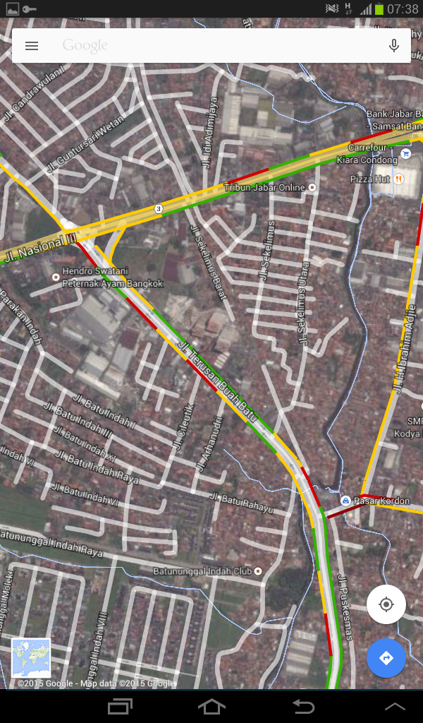
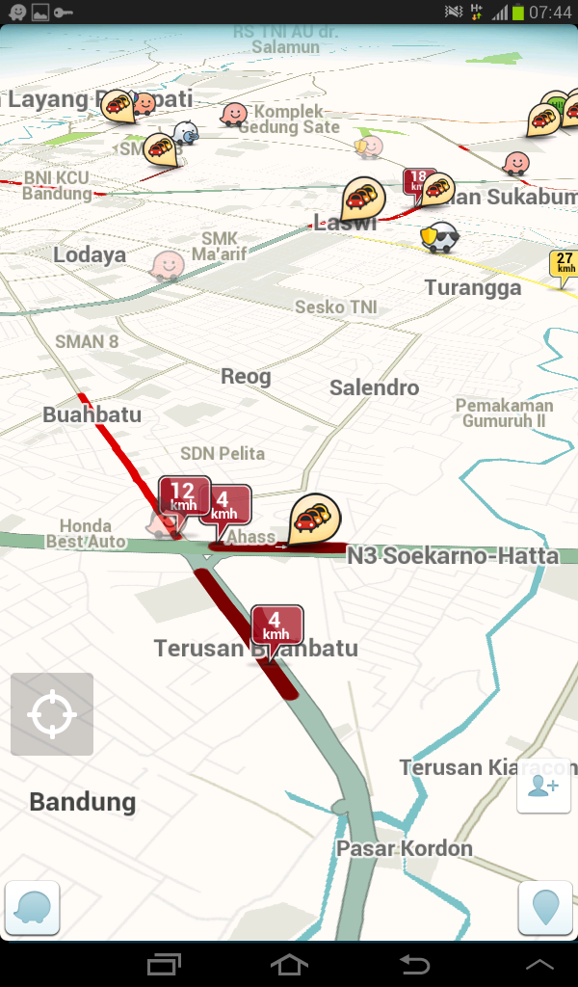
Contoh Akuisisi:
Alasan teknologi
atau ekonomi?
http://www.nextpowerup.com/news/14025/facebook-completes-whatsapp-acquisition-in-a-deal-worth-usd-21-8-billion.html

Slide 27
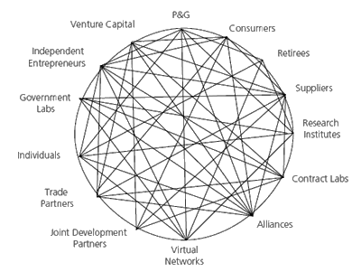
Open innovation . . .
Procter & Gamble’s web of links for
innovation and new product development
Source: HBR (2006)
Notes:
HBR = Harvard Business Review

Slide 28
Cyclic Innovation Model
Technological
research
integrated
engineering cycle
hard sciences
cycle
Scientific
exploration
Entrepreneurship
Product
creation
Marketing
cycle
soft sciences
cycle
Market
transitions
Source: G Berkhout (2007), TU Delft.

Slide 29
Discussion
Describe 5 technology most influence you
How them influence you and what social impact do you have (pros and cons)
For each of them describe min 3 underlying science
Notes:
There are also a number of technology related theories that address how (media) technology affects group processes. Broadly, these theories are concerned with the social effects of communication media. Some (e.g., media richness) are concerned with questions of media choice (i.e., when to use what medium effectively). Other theories (social presence, SIDE, media naturalness) are concerned with the consequences of those media choices (i.e., what are the social effects of using particular communication media).
Social presence theory (Short, et al., 1976) is a seminal theory of the social effects of communication technology. Its main concern is with telephony and telephone conferencing (the research was sponsored by the British Post Office, now British Telecom). It argues that the social impact of a communication medium depend on the social presence it allows communicators to have. Social presence is defined as a property of the medium itself: the degree of acoustic, visual, and physical contact that it allows. The theory assumes that more contact will increase the key components of "presence": greater intimacy, immediacy, warmth and inter-personal rapport. As a consequence of social presence, social influence is expected to increase. In the case of communication technology, the assumption is that more text-based forms of interaction (e-mail, instant messaging) are less social, and therefore less conducive to social influence.
Media richness theory (Daft & Lengel, 1986) shares some characteristics with social presence theory. It posits that the amount of information communicated differs with respect to a medium's richness. The theory assumes that resolving ambiguity and reducing uncertainty are the main goals of communication. Because communication media differ in the rate of understanding they can achieve in a specific time (with "rich" media carrying more information), they are not all capable of resolving uncertainty and ambiguity well. The more restricted the medium's capacity, the less uncertainty and equivocality it is able to manage. It follows that the richness of the media should be matched to the task so as to prevent over simplification or complication.
Media naturalness theory (Kock, 2001; 2004) builds on human evolution ideas and has been proposed as an alternative to media richness theory. Media naturalness theory argues that since our Stone Age hominid ancestors have communicated primarily face-to-face, evolutionary pressures have led to the development of a brain that is consequently designed for that form of communication. Other forms of communication are too recent and unlikely to have posed evolutionary pressures that could have shaped our brain in their direction. Using communication media that suppress key elements found in face-to-face communication, as many electronic communication media do, thus ends up posing cognitive obstacles to communication. This is particularly the case in the context of complex tasks (e.g., business process redesign, new product development, online learning), because such tasks seem to require more intense communication over extended periods of time than simple tasks.
Media synchronicity theory (MST, Dennis & Valacich, 1999) redirects richness theory towards the synchronicity of the communication.
The Social Identity model of Deindividuation Effects (SIDE) (Postmes, Spears and Lea 1999; Reicher, Spears and Postmes, 1995; Spears & Lea, 1994) was developed as a response to the idea that anonymity and reduced presence made communication technology socially impoverished (or "deindividuated"). It provided an alternative explanation for these "deindividuation effects" based on theories of social identity (e.g., Turner et al., 1987). The SIDE model distinguishes cognitive and strategic effects of a communication technology. Cognitive effects occur when communication technologies make "salient" particular aspects of personal or social identity. For example, certain technologies such as email may disguise characteristics of the sender that individually differentiate them (i.e., that convey aspects of their personal identity) and as a result more attention may be given to their social identity. The strategic effects are due to the possibilities, afforded by communication technology, to selectively communicate or enact particular aspects of identity, and disguise others. SIDE therefore sees the social and the technological as mutually determining, and the behavior associated with particular communication forms as the product or interaction of the two.
Time, interaction, and performance (TIP; McGrath, 1991) theory describes work groups as time-based, multi-modal, and multi-functional social systems. Groups interact in one of the modes of inception, problem solving, conflict resolution, and execution. The three functions of a group are production (towards a goal), support (affective) and well-being (norms and roles).

