Slide 1
HUG1I2 Konsep Pengembangan Sains dan Teknologi Pertemuan 2: Sains dan Teknologi
Author-Tim Dosen
Prodi S1 Teknik Informatika

Slide 2
Resume First Task
Write an essay about:
What is Science?
What is Technology?
How Science and Technology related each-other?
Essay write manually (don’t use computer) in paper (A4), write down references uses in the essay
What’s your answer??

Slide 3
Sains
Techology

Slide 4
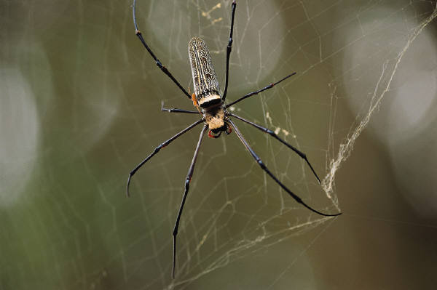
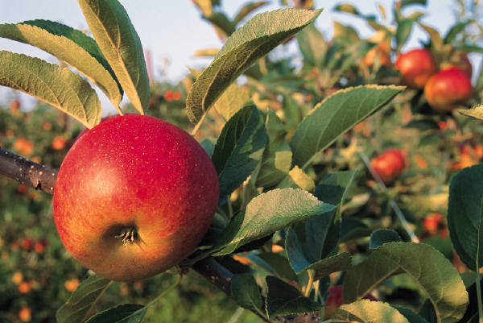
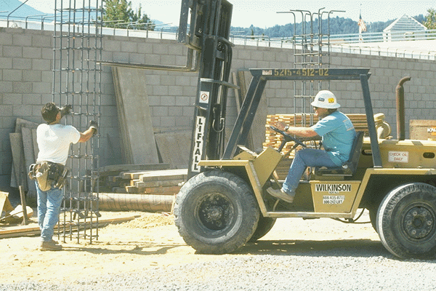
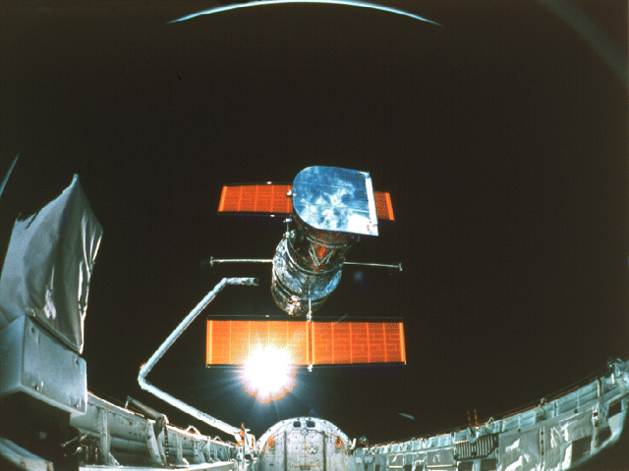
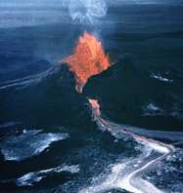
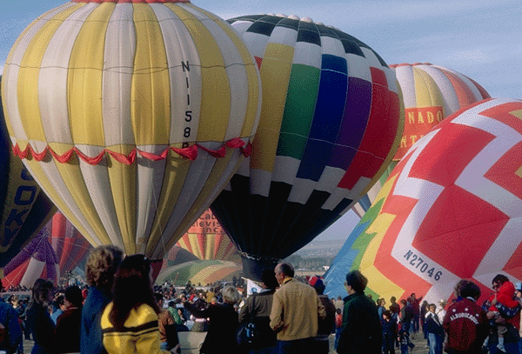
What is Science?
What is Technology?

Slide 5
The fact [1]
In the United States as well as in other countries, there is confusion about the term “technology.”
In 2001 and 2004, The International Technology Education Association (ITEA) conducted polls which were done by the Gallup Organization on how Americans think about technology.
In both polls, a majority of Americans (62% in 2004 and 59% in 2001) responded that science and technology are basically one and the same thing.

Slide 6
The fact [2]
When asked how important it is for high school students to understand the relationship between science and technology, 98% of the Americans stated that they thought that this was “very or somewhat important”.
Most Americans (68% in 2004 & 67% in 2001) view technology very narrowly as being computers, electronics, and the internet.
There was near total consensus (98% in 2004 & 97% in 2001) in the public sampled that schools should include the study of technology in the curriculum.

Slide 7
Why it’s important for us to know the answer for : What’s science, What’s Technology and What’s relation between science and technology
Science vs Technology ?
Science ~ Technology ?
Science better than technology ?

Slide 8
Mewujudkan Indonesia yang adil, makmur dan sejahtera
Negara Kepulauan Terbesar di Dunia
Negara Dengan Kekayaan Alam Yang Melimpah
Negara Dengan Jumlah Penduduk Ke-4 Terbesar di Dunia
Negara Dengan Jumlah Militer ke 17 di Dunia
Negara Dengan Pertumbuhan Ekonomi Yang Menjanjikan
Negara Dengan Pertumbuhan Ekonomi Yang Pesat GDP No 15 di Dunia

Slide 9
Komoditi SDA yang perlu pendayagunaan pengetahuan, engineering dan teknologi
Penghasil
Terbesar
Dunia no 10:
Buah
11,6 juta ton
Penghasil
Terbesar
Dunia no 3:
Beras
35,8 juta ton
Output
Terbesar
Dunia no 6:
Agricultural
US$ 60 milyar
Penghasil
Terbesar
Dunia no 3:
Kokoa
545.000 ton
Penghasil
Terbesar
Dunia no 6:
Teh
150.000 ton
Penghasil
Terbesar
Dunia no 5:
Kacang
69,4 juta ton
Penghasil
Terbesar
Dunia no 4:
Kopi
465.000 ton
Penghasil
Terbesar
Dunia no 1:
Kelapa Sawit
465.000 ton
Penghasil
Terbesar
Dunia no 3:
Karet
2,80 juta ton
Penghasil
Terbesar
Dunia no 2:
Timah
102.000 ton
Penghasil
Terbesar
Dunia no 6:
Tembaga
789.000 ton
Penghasil
Terbesar
Dunia no 4:
Bauksit
Cad . no 7
Penghasil
Terbesar
Panas Bumi
40% sumber daya dunia
Penghasil
Terbesar
Dunia no 10:
Natural Gas
69,7 milyar cubic mtr.
Penghasil
Terbesar
Dunia no 6:
Batubara
141,1 juta ton oil eq
Penghasil
Terbesar
Dunia no 3:
Nikel
229.000 ton
Penghasil
Terbesar
Dunia no 7:
Emas
105.000 ton

Slide 10
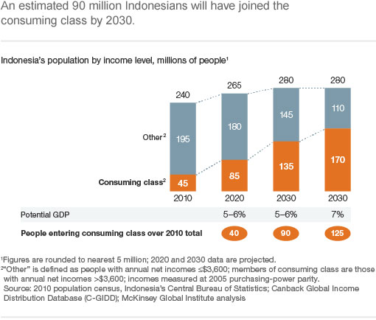
Indonesia di masa depan (2030)
7-th Largest economy in the world
135 million members of consuming class
113 million skilled workers needed
$1.8 trillion market opurtinity

Slide 11
Let’s transform into a better person and reach our dream
Tingkat 1
Tingkat 2
Tingkat 3
Tingkat 4
(Sarjana)

Slide 12
Science seeks to understand the natural world.
National Science Education Standards, National Research Council, 1996.

Slide 13
What is Technology?
It is the innovation, change, or modification of the natural environment in order to satisfy perceived human wants and needs. (Standards for Technological Literacy, ITEA, 2000)
The goal of technology is to make modifications in the world to meet human needs. (National Science Education Standards, NRC, 1996)

Slide 14
What is Technology ? (Continued)
In the broadest sense, technology extends our abilities to change the world: to cut, shape, or put together materials; to move things from one place to another; to reach farther with our hands, voices, and senses. (Benchmarks for Science Literacy, AAAS, 1993)
Technology is the process by which humans modify nature to meet their needs and wants. (Technically Speaking: Why All Americans Need to Know More About Technology, NAE/NRC, 2002)

Slide 15
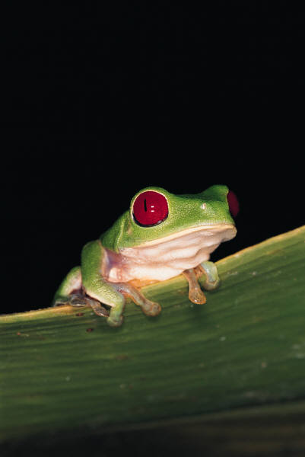
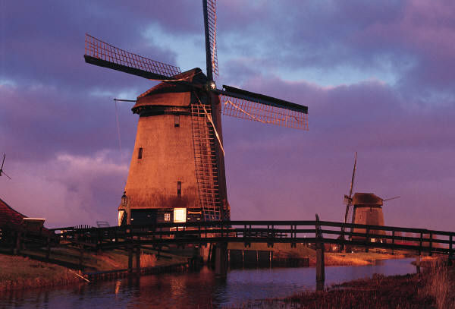
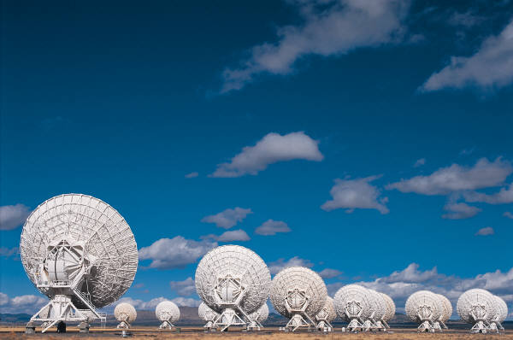
Sains
Technology
Deals with the natural world.
Is very concerned with what is (exists) in the natural world. (i.e.: Biology, Chemistry, Physics, Astronomy, Geology, etc.)
Deals with how humans modify, change, alter, or control the natural world.
Is very concerned with what can or should be designed, made, or developed from natural world materials and substances to satisfy human needs and wants

Slide 16
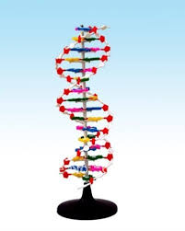
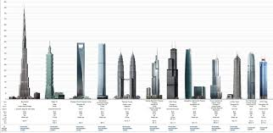
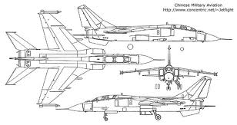
Sains
Technology
Is concerned with processes that seek out the meaning of the natural world by “inquiry”, “discovering what is”, “exploring”, and using “the Scientific Method”.
Is concerned with such processes that we use to alter/change the natural world such as “Invention”, Innovation”, Practical Problem Solving, and Design.

Slide 17
Resume
Aspek | Sains | Teknologi
Objek pengamatan | Nature (alam) | Kebutuhan manusia
Faktor Pendorong | Curiosity (rasa ingin tahu) | Better and comfortable life (hidup lebih baik dan nyaman)
Fokus | Process that seek out the meaning of the natural world | processes that we use to alter/change the natural world
Technique/process | “inquiry”, “discovering what is”, “exploring”, and using “the Scientific Method”. | “Invention”, Innovation”, Practical Problem Solving, and Design
Output | New knowledge | New method for engineering

Slide 18
While technology and science have a common denominator being the natural world, they are similar yet very different.
Technology is not any more “applied science” than science is “applied technology”.

Slide 19
Daftar Pustaka
William E. Dugger, Jr. “The Perspective of Technology Education”, The Second International Symposium on Educational Cooperation for Industrial Technology Education, Kariya City, Japan
Satryo Soemantri Brodjonegoro, Indonesia Inovatif

Slide 20
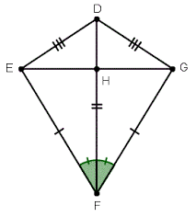
Prepare for Outdoor Activity (optional)
Anda mengenal apa itu layangan? Pernahkah anda bermain layangan?
Tugas anda: merancang dan merealisasikan sebuah layangan selain bentuk standar untuk dapat anda terbangkan dalam waktu yang sangat singkat dengan kondisi angin yang sangat minim.

