Slide 1
CSG3G3 Kercerdasan Mesin dan Artifisial
Pertemuan 4: Searching 3
Author-Tim Dosen
KK ICM

Slide 2
Perbandingan metode pencarian [RUS95] – Tree Search
Kriteria | BFS | UCS | DFS | DLS | IDS | BDS
Time | b^{d} | b^{d} | b^{m} | b^{l} | b^{d} | b^{d/2}
Space | b^{d} | b^{d} | bm | bl | bd | b^{d/2}
Complete? | Yes | Yes | No | Yes, if l ≥ d | Yes | Yes
Optimal? | Yes if cost identic | Yes | No | No | Yes | Yes
Process Node (expanding ) | First | First (sort) | First | First | First | Depend on
Insert Node | Last | Sort | First | Fisrt | First | Depend on

Slide 3
Branching Factor
It affect the time and space complexcity
Know your enemy before the war ☺
Let’s start with simple problem 5 Puzzle

Slide 4
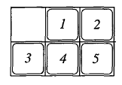
5 Puzzle Problem
Equal likelihood:
  Expanding node determined by blank position, let’s call it in corner (c) and side (s)
  In c position the branching will be 2 node, while in s position the branching will be 3 node
  The asymptotic branching factor value will range in 2 until 3.
  By evaluate all possible position we get branching factor is: 14/6=2.333
  Unfortunately, this assumes that all possible location of blank are equally likely, which is incorrect
  The number of s position will occur frequently and will overrepresented in the search tree.
Branching posibility base on blank position
2 | 3 | 2
2 | 3 | 2

Slide 5
5 Puzzle Problem Branching Factor [1]
nfc
c
nfc
The exact value of the branching factor will depend on fs, the fraction of total nodes at a given level of the tree that are s nodes, with fc = 1 - fs being the fraction of c nodes.
A c node at one level generates an s node and another c node at the next level. Similarly, an s node at one level generates another s node and two c nodes at the next level.
Thus, the number of c nodes at a given level is two times the number of s nodes plus the number of c nodes at the previous level, and the number of s nodes is the number of c nodes plus the number of s nodes at the previous level.
Thus, if there are nfs s nodes and nfc c nodes at one level, then at the next level we will have 2nfs + nfc c nodes and nfs + nfc s nodes at the next level.
c
s
nfc
nfs
2c
nfs
s
s
nfs
Jumlah c node= 2nfs+ nfc
Jumlah s node= nfs+ nfc

Slide 6
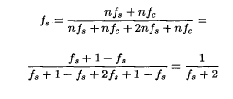
5 Puzzle Problem Branching Factor [2]
Next we assume that the fraction fs converges to an equilibrium value, and hence must be the same at the next level, or
Jumlah node state ke-n
Jumlah node state ke-n+1

Slide 7
5 Puzzle Problem Branching Factor [3]
The solution of the equantation is ~0.4142 (sqrt(2)-1)
fs=0.4142, fc=1-fs = 0.5858
Branching factor at each level:
  3nfs+2nfc (abaikan n)
  3 x 0.4142+ 2 x 0.5858 = 2.4142
This branching factor assume that the parent of a node is generated as one of its children.
What is value of 5 Puzzle Branching Factor if the we wouldn’t generate the parent as one of the children?

Slide 8
Searching 3
  Pseudo-code :UnInformed Search

Slide 9
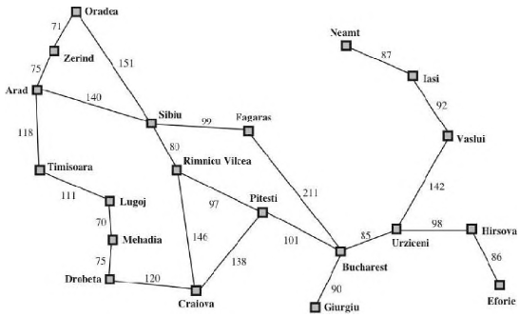
Example

Slide 10
Infrastructure
For each node in tree -> 4 component:
  n.STATE: the state in state space to which node corresponds
  n.PARENT: the node in search tree that generated this node
  n.ACTION: the action that applied to parent to generate the node
  n.PATH_COST: the cost of the path from initial_state to the node

Slide 11
The primitif
Empty?(queue) -> return true if queue empty
PROCESS(queue) -> remove the first element in queue to be expanding
INSERT(element,queue)-> insert and element to queue

Slide 12
Problem Definition
  Initial-State
  Action
  Transition model
  Goal-Test
  Path cost

Slide 13
BFS-Pesudo Code
node <- problem.Initial-State,PATH-COST=
If problem.Goal-Test (node.State) then return SOLUTION(node)
frontier <-node
explored <-empty
loop do
  if EMPTY?(frontier) then return failure
  node <- PROCESS(frontier) */always process first node*/
  add node.STATE to explored
  For each action in problem.ACTION(node.STATE) do
  child <- CHILD-NODE (problem, node, action)
  if child.STATE is not in explored or frontier then
  if problem.Goal-Test(child.State) the return SOLUTION(child)
  INSERT(child, frontier) */insert last*/

Slide 14
UCS-Pesudo Code
node <- problem.Initial-State,PATH-COST=
If problem.Goal-Test (node.State) then return SOLUTION(node)
frontier <-node */PRIORITY QUEUE*/
explored <-empty
loop do
  if EMPTY?(frontier) then return failure
  node <- PROCESS(frontier) */always choose the lowest cost node*/
  add node.STATE to explored
  For each action in problem.ACTION(node.STATE) do
  child <- CHILD-NODE (problem, node, action)
  if child.STATE is not in explored or frontier then
  INSERT(child, frontier) */insertion sort*/
  elseif child.STATE is in frontier with higher PATH-COST then
  replace that frontier node with Child

Slide 15
DFS-Pesudo Code
node <- problem.Initial-State,PATH-COST=
If problem.Goal-Test (node.State) then return SOLUTION(node)
frontier <-node
explored <-empty
loop do
  if EMPTY?(frontier) then return failure
  node <- PROCESS(frontier) */always process first node*/
  add node.STATE to explored
  For each action in problem.ACTION(node.STATE) do
  child <- CHILD-NODE (problem, node, action)
  if child.STATE is not in explored or frontier then
  if problem.Goal-Test(child.State) the return SOLUTION(child)
  INSERT(child, frontier) */insert first*/

Slide 16
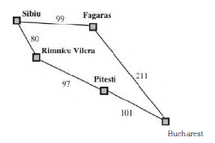
Test-Case 1 Sibiu - Bucharest

Slide 17
Path-Result
BFS: Sibiu-Faragas-Bucharest
UCS:
  1. Solution : Sibui-Faragas-Bucharest
  2. Solution: Sibiu-Rimnivicu Vilcea-Pitesti-Bucharest (best solution)

Slide 18
Searching 3
  Informed Search

Slide 19
Heuristic (Informed) Search
Heuristic berasal dari bahasa Yunani, heuriskein, yang berarti ‘mencari’ atau ‘menemukan’.
Archimedes: “Eureka! Eureka!” (sudah kutemukan)
Dalam dunia pemrograman, heuristik adalah lawan kata dari algoritmik.
Heuristik → fungsi yang memberikan suatu nilai berupa biaya perkiraan (estimasi) dari suatu solusi.

Slide 20
Fungsi heuristik (admissibility and consistency)
Admissable : Suatu fungsi dapat diterima sebagai fungsi heuristik jika biaya perkiraan yang dihasilkan tidak melebihi biaya sebenarnya (overestimate).
Jika fungsi heuristik overestimate, maka proses pencarian bisa tersesat dan tidak optimal.
Fungsi heuristik dikatakan baik jika memberikan biaya perkiraan yang mendekati biaya sebenarnya.
Semakin mendekati biaya sebenarnya, fungsi heuristik tersebut semakin baik.
Notes:
Admissible= dapat diterima

Slide 21
Fungsi heuristik (admissibility and consistency)
Consistency (monotonicty): For every node n and every successor n' of n generated by any action a, the estimated cost of reaching the goal from n is no greater than the step cost of getting to n' plus the estimated cost of reaching the goal from n’
  h(n)< c(n,a,n’)+h(n’)
Notes:
Admissible= dapat diterima

Slide 22
Fungsi heuristik h berupa jarak garis lurus:

Slide 23
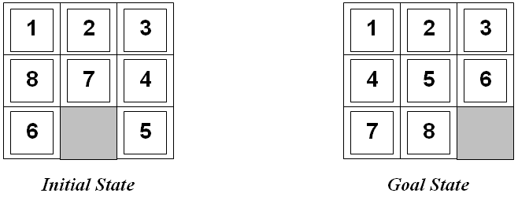
Masalah 8-puzzle
Fungsi heuristik = ?

Slide 24
Fungsi heuristik 8-Puzzle
h₁ = jumlah kotak yang posisinya salah.
Pada masalah di atas, angka 1, 2 , dan 3 sudah berada pada posisi yang benar.
Sedangkan lima angka yang lain berada di posisi yang salah.
Jadi h₁ = 5.

Slide 25
Masalah 8-puzzle
Fungsi heuristik = ?

Slide 26
Fungsi heuristik 8-Puzzle
h₂ = jumlah langkah yang diperlukan masing-masing kotak menuju posisi yang benar di goal state.
Biasanya disebut City Block distance atau Manhattan distance.
Untuk masalah di atas, angka 1, 2 dan 3 membutuhkan 0 langkah.
Angka 4, 5, 7, dan 8 membutuhkan 2 langkah.
Sedangkan angka 6 membutuhkan 3 langkah.
Sehingga h₂ = 0 + 0 + 0 + 2 + 2 + 3 + 2 + 2 = 11.

Slide 27
Bisa ditambahkan k trials
for i=1 to k

Slide 28
Best-First Search

Slide 29
Greedy Best-First Search
Best First Search yang paling sederhana
Hanya memperhitungkan biaya perkiraan
Biaya sebenarnya tidak diperhitungkan
f(n) = h(n)
Complete?, tapi Tidak Optimal
Notes:
"greedy"—at each step it tries to get as close to the goal as it can.
Incomplete, Not ooptimal

Slide 31
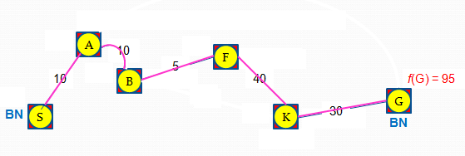
Biaya optimal = 95
90

Slide 32
Greedy Best-First Search
A
f(A) = h(A) = 80
F
f(F) = h(F) = 70
5
10
B
B
f(B) = h(B) = 60
f(B) = h(B) = 60
25
50
K
K
f(K) = h(K) = 30
S
f(K) = h(K) = 30
30
C
f(C) = h(C) = 70
30
35
G
10
D
f(D) = h(D) = 85
f(G) = h(G) = 0
Total Biaya = 25 + 50 + 30 = 105
E
f(E) = h(E) = 74
Tidak optimal !!!

Slide 33
Example

Slide 34
A*
Gabungan Uniform Cost Search dan Greedy Best-First Search.
Biaya yang diperhitungkan didapat dari biaya sebenarnya ditambah dengan biaya perkiraan
f(n) = g(n) + h(n)
Complete dan Optimal dengan syarat fungsi heuristic ad

Slide 36
A*
90
f(A) = g(S) + g(S ke A) + h(A) = 0 + 10 + 80 = 90
f(A) = g(S) + g(S ke A) + h(A) = 0 + 10 + 80 = 90
BN
A
BN
A
BN
10
BN
10
F
F
f(F) = 95
f(F) = 100
f(F) = 100
f(F) = 95
BN
5
10
BN
B
B
f(B) = 85
f(B) = 85
40
f(G) = 100
f(G) = 100
f(G) = 95
f(G) = 95
25
50
G
G
S
BN
30
BN
K
K
f(K) = 105
f(K) = 105
f(K) = 100
f(K) = 100
f(K) = 95
f(K) = 95
BN
BN
30
BN
C
f(C) = 100
f(B) = 85
f(B) = 85
35
10
D
f(D) = 120
f(D) = 120
15
f(D) = 110
Total Biaya = 95
BN
BN
E
E
f(E) = 84
f(E) = 84
20
J
f(J) = 130
Biaya optimal = 95

Slide 37
Iterative Deepening A* (IDA*)
A* yang iteratif dengan batasan berupa f-limit
Complete dan optimal
Iteratif → time complexity-nya tinggi
Keuntungan: space complexity sangat rendah
Sesuai untuk mobile systems

Slide 40
Kondisi awal, next-f = infinity
f(A) = g(A) + h(A) = 10 + 80 = 90
if f(A) > f-limit) then return null
next-f = MIN(next-f,90) = 90
A
Input:
node = S
f-limit = 80
10
Return:
null
next-f = 90
S

Slide 41
next-f = 90
Input:
node = S
f-limit = 80
A
f(B) = g(B) + h(B) = 25 + 60 = 85
if f(B) > f-limit) then return null
next-f = MIN(next-f,85) = 85
B
Return:
null
next-f = 85
25
S

Slide 42
next-f = 85
Input:
node = S
f-limit = 80
A
B
Return:
null
next-f = 85
f(C) = g(C) + h(C) = 30 + 70 = 100
if f(C) > f-limit) then return null
next-f = MIN(next-f,100) = 85
S
30
C

Slide 43
next-f = 85
A
Input:
node = S
f-limit = 80
B
Return:
null
next-f = 85
S
C
35
f(D) = g(D) + h(D) = 35 + 85 = 120
if f(D) > f-limit) then return null
next-f = MIN(next-f,120) = 85
D

Slide 44
next-f = 85
A
Input:
node = S
f-limit = 80
B
Return:
null
next-f = 84
S
C
D
10
f(E) = g(E) + h(E) = 10 + 74 = 84
if f(D) > f-limit) then return null
next-f = MIN(next-f,84) = 84
E

Slide 49
Simplified Memory-Bounded A* (SMA*)
IDA* yang hanya mengingat satu f-limit
SMA* mengingat f-Cost dari setiap iterasi sampai sejumlah simpul yang ada di dalam memori.
Jika memori komputer hanya mampu menyimpan 100 simpul, maka kita bisa melakukan pencarian sampai level 99.

Slide 50
Memory = 3 node
f = g + h
solusi

Slide 53
SMA*
Pada kasus ini, misalkan memori komputer hanya mampu menyimpan 6 simpul.
Oleh karena itu, level maksimum yang dapat dijangkau oleh SMA* adalah level 5.

Slide 60
Total Biaya = 95
Biaya optimal = 95

Slide 61
Bi-directional A* (BDA*)
Algoritma A* dari dua arah: simpul asal dan tujuan.
Pencarian dihentikan jika BestNode dari simpul asal telah berada di dalam CLOSED dari simpul tujuan. Cek apakah harus mengganti parent dari BestNode tersebut dari arah simpul tujuan.
Atau sebaliknya, pencarian dihentikan jika BestNode dari simpul tujuan telah berada di dalam CLOSED dari simpul asal. Cek apakah harus mengganti parent dari BestNode tersebut dari arah simpul asal.

Slide 62
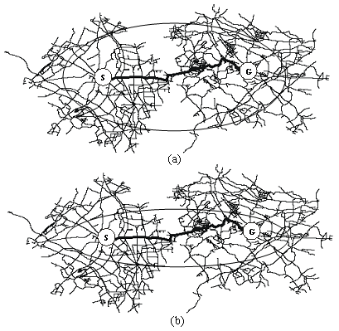
Area pencarian yang dilakukan oleh BDA* (b) lebih sempit dibandingkan dengan area pencarian A* (a).

Slide 67
Total Biaya = 95
Rute: S-A-B-F-K-G
Biaya optimal = 95

Slide 68
BDA*
Cari suksesor dari B yang sudah ada di dalam CLOSEDs. A adalah suksesor dari B dan berada di dalam CLOSEDs.
g(S,B) melalui A lebih kecil daripada g(S,B) langsung, maka parent dari B diubah (dari S manjadi A)
Nilai g dan f pada B juga diubah.
Hasil penelusuran balik menghasilkan S-A-B-F-K-G dengan total jarak = 95.
BDA* adalah complete dan optimal.

