Slide 1
IFG3A3 KEPROFESIAN BIDANG INFORMATIKA Pertemuan 9: Bisnis ICT Bagian 1
Author-Tim Dosen
Prodi S1 Teknik Informatika

Slide 2
Trend Bisnis ICT

Slide 3
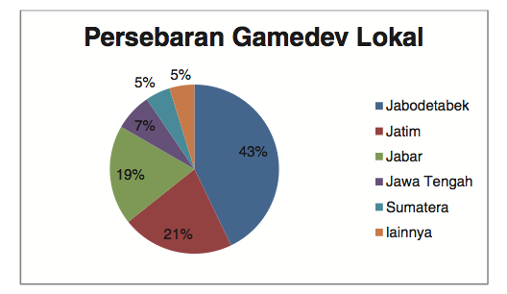
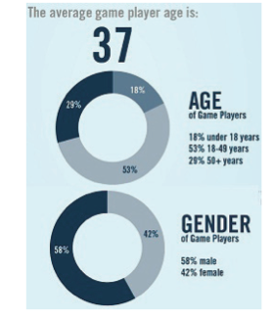
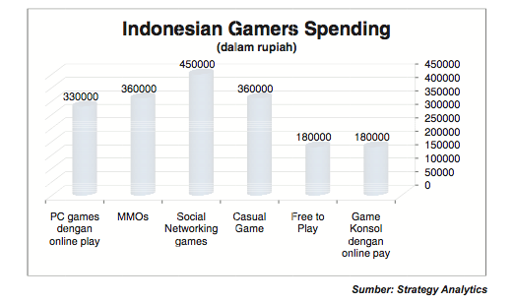
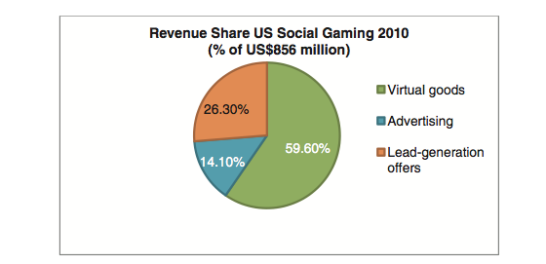
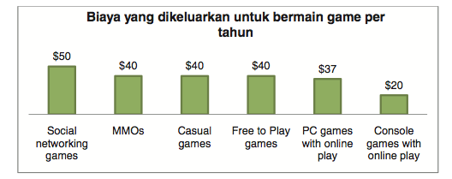
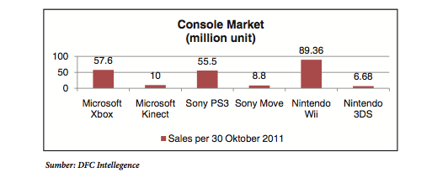
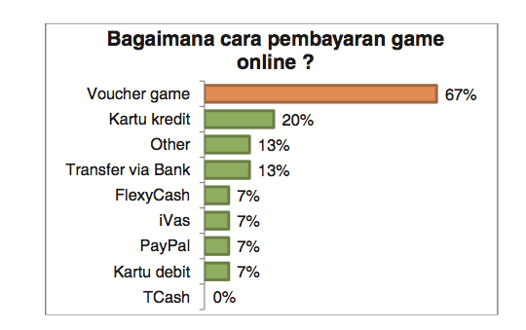
Potensi Industri Game
Notes:
Jaman sekarang budaya juga sudah diperjual belikan :
Anime & Manga : Jepang
BlockBuster : Amerika / Eropa
Drama : Korea
Animasi : Malaysia (upin / ipin)
Horror : Thailand / Vietnam
Indonesia mana?
(harus di dukung data)

Slide 4
Today’s News
Alibaba.com
IPO in September 2014
The stock opened at $92.70 shortly before noon ET (1600 GMT) and quickly rose to a high of $99.70, before paring gains to close at $93.89. Some 271 million shares changed hands, more than double the turnover on Twitter Inc's first day last year, although still short of volume for the General Motors Co and Facebook Inc IPOs.
The pricing of the IPO on Thursday initially raised $21.8 billion for Alibaba. Scott Cutler, head of the New York Stock Exchange's global listing business, told a TV news channel that underwriters would exercise their option for an additional 48 million shares, to bring the IPO's size to about $25 billion, making it the largest initial public offering in history.
At its closing share price on Friday, Alibaba has a market value of $231 billion, exceeding the combined market capitalizations of Amazon and eBay, the two leading US e-commerce companies.

Slide 5
ICT Business and Business of ICT?
Why Businesses use ICT?
Revenue
Profitability
Cost and Efficiency
Reach and Brand Image
Employee satisfaction
New Product
New Businees Model
Competitive Advantage / Differentiation
Emerging of ICT and Business Era

Slide 6
Fokus Materi
Monopolies and their economic implications
Pricing strategies in the computing domain T
The phenomenon of outsourcing and off-shoring; impacts on employment and on economics

Slide 7
Monopoli
Monopoli adalah suatu bentuk pasar dimana hanya terdapat satu perusahaan atau produsen ( penjual) tanpa ada pesaing . Biasanya keuntungan melebihi normal dan ini diperoleh karena terdapat hambatan yang sangat tangguh kepada perusahaan lain untuk memasuki industri tersebut.
Ciri-ciri
industri satu pasar, tidak mempunyai barang pengganti yang mirip, tidak terdapat kemungkinan untuk masuk kedalam industri, dapat mempengaruhi penentuan harga, promosi iklan kurang diperlukan.

Slide 8
Faktor yang menimbulkan monopoli
Ada 3 faktor yang menyebabkan wujudnya pasar monopoli :
Perusahaan monopoli mempunyai suatu sumber daya tertentu yang unik dan tidak dimiliki oleh perusahaan lain.
Perusahaan monopoli pada umumnya dapat menikmati skala ekonomi hingga ketingkat produksi yang sangat tinggi.
Monopoli wujud dan berkembang melalui undang-2 yaitu pemerintah memberi hak monopoli kepada perusahaan tersebut.

Slide 9
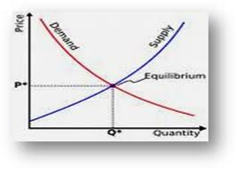
Pendahuluan
Hukum Permintaan
Semakin banyak permintaan maka harga barang akan naik, vice versa
Konsep Efisiensi Industri
Semakin banyak barang yang DIPRODUKSI maka biaya produksi menjadi turun
Apakah ini berlaku pada produk IT/Bisnis IT ?

Slide 10
Menjaga Keseimbangan Pasar
Kurva hasil penjualan dan rata-2 dan marginal.
A
50
20
TR
16
Ed >1
Hasil penjualan
10
Ed = 1
Hasil penjualan
4
Ed < 1
B
D = AR
0
5
10
0
2
5
8
Jmlh barang
Jmlh barang

Slide 11
SYARAT-SYARAT DISKRIMINASI HARGA
Barang tidak dapat dipindahkan dari satu pasar ke pasar lain.
Sifat barang dan jasa itu memungkinkan dilakukan diskriminasi harga.
Sifat permintaan dan elastisitas permintaan dimasing-2 pasar haruslah berbeda.
Kebijakan diskriminasi harga tidak memerlukan biaya melebihi tambahan keuntungan dari kebijakan tersebut.
Produsen dapat mengeksploiter beberapa sikap tidak rasional konsumen.

Slide 12
Contoh kebijakan diskriminasi harga
Kebijakan diskriminasi harga oleh perusahaan monopoli pemerintah. Contoh : PLN.
Kebijakan diskriminasi harga oleh jasa-2 profesional. Contoh : dokter spesialis.
Kebijakan diskriminasi harga dipasar internasional.

Slide 13
Diskusi
Apakah Monopoli itu baik atau tidak?
Efek dari Monopoli?

Slide 14
Fokus Materi
Monopolies and their economic implications
Pricing strategies in the computing domain T
The phenomenon of outsourcing and off-shoring; impacts on employment and on economics

Slide 15
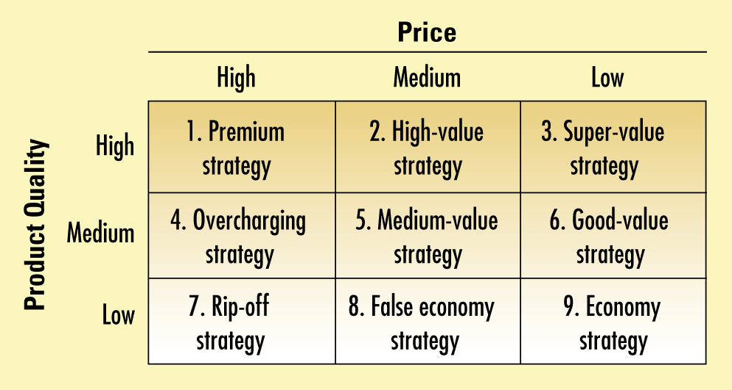
Sembilan Strategi Harga Mutu

Slide 16
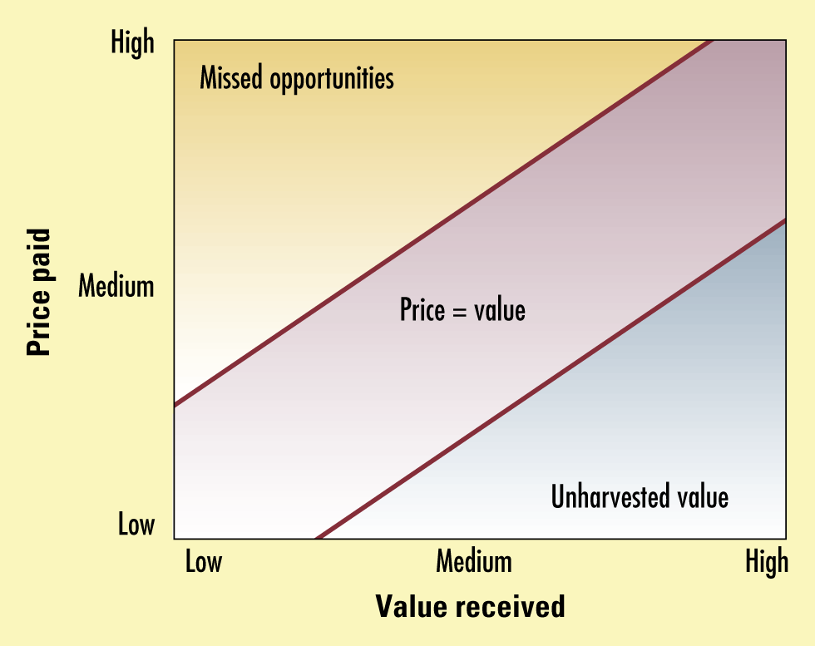
Harga Seharusnya Sejajar Dengan Nilai

Slide 17
Menentukan Kebijakan Penetapan Harga
Salah satu tantangan dalam produk IT khusunya yang berbasis Perangkat Lunak adalah menentukan harga yang optimum.
Meskipun ini bukan tugas utama anda, tapi anda harus mulai memikirkan hal ini.
Pengetahuan ini dapat menjadi salah kelebihan anda

Slide 18
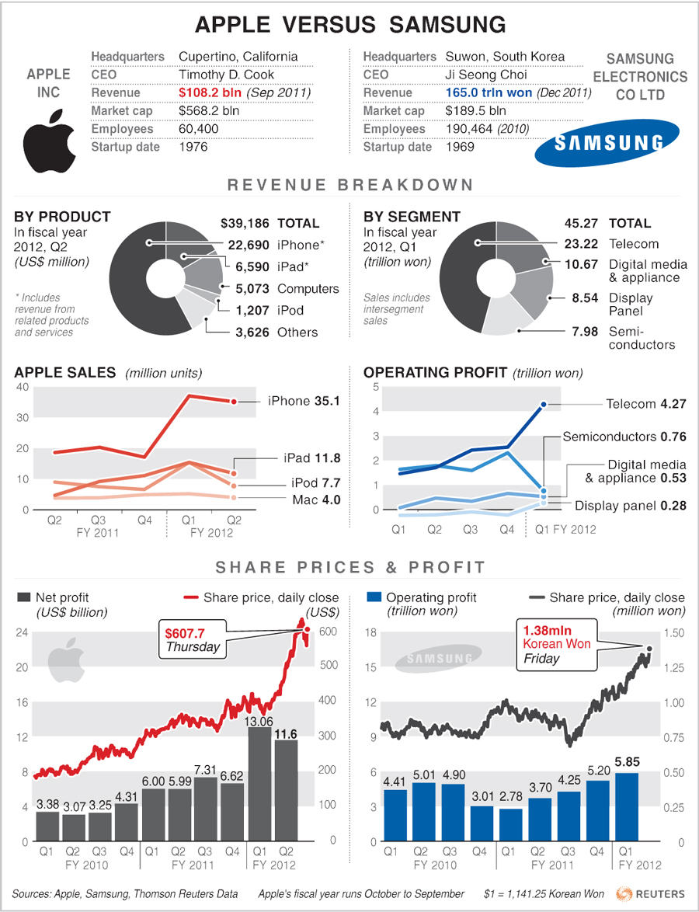
Studi Kasus Apple dan Samsung

Slide 19
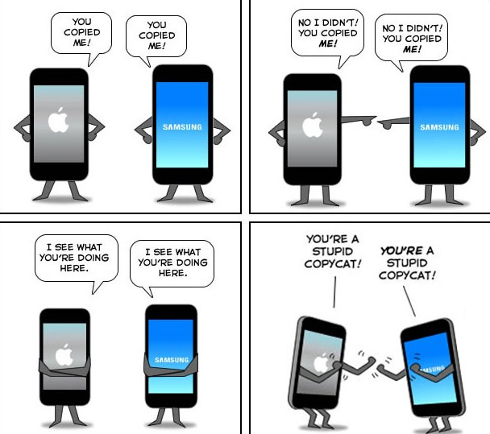
Studi Kasus Apple dan Samsung

Slide 20
Fokus Materi
Monopolies and their economic implications
Pricing strategies in the computing domain T
The phenomenon of outsourcing and off-shoring; impacts on employment and on economics

Slide 21
Outsourcing vs Off-shoring
The terms "outsourcing" and "offshoring" are often used almost synonymously in much of the popular literature today. However, there is a technical difference.
When a company outsources, it buys from a third party a part or service it used to produce itself. This does not necessarily mean that the product is outsourced abroad, although it can be. For instance, General Motors, a US company, can outsource production of a certain car part to a Chinese company. The Chinese company, in turn, can outsource production of various components of that part to various other Chinese companies.
When a company offshores, it shifts the location of a service or production of a part to a location abroad. This can include companies who outsource to foreign companies - for example, GM offshores production of a certain part to a Chinese company, and the Chinese company outsources (but does not offshore) various components of the production to other Chinese companies. However, offshoring also includes companies who transfer production or services to a location abroad without outsourcing the job. So, for instance, if GM opens a factory in China, and shifts production of a car part to the factory in China, it is offshoring but not outsourcing - it is still an American company running the factory rather than a Chinese one.

Slide 22
Why Outsourcing? [1]
The growth in outsourcing in recent years is partly the result of a general shift in business philosophy. Prior to the mid-1980s, many companies sought to acquire other companies and diversify their business interests in order to reduce risk.
As more companies discovered that there were limited advantages to running a large group of unrelated businesses, however, many began to divest subsidiaries and refocus their efforts on one or a few closely related areas of business.
Companies tried to identify or develop a "core competence" a unique combination of experience and expertise that would provide a source of competitive advantage in a given industry.

Slide 23
Why Outsourcing? [2]
All aspects of the company's operations were aligned around the core competence, and any activities or functions that were not considered necessary to preserve it were then outsourced.
Today, outsourcing is embraced by companies of all sizes and industry orientations. As analysts Tom Osmond commented in Employee Benefit News, "many companies have decided that transactional and administrative functions are neither core competencies nor value-added activities.
In fact, some companies are putting themselves at risk as a result of using outdated technology and not complying with government regulations. Vendors, by focusing on administration as part of their business model, provide better service enforced by contracts and service-level agreements."

Slide 24
Why Outsourcing? [3]
Successful outsourcing requires a strong understanding of the organization's capabilities and future direction.
As William R. King explained in Information Systems Management,
“decisions regarding outsourcing significant functions are among the most strategic that can be made by an organization, because they address the basic organizational choice of the functions for which internal expertise is developed and nurtured and those for which such expertise is purchased. These are basic decisions regarding organizational design."
Outsourcing based only upon a comparison of costs can lead companies to miss opportunities to gain knowledge that might lead to the development of new products or technologies.

Slide 25
Outsourcing Mechanism
Vendors providing outsourcing services are generally grouped into two models: Business Process Outsourcing (BPO) and Application Service Provider (ASP).
In the BPO model, major resources and assets are transferred from the company to the vendor.
Under the ASP model, on the other hand, vendors concentrate on providing selected services for multiple clients.
But as Osmond told Employee Benefit News, many variations exist within these two models.
"Each vendor has a particular focus and/or point of entry to the market, particularly in the ASP space,"
Osmond stated. "There is also a wide range of pricing models and option. The good news is that there is a seemingly endless combination of service, pricing, and delivery, providing a solution for most situations. The bad news is that it can be difficult to compare vendors on an apples-to-apples basis."

Slide 26
Rangkuman dan Diskusi
Pendapat mengenai outsourcing akan sangat dipengaruhi oleh sudut pandang anda (apakah sebagai pengusaha, atau sebagai karyawan).
Dalam sebuah model bisnis, outsourcing adalah mekanisme antara B2B, namun dalam implementasinya sering diterapkan mekanisme B2E. Hal inilah yang menimbulkan permasalahan karena kepastian masa depan pegawai menjadi tidak menentu.

Slide 27
Tugas Business Plan
Bayangkan anda dan rekan-rekan ingin mendirikan sebuah perusahaan di bidang ICT (start-up company).
Anda membutuhkan investor untuk menjalankan/memulai start-up company
Tugas anda dan rekan-rekan adalah untuk membuat sebuah proposal bisnis dengan target mendapatkan investor
Waktu pengerjaan tugas 2 minggu.

Slide 28
Reference
Emerging & Future Trends in ICT: How can South Africa play a stronger role in creating them - delivered as opening Keynote at the SAFIPA conference in Pretoria, Oct 19, 2011.
http://www.yenlo.nl/nl/internet-of-things-iot/
Modern Trends of ICT in Business, Highbartech
http://profit.ndtv.com/news/ipo/article-alibaba-ipo-may-be-the-largest-in-history-668520
http://www.gartner.com/newsroom/id/2614915
http://blog.thomsonreuters.com/index.php/apple-vs-samsung-graphic-of-the-day/
http://www.techriff.com/apple-vs-samsung-hot-tech-war-ever/
https://www.mtholyoke.edu/~kahan20r/classweb/globalization/off-out.html

Slide 30
Penetapan harga
Tahap 1: memilih tujuan penetapan harga
Kelangsungan hidup/ Survival
Memaksimalkan keuntungan sekarang/ Maximize current profits
Memaksimalkan pangsa pasar mereka/ Maximize their market share/
Penetapan harga penetrasi pasar/ Market-penetration pricing
Terbaik apabila:
Pasar sangat peka terhadap harga, dan harga rendah merangsang pertumbuhan pasar,
Biaya produksi dan distribusi menurun dengan semakin banyaknya pengalaman produksi, dan
Harga yang rendah menghilangkan semangat pesaing lama dan potensial.

Slide 31
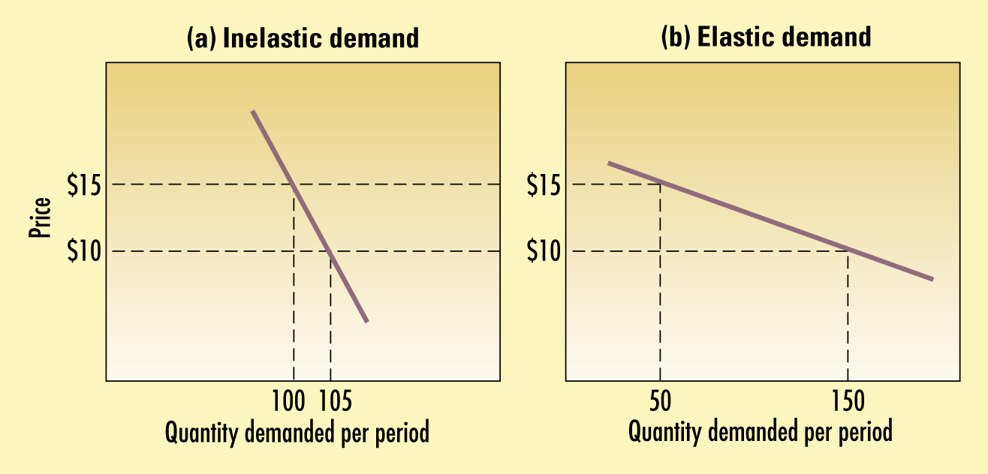
Permintaan yang Inelastis dan Elastis
Penetapan Harga
Tahap 2: Menentukan permintaan
Kepekaan harga/ Price sensitivity

Slide 32
Penetapan Harga
Tom Nagle menawarkan daftar faktor-faktor yang berhubungan dengan kepekaan harga:
Pengaruh nilai unik.
Pengaruh kesadaran atas produk pengganti.
Pengaruh perbandingan yang sulit.
Pengaruh pengeluaran total
Pengaruh manfaat akhir
Pengaruh biaya bersama
Pengaruh investasi tertanam
Pengaruh mutu dan harga
Pengaruh persediaan

Slide 33
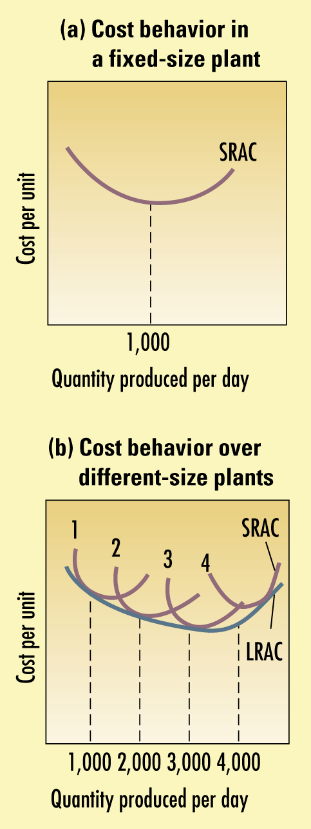
Biaya Per-unit Untuk Berbagai Level Produksi Per Periode
Penetapan Harga
Memperkirakan kurva permintaan
Elastisitas harga dari permintaan
Inelastis
Elastis
Price indifference band

Slide 34
Penetapan Harga
Tahap 3: Memperkirakan Biaya
Jenis-jenis Biaya dan Level Produksi
Biaya tetap (overhead), adalah biaya-biaya yang tidak dipengaruhi oleh produksi atau penjualan.
Biaya variabel, langsung berubah menurut level produksi
Biaya total, merupakan jumlah biaya tetap dan biaya variabel untuk tiap level produksi tertentu.
Biaya rata-rata, adalah biaya perunit untuk level produksi tersebut; biaya tersebut sama dengan total biaya dibagi produksi.
Produksi yang Terakumulasi
Kurva pengalaman/ Experience curve (Learning curve), adalah penurunan biaya rata-rata dengan terakumulasinya pengalaman produksi tersebut.

Slide 35
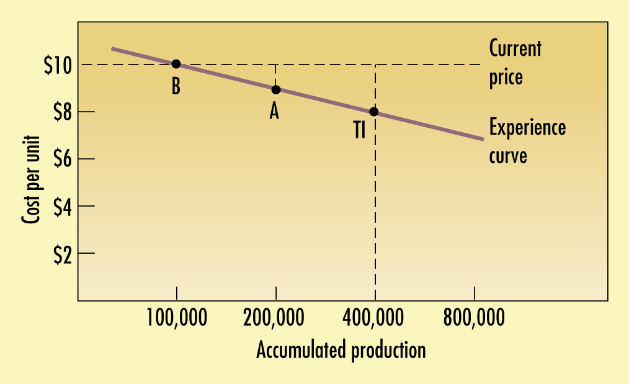
Biaya Per Unit Sebagai Fungsi Dari Akumulasi Produksi: Kurva Pengalaman

Slide 36
Model Tiga C Untuk Penetapan Harga
Penetapan Harga
Tawaran pemasaran yang terdiferensiasi
Activity-based cost (ABC) accounting
Biaya berdasarkan sasaran
Tahap 4: Menganalisis Biaya, Harga, dan Tawaran Pesaing

Slide 37
Penetapan Harga
Tahap 5: Memilih Metode Penetapan Harga
Harga markup/ Markup Pricing
Biaya perunit = biaya variabel + (biaya tetap/unit penjualan)
Harga markup= biaya perunit/ (1 – pengembalian atas penjualan yg diinginkan)
Harga Sasaran Pengembalian/Target-return Pricing
Harga sasaran pengembalian =
Biaya perunit + (tingkat pengembalian X modal yg diinvestasikan)/penjualan perunit

Slide 38
Penetapan Harga
Volume titik impas
Volume titik impas = biaya tetap / (harga – biaya variabel)
Harga berdasarkan nilai yang dipersepsikan
Nilai yang dipersepsikanPerceived value
Harga pembeli/ Price buyers
Nilai pembeli/ Value buyers
Pembeli yang setia/ Loyal buyers
Harga berdasarkan nilai yg digunakan/ Value-in-use price

Slide 39
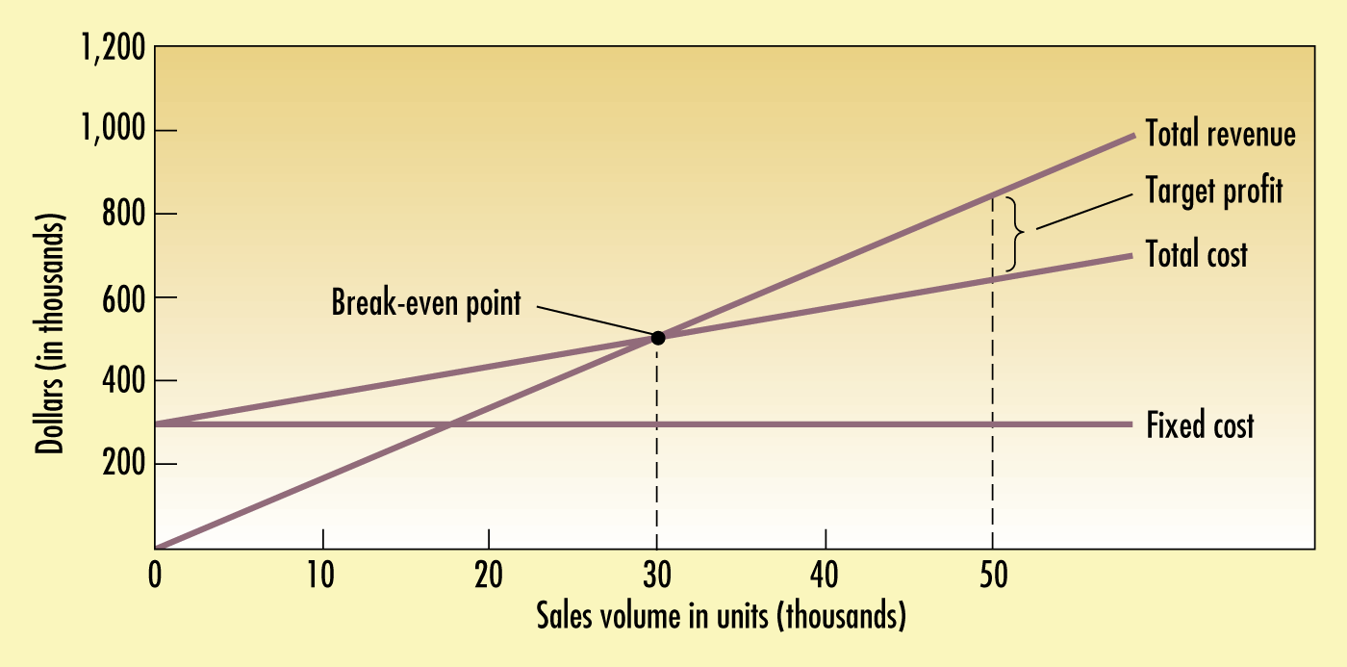
Bagan Titik Impas Untuk Menentukan Harga Berdasarkan Pengembalian yang Diinginkan dan Volume Titik Impas

Slide 40
Penetapan Harga
Penetapan harga nilai/ value pricing
Penetapan harga murah setiaphari/ everyday low pricing (EDLP)
Penetapan harga tinggi-rendah/ high-low pricing
Penetapan harga sesuai harga yang berlaku/ going-rate pricing
Penetapan harga tender/ auction-type pricing
Tender di Inggris/ english auctions (tawaran menaik)
Tender di bBelanda/ Dutch auctions (tawaran menurun)
Tender penawaran tertutup/ sealed-bid auctions
Penetapan harga kelompok/ group pricing

Slide 41
Dampak Berbagai Penawaran Tender Terhadap Laba Yang Diharapkan
Penawaran perusahaan | Laba perusahaan |  | Probabilitas mendapatkan kontrak dengan penawaran ini (Asumsi) |  | Laba yang diharapkan
$ 9,500 | $ 100 | 0.81 |  | $ 81
10,000 | 600 | 0.36 |  | 216
10,500 | 1,100 | 0.09 |  | 99
11,000 | 1,600 | 0.01 |  | 16

Slide 42
Penetapan Harga
Tahap 6: Memilih Harga Akhir
Penetapan harga psikologis
Harga referensi/ Reference price
Penetapan harga pembagian resiko dan keuntungan
Pengaruh elemen-elemen pemasaran lain
Merek dengan mutu yang relatif rata-rata tetapi dengan anggaran iklan yang relatif tinggi dapat menggunakan harga premium.
Merek dengan mutu relatif tinggi dan iklan yang relatif tinggi memperoleh harga tertinggi.
Hubungan positif yang paling kuat antara harga yang tinggi dan iklan yang tinggi terjadi pada tahap-tahap akhir siklus hidup produk bagi pemimpin pasar.
Kebijakan penetapan harga perusahaan.
Pengaruh harga terhadap pihak-pihak lain.

Slide 43
MENGADAPTASI HARGA
Penetapan Harga Geografis
Barter
Offset
Transaksi Kompetisi
Persetujuan Pembelian Kembali

Slide 44
MENGADAPTASI HARGA
Diskon Dan Potongan Harga
Diskon
Tunai
Diskon
Fungsional
Diskon
Kuantitas
Diskon
Musiman
Potongan
Tukar Tambah
Potongan
Promosi

Slide 45
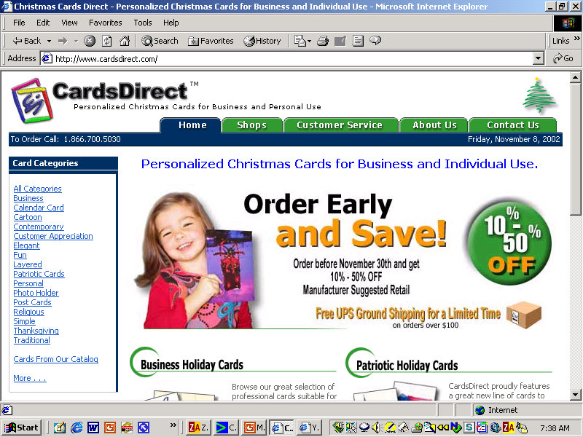
MENGADAPTASI HARGA
Diskon atau Potongan Seperti Apakah yang Digunakan Cardsdirect?

Slide 46
MENGADAPTASI HARGA
Harga
Peristiwa
Khusus
Loss-Leader Pricing
Pembiayaan
Berbunga
Rendah
Taktik
Penetapan
Harga Promosi
Rabat
Tunai
Garansi dan
Kontrak Jasa
Diskon
Psikologi
Syarat Pembayaran yang Lebih Lama

Slide 47
MENGADAPTASI HARGA
Taktik Penetapan Harga Diskriminasi
Penetapan Harga Waktu
Penetapan Harga Citra
Penetapan Harga Saluran
Penetapan Harga Lokasi
Penetapan Harga Bentuk-Produk
Penetapan Harga Segmen-Pelanggan

Slide 48
MENGADAPTASI HARGA
Diskriminasi harga dapat berhasil apabila:
Pasar harus dapat disegmentasikan dan segmen-segmen tersebut harus menunjukkan perbedaan intensitas permintaan
Konsumen pada segmen harga lebih rendah tidak dapat dapat menjual kembali produk tersebut kepada segmen harga lebih tinggi.
Pesaing tidak dapat menjual dengan harga yang lebih rendah dibandingkan harga perusahaan yang harganya lebih tinggi.
Biaya segmentasi dan pengawasan aturan pasar tidak melebihi pendapatan ekstra yang diperoleh dari diskriminasi harga.
Praktek tersebut tidak boleh menimbulkan ketidaksenangan dan niat buruk pelanggan.
Bentuk diskriminasi harga tersebut tidak boleh melanggar hukum.

Slide 49
MENGADAPTASI HARGA
Taktik Penetapan Harga Bauran Produk
Penetapan Harga Dua-Bagian
Penetapan Harga Produk Sampingan
Penetapan Harga Lini-Produk
Penetapan Harga Bundel Produk
Penetapan Harga Produk-Pelengkap
Penetapan Harga Keistimewaan Produk

Slide 50
Memprakarsai dan Menanggapi Perubahan Harga
Memprakarsai penurunan harga
Mendominasi pasar melalui biaya yang lebih rendah.
Jebakan mutu rendah
Jebakan pangsa pasar rapuh
Jebakan kantong tipis

Slide 51
Alternatif Bauran Pemasaran
Pilihan Strategi | Alasan | Konsekuensi
1. Mempertahankan harga dan mutu yang dipersepsikan. Mengurangi pelanggan secara selektif | Perusahaan memiliki kesetiaan pelanggan yang tinggi. Perusahaan rela melepaskan pelanggan yang lebih miskin pesaingnya. | Pangsa pasar lebih kecil. Profitabilitas lebih rendah.
2. Meningkatkan harga dan mutu yang dipersepsikan 3. Menurunkan harga sebagian dan meningkatkan mutu yang dipersepsikan | Meningkatkan harga untuk menutup kenaikan biaya. Meningkatkan mutu untuk membenarkan kenaikan harga. Mempertahankan harga dan meningkatkan mutu yang dipersepsikan merupakan strategi yang murah. | Pangsa pasar lebih kecil. Mempertahankan profitabilitas. Pangsa pasar lebih kecil. Penurunan profitabilitas jangka pendek. Mening-katkan profitabilitas jang-ka panjang
Lihat bahan untuk tabel lengkap

Slide 52
Laba Sebelum Dan Sesudah Kenaikan Harga
Memprakarsai dan Menanggapi Perubahan Harga
 | Sebelum |  | Sesudah
Harga | $ 10 |  | $10.10 | (kenaikan harga 1 persen)
Unit terjual | 100 |  | 100
Pendapatan | $1000 |  | $1010
Biaya | -970 |  | -970
Keuntungan | $ 30 |  | $ 40 | (kenaikan laba 33 1/3 percent)

Slide 53
Memprakarsai dan Menanggapi Perubahan Harga
Memulai peningkatan harga
Inflasi biaya
Penetapan harga antisipatif
Kelebihan permintaan
Penundaan penetapan harga
Klausul kenaikan harga
Memisah-misahkan elemen pembentuk harga
Pengurangan diskon.

Slide 54
Memprakarsai dan Menanggapi Perubahan Harga
Menanggapi biaya yang lebih tinggi atau permintaan yang berlebih tanpa menaikkan harga termasuk:
Mengurangi jumlah produk daripada menaikkan harga.
Mengganti dengan bahan atau unsur yang lebih murah.
Mengurangi atau menghilangkan keistimewaan produk.
Mengurangi atau menghilangkan pelayanan produk, seperti pemasangan atau pengiriman gratis.
Menggunakan bahan kemasan yang lebih murah atau mempromosikan ukuran yang lebih besar guna mengurangi biaya pengemasan.
Mengurangi jenis ukuran dan model yang ditawarkan.
Menciptakan merek ekonomis baru.

Slide 55
Memprakarsai dan Menanggapi Perubahan Harga
Reaksi Atas Perubahan Harga
Reaksi pelanggan
Reaksi pesaing
Menanggapi Perubahan Harga Pesaing
Mempertahankan harga
Mempertahankan harga dan nilai tambah.
Menurunkan harga
Meningkatkan harga dan memperbaiki mutu
Meluncurkan lini petarung berharga murah

Slide 56
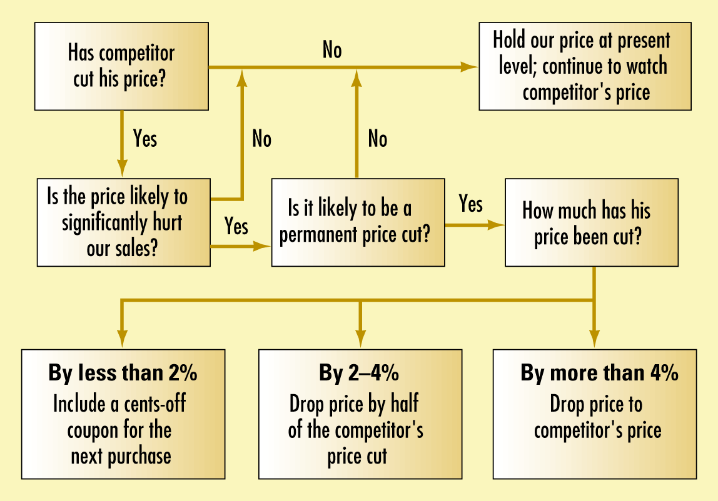
Program Reaksi Harga Untuk Menghadapi Penurunan Harga Pesaing

Slide 57
ADVANTAGES OF OUTSOURCING
Companies that decide to outsource do so for a number of reasons, all of which are based on realizing gains in business profitability and efficiency. Principal merits of outsourcing include the following:
Cost savings. Many businesses embrace outsourcing as a way to realize cost savings or better cost control over the outsourced function. Companies usually outsource to a vendor that specializes in a given function and performs that function more efficiently than the company could, simply by virtue of transaction volume.

Slide 58
ADVANTAGES OF OUTSOURCING
Staffing levels. Another common reason for outsourcing is to achieve headcount reductions or minimize the fluctuations in staffing that may occur due to changes in demand for a product or service.
Companies also outsource in order to reduce the workload on their employees (freeing them to take on additional moneymaking projects for the business), or to provide more development opportunities for their employees by freeing them from tedious tasks.

Slide 59
ADVANTAGES OF OUTSOURCING
Focus. Some companies outsource in order to eliminate distractions and force themselves to concentrate on their core competencies. This can be a particularly attractive benefit for start-up firms.
Outsourcing can free the entrepreneur from tedious and time-consuming tasks, such as payroll, so that he or she can concentrate on the marketing and sales activities that are most essential to the firm's long-term growth and prosperity.
"What an outsourcing partner really sells is focus," wrote Adam Katz-Stone in Baltimore Business Journal. "In accounting for instance, that is something that typically is seen as necessary but not essential, not the core of the business.
So you bring in an outsourcing partner and then you don't have to think about that any more. You can focus your energies on sales, marketing, all the other things that matter more."

Slide 60
ADVANTAGES OF OUTSOURCING
Morale. This is an often-overlooked but still notable benefit that can sometimes be gained by initiating an outsourcing relationship.
"Often a business's lack of internal expertise or dedication to non-core tasks results in poor attitudes and ultimately poor performance," wrote Kevin Grauman in CPA Journal.
"This can lead to overlap and duplication of internal efforts. An effectively designed and ongoing communication process emanating from one or more outsourcers can greatly reduce or eliminate these duplications."

Slide 61
ADVANTAGES OF OUTSOURCING
Flexibility. Still others outsource to achieve greater financial flexibility, since the sale of assets that formerly supported an outsourced function can improve a company's cash flow. A possible pitfall in this reasoning is that many vendors demand long-term contracts, which may reduce flexibility.
Knowledge. Some experts tout outsourcing of computer programming and other information technology functions as a way to gain access to new technology and outside expertise. This may be of particular benefit to small businesses, which may not be able to afford to hire computer experts or develop the in-house expertise to maintain high-level technology. When such tasks are outsourced, the small business gains access to new technology that can help it compete with larger companies.

Slide 62
ADVANTAGES OF OUTSOURCING
Accountability. Outsourcing is predicated on the understanding—shared by business and vendor alike—that such arrangements require quality service in exchange for payment.
"Paying for a business service creates the expectation of performance," stated Grauman. "Outsourcers are well aware that this accountability is both practical and legal, with fiscal implications. The same cannot be said for internally provided functions."

Slide 63
DISADVANTAGES OF OUTSOURCING
Some of the major potential disadvantages to outsourcing include poor quality control, decreased company loyalty, a lengthy bid process, and a loss of strategic alignment.
All of these concerns can be addressed and minimized, however, by companies who go about the outsourcing process in an informed and deliberate fashion.
Info World 's Maggie Biggs counsels businesses to define "exactly what business processes and/or functions it makes sense to maintain via a service relationship. Unless you have a lot of resources to expend, it may make sense to prioritize outsourcing projects based on the number of benefits you expect to gain from the arrangement."
There may also be inherent advantages of maintaining certain functions internally. For example, company employees may have a better understanding of the industry, and their vested interests may mean they are more likely to make decisions in accordance with the company's goals. Indeed, most analysts discourage companies from outsourcing core functions that directly affect the products or services that the business offers.

Slide 64
STEPS IN SUCCESSFUL OUTSOURCING
Once a company has made the decision to outsource, there are still a number of factors it must consider in making a successful transition and forming a partner relationship with the vendor. First, the company should determine what sort of outsourcing relationship will best meet its needs. "Decide what's important," urged the Journal of Accountancy. "If a function is not strategic to your business—for instance, payroll services or health insurance needs in a recruiting agency with only ten employees—consider outsourcing it to an expert provider." Some businesses share strategic decision-making with their vendors, while others only outsource on a limited, as needed basis.
As Ethel Scully noted in National Underwriter, the company needs to obtain the support of key personnel during this time. Many companies encounter resistance from employees who feel that their jobs are threatened by outsourcing. Scully suggested forming a team consisting of an outsourcing expert, representatives from senior management and human resources, and the managers of all affected areas of the company to help address employee concerns about the decision.

Slide 65
STEPS IN SUCCESSFUL OUTSOURCING
Once your business has decided which functions to outsource, it should initiate a search process that utilizes referrals from other companies and service-provider directories. You can then begin contacting potential vendors and ask specific questions about the services they provide and their abilities to meet your company's unique and specific needs.
Ideally, the vendor you select will have experience in handling similar business and will be able to give all of its clients' needs the priority they deserve. "Consider the service company's knowledge of the entirety of your business, its willingness to customize service, and its compatibility with your firm's business culture, as well as the long-run cost of its services and its financial strength," said service provider Carl Schwenker in Money.
During this period, you should also reexamine your own company culture and business needs to make sure that the outsourcing arrangement under consideration is a good fit. Many outsourcing experts counsel businesses to select vendors that can effectively integrate all their outsourced business functions so that they do not have to find individual vendors for each function.

Slide 66
STEPS IN SUCCESSFUL OUTSOURCING
Finally, you should select a vendor you trust in order to develop a mutually beneficial partner relationship. It is important to develop tangible measures of job performance before entering into an agreement, as well as financial incentives to encourage the vendor to meet deadlines and control costs.
The contract should clearly define responsibilities and performance criteria, outline confidentiality rules and ownership rights to new ideas or technology. It should also include a means of severing the relationship if the service does not meet your expectations. Since the vendor is likely to have more experience in preparing outsourcing agreements than a small client company, it may also be helpful to consult with an attorney during contract negotiations.

