Slide 1
CIG4I3 SISTEM REKOGNISI
Pertemuan 9: Ekstraksi Ciri Bentuk
Author-Tim Dosen
KK ICM

Slide 2
Resume Materi Pertemuan 8
Ciri Warna:
  Color Fundamental
  Color Space
  Color Feature : Histogram and Color Moment

Slide 3
Generic Process Block
Akuisisi Data
Representasi Data
Result Analysis
Recognition Process
Transformasi
Pre-Processing
Data Properti/Descriptor
Ektraksi Ciri
Knowledge Based
Model
Clasifier
Matching/Similarity
Used training Result
Performance : accuration, precission, recall
etc
Primary
Secondary

Slide 4
Materi Pertemuan 9
Ciri Bentuk:
  Boundary Based : Chain Code
  Region Based : Moment

Slide 5
Shape features
Spectral descriptors

Slide 6
Requirements to the shape features
Translation invariance
Scale invariance
Rotational invariance
Stability against small form changes
Low computation complexity
Low comparison complexity

Slide 7
Boundary-based features

Slide 8
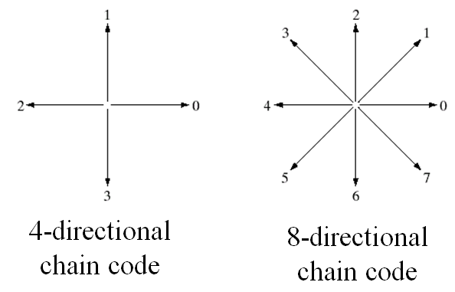
Chain Code
Why we focus on a boundary?
  The boundary is a good representation of an object shape
  and also requires a few memory.
Chain codes: represent an object boundary by a connected sequence of straight line segments of specified length and direction.
(Images from Rafael C. Gonzalez and Richard E. Wood, Digital Image Processing, 2nd Edition.

Slide 9
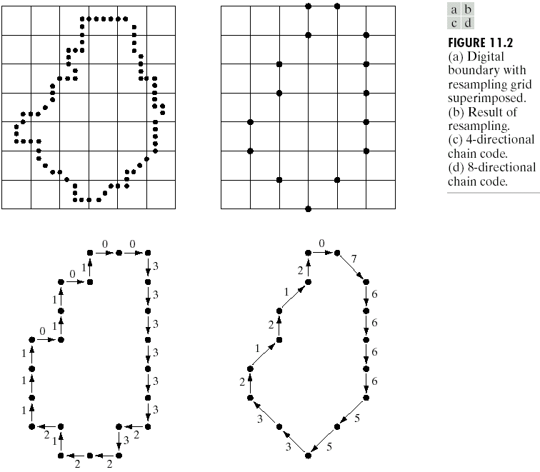
Example of Chain Code
Object
boundary
(resampling)
Boundary
vertices
4-directional
chain code
8-directional
chain code

Slide 10
Problem In Chain Code
Problem of a chain code: a chain code sequence depends on a starting point.
Solution: treat a chain code as a circular sequence and redefine the starting point so that the resulting sequence of numbers forms an integer of minimum magnitude.
The first difference of a chain code: counting the number of direction change ( in counterclockwise ) between 2 adjacent elements of the code.
1
Example:
- a chain code: 10103322
- The first difference = 3133030
- Treating a chain code as a
circular sequence, we get
the first difference = 33133030
Chain code : The first
difference
0 → 1 1
0 → 2 2
0 → 3 3
2 → 3 1
2 → 0 2
2 → 1 3
2
0
3
The first difference is rotational invariant.

Slide 11
Problem In Chain Code
Directions for 4-connected and 8-connected chain codes:
A: 03001033332322121111
B: 70016665533222
Example:
Starting point invariance: minimal code
70016665533222 -> 00166655332227
Rotation invariance: codes subtraction
00166655332227 -> 01500706070051
A
B

Slide 12
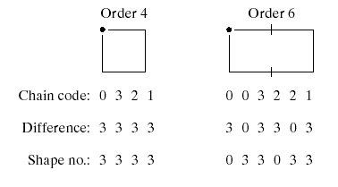
Chain Code -> Boundary Descriptor
Shape number of the boundary definition: the first difference of smallest magnitude
The order n of the shape number: the number of digits in the sequence
1
2
0
3

Slide 13
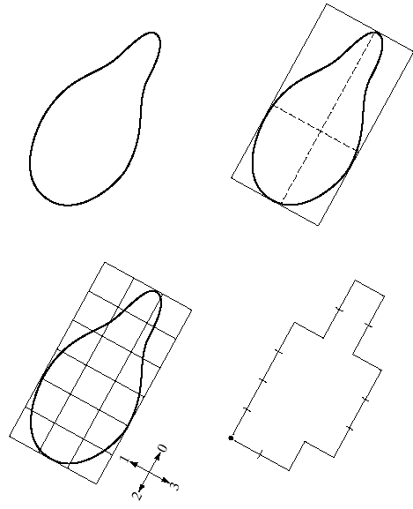
Shape Number
1. Original boundary
2. Find the smallest rectangle
that fits the shape
Chain code:
0 0 0 0 3 0 0 3 2 2 3 2 2 2 1 2 1 1
First difference:
3 0 0 0 3 1 0 3 3 0 1 3 0 0 3 1 3 0
Shape No.
0 0 0 3 1 0 3 3 0 1 3 0 0 3 1 3 0 3
(Images from Rafael C. Gonzalez and Richard E.
Wood, Digital Image Processing, 2nd Edition.
4. Find the nearest
Grid.
3. Create grid

Slide 14
Chain Code
Chain Code Variation:
  Difference length of chain code -> normalize chain code
  Ridig boundary -> Vertex Chain Code
Define primitif of shape:
  Line : horizontal, vertical, etc
  Curve

Slide 15
Materi Pertemuan 9
Ciri Bentuk:
  Boundary Based : Chain Code
  Region Based : Moment

Slide 16
Region-based features

Slide 17
Grid-method
А
А: 001111000 011111111 111111111 111111111 111110111 0111000011
Б
Б: 001100000 011100000 111100000 111101111 111111110 001111000
Invariance:
Normalization by major axe:
direction;
scale;
position.

Slide 18


Moment invariants
The moment of order (p+q) for a two-dimension continuous function:
Central moments for f(x,y) – discrete image:
Feature vector:
Seven scale, translation and rotation invariant moments were derived based on central normalized moments of order p + q = 2; 3.

Slide 19
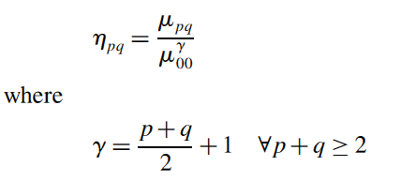
Invariant Moment

Slide 20
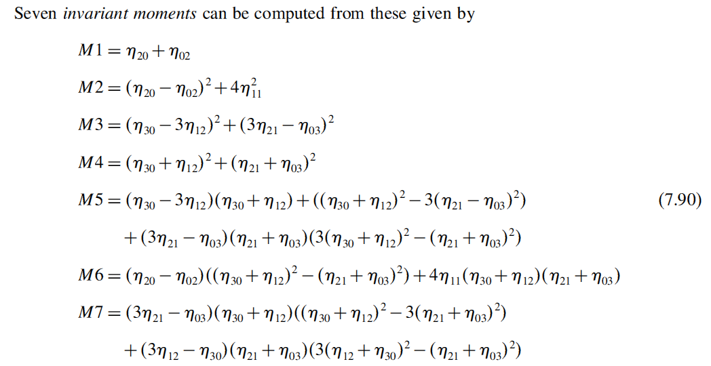
7 Invariant moments

Slide 21
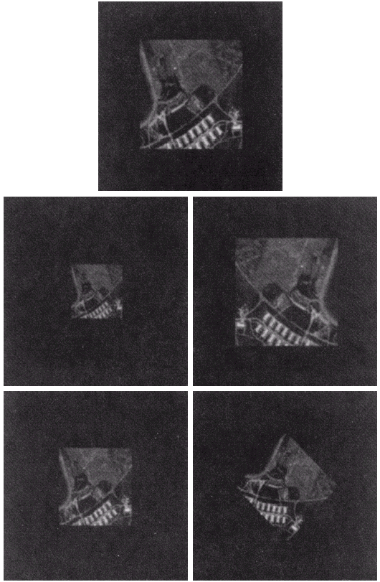
Moment Example
1. Original image
2. Half size
3. Mirrored
(Images from Rafael C. Gonzalez and Richard E. Wood, Digital Image Processing, 2nd Edition.
4. Rotated 2 degree
5. Rotated 45 degree

Slide 22
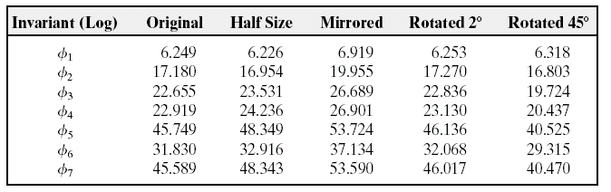
Moment Example
Invariant moments of images in the previous slide
Invariant moments are independent of rotation, translation,
scaling, and reflection

Slide 23
Review Moment
Moment
Centralized Moment
Normalize Central Moment

Slide 24
Shape features comparison
Mehtre B. M., Kankanhalli M. S., Lee W. F. Shape measures for content based image retrieval: a comparison. Inf. Processing and Management, vol. 33, No. 3, pages 319-337, 1997.

Slide 25


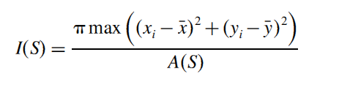
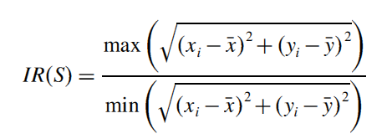
Region Descriptor
Describe regions or area
  Another Region Descriptor: Perimeter, Compactness, Iregularity

Slide 26
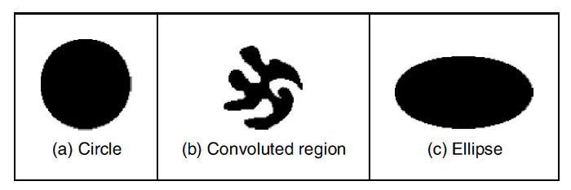
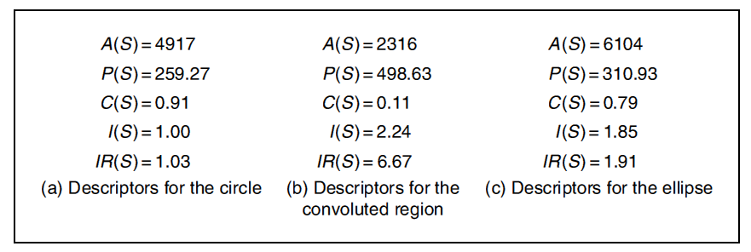
Region Descriptor

Slide 27
Sumber
Russian Summer School In Information Retrieval: CBIR, Natalia Vassilieva , HP Labs Russia, 2008
Bahan Slide dapat diakses di Nawapak Eua-anant:gear.kku.ac.th/~nawapak

