Slide 1
CIG4I3 SISTEM REKOGNISI
Pertemuan 8: Ekstraksi Ciri Warna
Author-Tim Dosen
KK ICM

Slide 2
Resume Materi Pertemuan 4-5-6-7
Teknik Dasar Pengolahan Citra
Konvolusi, Deteksi Sisi,Korelasi
Image Segmentation

Slide 3
Generic Process Block
Akuisisi Data
Representasi Data
Result Analysis
Recognition Process
Transformasi
Pre-Processing
Data Properti/Descriptor
Ektraksi Ciri
Knowledge Based
Model
Clasifier
Matching/Similarity
Used training Result
Performance : accuration, precission, recall
etc
Primary
Secondary

Slide 4
Materi Pertemuan 8
Ciri Warna:
  Color Fundamental
  Color Space
  Color Feature : Histogram and Color Moment

Slide 5
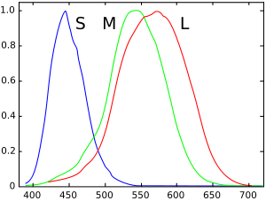
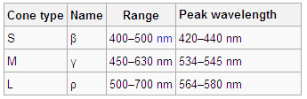
Color fundamentals
Color in the eye
  Varying sensitivity of different cells in the retina (cones) to light of different wavelengths:
    S-cones: short-wavelength (blue);
    M-cones: middle-wavelength (green);
    L-cones: long-wavelength (red).
Normalized typical human cone cell responses (S, M, and L types) to monochromatic spectral stimuli

Slide 6
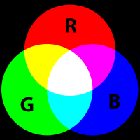
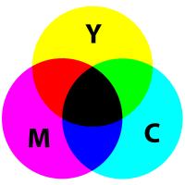
Color fundamentals
Primary and secondary colors
  Due to different absorption curves of the cones, colors are seen as variable combinations of the so-called primary colors: red, green and blue.
  The primary colors can be added to produce the secondary colors of light: magenta (R+B), cyan (G + B), and yellow (R + G).
  For pigments and colorants, a primary color is the one that subtracts (absorbs) a primary color of light and reflects the other two.
Mixture of lights (Additive primaries)
Mixture of pigments (Subtractive primaries)

Slide 7
Color fundamentals
Brightness, hue, and saturation
  Brightness is a synonym of intensity
  Hue represents the impression related to the dominant wavelength of the color stimulus
  Saturation expresses the relative color purity
  (amount of white light in the color)
  Hue and Saturation taken together are called the chromaticity coordinates (polar system)

Slide 8
Color fundamentals
From tristimulus values to chromaticity coordinates
  The amounts of red, green, and blue needed to form any particular color are called the tristimulus values and denoted by X, Y, and Z
  The chromaticity coordinates x and y (Cartesian system) are obtained as:

Slide 9
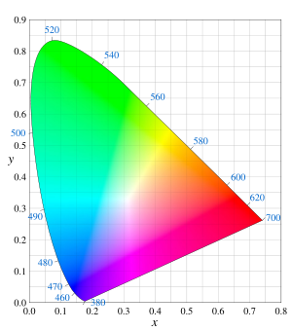
Color fundamentals
CIE xy Chromaticity Diagram
  Created by the International Commission on Illumination (CIE) in 1931.
  Function of x (red) and y (green) :
  z = 1 – (x + y).
  The outer boundary is the spectral (monochromatic) locus, wavelengths shown in nm.
  (x,y) = (1/3,1/3) is a flat energy spectrum point (point of equal energy).
  Any point on the boundary is completely saturated.
  Boundary → point of equal energy : saturation → 0
The CIE 1931 chromaticity diagram.

Slide 10
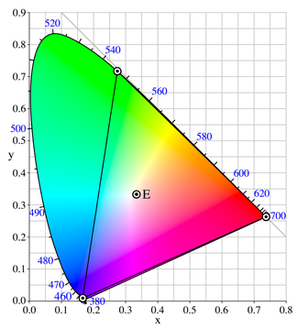
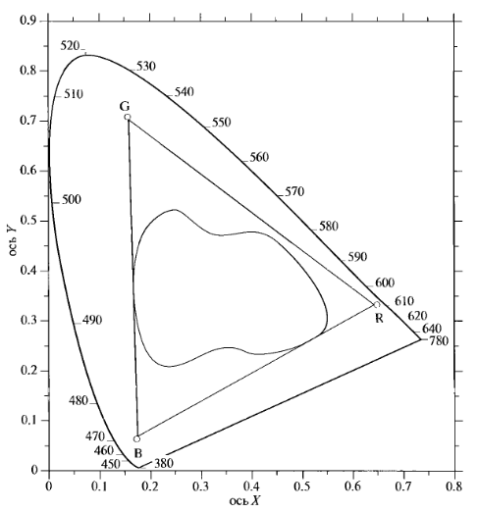
Color fundamentals
Color Gamut
RGB monitor
color gamut
printing device
color gamut
Gamut of the CIE RGB primaries and location of primaries on the CIE 1931 xy chromaticity diagram.
Typical gamuts of a monitor and of a printing device.

Slide 11
Materi Pertemuan 8
Ciri Warna:
  Color Fundamental
  Color Space
  Color Feature : Histogram and Color Moment

Slide 12
Color spaces
The purpose of a color space (or color model or color system) is to facilitate the specification of colors in some standard way.
A color model provides a coordinate system and a subspace in it where each color is represented by a single point.
Common color spaces:
  RGB (monitors, video cameras),
  CMY/CMYK (printers),
  HSI/HSV/HSL/HSB (image processing),
  CIE Lab (image processing).

Slide 13
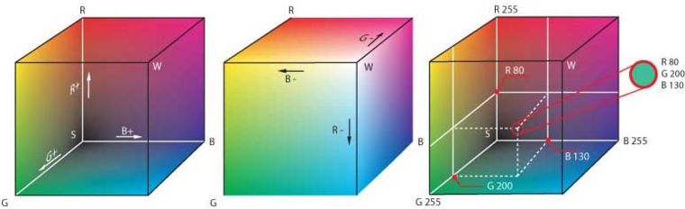
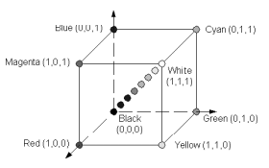
Color spaces
RGB color space
If R,G, and B are represented with 8 bits (24-bit RGB image), the total number of colors is (2⁸)³=16,777,216

Slide 14
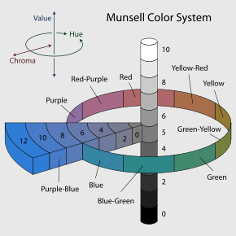
Color spaces
Munsell color system
  By Professor Albert H. Munsell in the beginning of the 20th century.
  Specifies colors based on 3 color dimensions, hue, value (lightness), and chroma (color purity or colorfulness).
Munsell hues; value 6 / chroma 6
Notes:
The system consists of three independent dimensions which can be represented cylindrically in three dimensions as an irregular color solid: hue, measured by degrees around horizontal circles; chroma, measured radially outward from the neutral (gray) vertical axis; and value, measured vertically from 0 (black) to 10 (white). Munsell determined the spacing of colors along these dimensions by taking measurements of human visual responses. In each dimension, Munsell colors are as close to perceptually uniform as he could make them, which makes the resulting shape quite irregular. As Munsell explains:
“Desire to fit a chosen contour, such as the pyramid, cone, cylinder or cube, coupled with a lack of proper tests, has led to many distorted statements of color relations, and it becomes evident, when physical measurement of pigment values and chromas is studied, that no regular contour will serve.”

Slide 15
Color spaces
HSI/HSL/HSV/HSB color spaces
  RGB, CMY/CMYK are hardware oriented color spaces (suited for image acquisition and display).
  The HSI/… (Hue, Saturation, Intensity/Lightness/ Value/Brightness) are perceptive color spaces (suited for image description and interpretation).
  Allow the decoupling of chromatic signals (H+S) from the intensity signal (I).

Slide 16
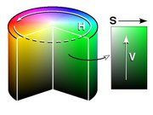
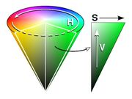
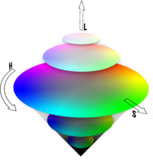
Color spaces
HSI/HSL/HSV/HSB color spaces
Graphical depiction of HSV (cylinder and cone)
http://www.easyrgb.com/index.php?X=MATH
Graphical depiction of HSL

Slide 17
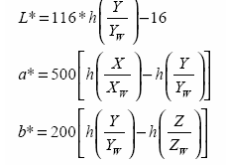
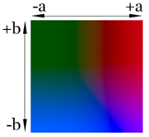
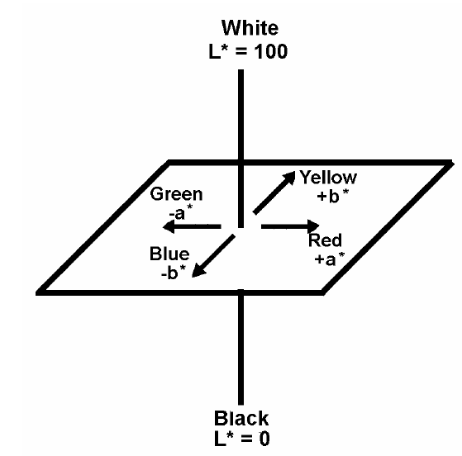
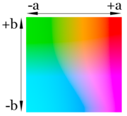

Color spaces
CIE L*a*b color space
  It’s a device independent and perceptually uniform color model.
  It allows the color gamuts of monitors and output devices to be related to one another.
  The L*a*b* components are given by
Lightness 75%
Lightness 25%

Slide 18
Color spaces
HCL color space
CIE Lab color space
HCL color space

Slide 19
Color spaces
HCL color space
, where
,
,
And finally to allow hue to vary in an interval from -180° to +180°:

Slide 20
Materi Pertemuan 8
Ciri Warna:
  Color Fundamental
  Color Space
  Color Feature : Histogram and Color Moment

Slide 21
Color Feature
Statistical moments for every color channel
F(I) = (E₁^{I},E₂^{I},E₃^{I},
σ₁^{I},σ₂^{I},σ₃^{I},
s₁^{I},s₂^{I},s₃^{I})
F(I) = (h₁^{I}, h₂^{I}, …, h_{N}^{I})
Metrics: L₁, L₂, L∞
Metrics: ~L₁
Stricker M., Orengo M. Similarity of Color Images. Proceedings of the SPIE Conference, vol. 2420, p. 381-392, 1995

Slide 22

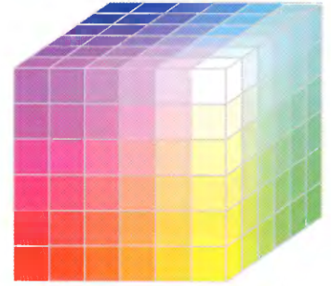
Color histograms
Quantization of color space
  Quantization is important: size of the feature vector.
  When no color similarity function used:
    Too many bins – similar colors are treated as dissimilar.
    Too little bins – dissimilar colors are treated as similar.

Slide 23
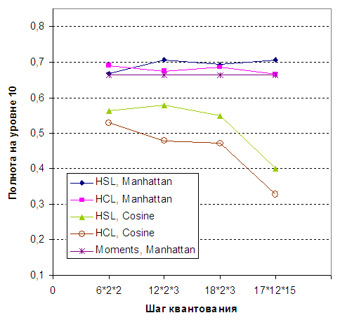
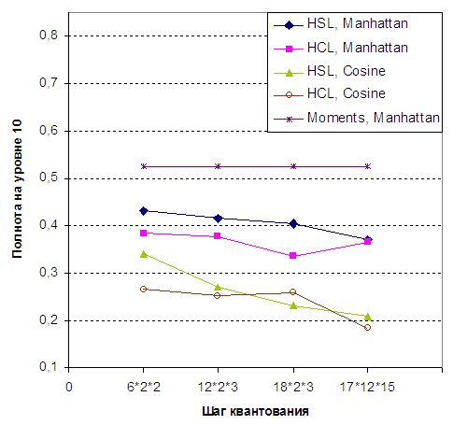
Color histograms
Quantization of color space: recall
Recall at 10
Recall at 10
Quantization
Quantization
ImageDB-100
ImageDB-1000

Slide 24
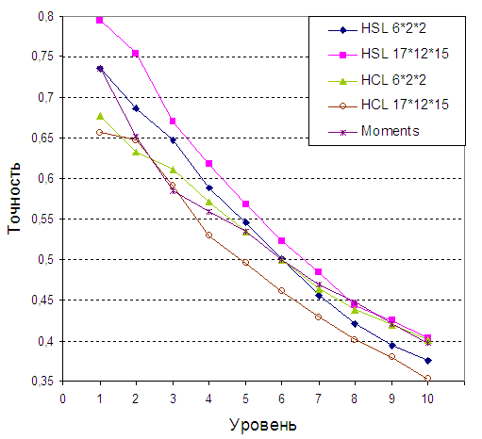
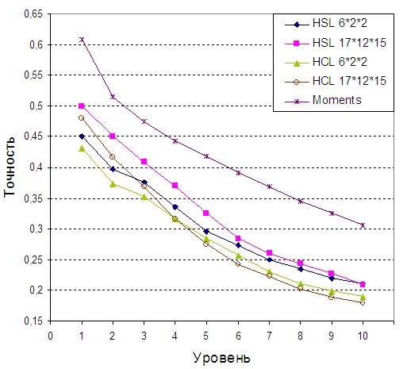
Color histograms
Quantization of color space: precision
Precision at N
Precision at N
Top N
Top N
ImageDB-100
ImageDB-1000

Slide 25
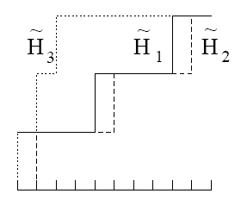
Color histograms: main disadvantages
1. Colors similarity across histo bins is not considered:
Cumulative histograms
d(H₁, H₂) > d(H₁, H₃)

Slide 26
Color histograms: main disadvantages
1. Colors similarity across histo bins is not considered:
Cumulative histograms
А – matrix with color similarity coefficients
Niblack W., Barber R., et al. The QBIC project: Querying images by content using color, texture and shape. In IS&T/SPIE International Symposium on Electronic Imaging: Science & Technology, Conference 1908, Storage and Retrieval for Image and Video Databases, Feb. 1993
d(H₁, H₂) > d(H₁, H₃)

Slide 27
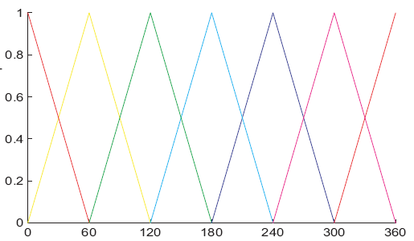
Color histograms: main disadvantages
1. Colors similarity across histo bins is not considered:
Cumulative histograms
Fuzzy histo
d(H₁, H₂) > d(H₁, H₃)
Coefficient
Hue

Slide 28

Color histograms: main disadvantages
1. Colors similarity across histo bins is not considered:
Cumulative histograms
Fuzzy histo
Color similarity measure
d(H₁, H₂) > d(H₁, H₃)

Slide 29
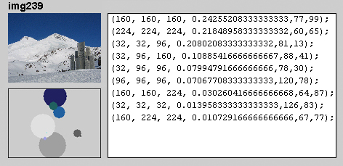
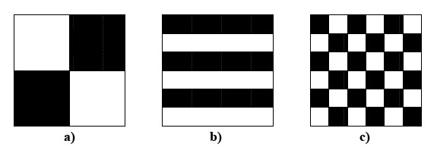
Color histograms: main disadvantages
2. Spatial color layout is not considered:
( 3, 0.242552, 77, 99)
( 1, 0.218489, 60, 65)
(21, 0.208021, 81, 13)
(19, 0.108854, 88, 41)
(13, 0.079948, 78, 30)
(27, 0.070677, 120, 78)
(31, 0.030260, 64, 87)
(19, 0.013958, 126, 83)
H_{A}= H_{B} = H_{C}
A
B
C
bin number
(color num)
amount of color
position of color

Slide 30


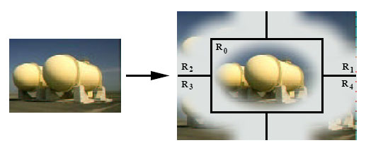
Color moments
Average, standard deviation, skewness
Average, covariance matrix of the color channels
Consider spatial layout: fuzzy regions
Stricker M., Dimai A. Spectral Covariance and Fuzzy Regions for Image Indexing. Machine Vision and Applications, vol. 10., p. 66-73, 1997

Slide 31
Histograms or color moments? (1)
Stricker M., Orengo M. Similarity of Color Images. ... (3000 images)

Slide 32
Histograms or color moments? (2)
ImageDB-1000
Recall at 10
Precision at N
Quantization
Top N

Slide 33



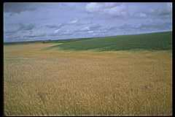
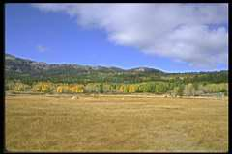
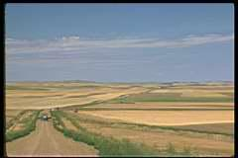
Histograms or color moments? (3)

Slide 34
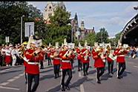
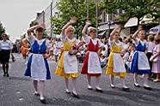
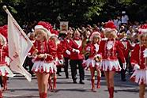
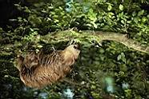
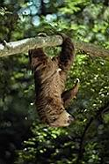
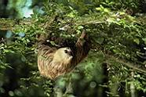
Histograms or color moments? (4)

Slide 35
Sumber
Russian Summer School In Information Retrieval: CBIR, Natalia Vassilieva , HP Labs Russia, 2008
Bahan Slide dapat diakses di Nawapak Eua-anant:gear.kku.ac.th/~nawapak

