Slide 1
IFG3A3 KEPROFESIAN BIDANG INFORMATIKA Pertemuan 5: The Future Of Computing
Author-Tim Dosen
Prodi S1 Teknik Informatika

Slide 2
Who is a computing professional? [1]
Computer scientists, software engineers, computer engineers, and some of the telecom engineers are generally classified as computing professionals
Subset of computing professionals: those involved in the development of SW
Development Team
Executive Team
Busineess Development Team
Configuration Management Team
Support Team
Architecutre Team
Quality Assurance Team
Technology Transfer Team
Process Team

Slide 3
Who is a computing professional? [2]
Development Team : Responsible for a project from after the specifications stage till the very end
Executive Team
Busineess Development Team : Responsible for the development of detailed proposals for projects
Architecutre Team : Consists of the sharpest technical minds in the company
Configuration Management Team : Keeps a vigilant eye on the process that keeps an extensive record of all versions of everything that is ever developed for a particular project: from proposals to specifications to plans to design to code
Process Team : Team’s goal: To continuously improve the SW development process to achieve improvements in cost, schedule, and quality

Slide 4
Who is a computing professional? [3]
Quality Assurance Team : Responsible for assuring the quality of all SW (i.e. making sure that it does what it is supposed to) that is produced at the organization
Technology Transfer Team : This team is responsible for:
Evaluating new technologies, products, processes
Selecting the ones that are right for the organization
Developing an expertise in their use
Introducing them in various ongoing/future projects
Support Team: Responsible for the maintenance, expansion, improvement of the infrastructure consisting of:
Workstations, servers, printers
Networking equipment (router, switch, hub)
SW (development SW, productivity SW, etc.)
Network security

Slide 5
Development Team
Responsible for a project from after the specifications stage till the very end
Project Manager:
Responsibilities:
Planning and tracking of the project
Arranging of the appropriate resources
Client relationship management
SW Architect
Responsibilities:
Technical guru of the project
Technology selection
High-level design
Makes certain that the implementation remains true to the design

Slide 6
Development Team
Team Lead
Responsibilities:
Planning and tracking of the project
Detailed design
Professional development of team members
Development activities, in case of small teams
Developer
Responsibilities:
Module-level design
Coding
Unit-testing

Slide 7
Executive Team
CEO – Chief Executive Officer
Developer of the vision of the organization
Great PR skills
Great knack for spotting talent
COO – Chief Operating Officer
Responsible for the day-to-day operations
Great planning & interpersonal skills
CMSO – Chief Marketing & Sales Officer
Responsible for bringing in work
Innovative

Slide 8
Profesional Ethic’s
Ethics is a collection of heuristics that, when followed, improves our way of life
The professional ethics provide a way of simplifying our decision making process
We also looked at few situations where a knowledge of professional ethics would have simplified the process of decision making

Slide 9
Today’s Goal
To visualize the advances in computing that will take place in the future
To visualize the impact of computing on our future
And the important part : decide our place in the future

Slide 10
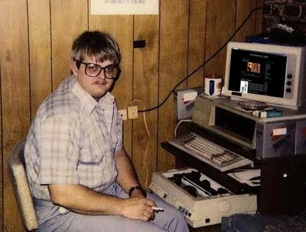
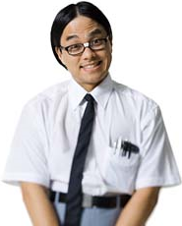
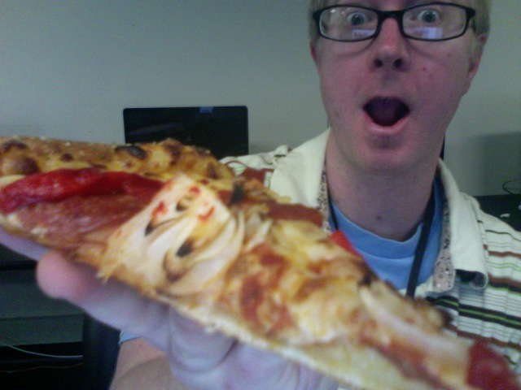
Stereotypes of CS Majors
It’s true??

Slide 11
Computing & Telecommunications

Slide 12
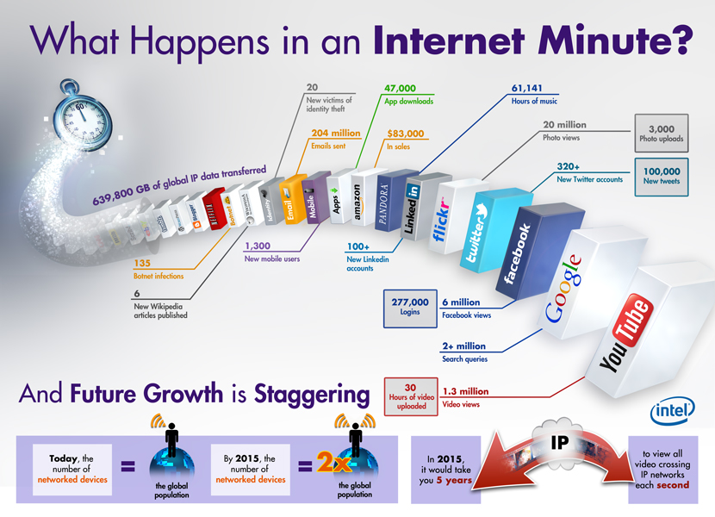
Computing & Telecommunications
The two fields are converging, and, as time passes, are becoming more and more indistinguishable from each other
Therefore, when we talk about the future of one, we must talk about the future of both

Slide 13
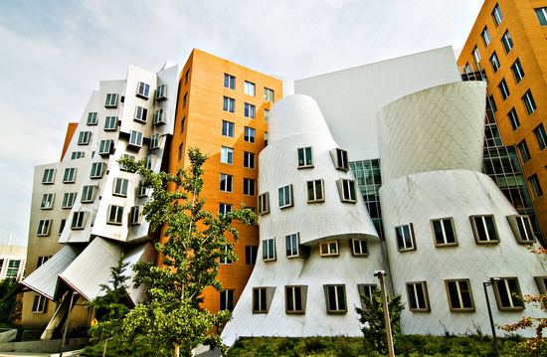
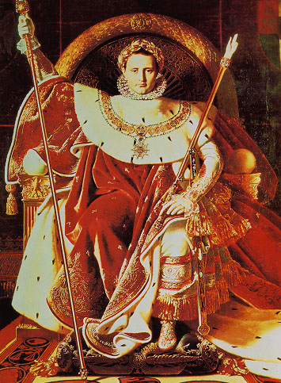
Computer Science Is Interdisciplinary
Physics
Biology
Math
Brain/Cognitive
Economics
Notes:
As you’ve probably gathered by now, one of the best things about CS, the thing I love most about it, is its interdisciplinary nature. CS is NOT about programming – that’s a misconception! Instead, CS is a powerful set of ideas for understanding almost anything in any area of science.
Look: from our perch at the Stata Center, we have wonderful interactions with physics, as I already told you, but also with math, brain and cognitive science, economics, biology, and so many other fields that study various special cases of the phenomena of algorithms and computation. And it’s really rewarding to collaborate with all these people---they always learn a lot from us.

Slide 14
Imagine About
My Personal Mobile Communicator
A Mobile Video-Phone
My Personal Agent
The Web in The Future
Computer in the future : On-Demand Computing Power, Eletricty Supply, Display, Storage
Entertaiment, Education, Medical, etc

Slide 15
Tugas
Carilah Video mengenai dunia computing/informatic’s di masa depan
Buatkan slide presentasi yang terdapat mengenai teknologi yang anda bayangkan dengan kebutuhan skill / mata kuliah

Slide 16
Reference
Slide Presentation : CS101 Introduction to Computing Lecture 43 The Future of Computing
Slide Presentation:The Future of Computer Science And Why Every Other Major Sucks By Comparison, Scott Aaronson Associate Professor, EECS

