Slide 1
IFG412 Tugas Akhir I (Seminar Proposal) Academic Writing
Dana S. Kusumo, Dawam Dwi Jatmiko Suwawi
Prodi S1 Teknik Informatika

Slide 2
Aim of this slide
To review academic writing structure (part I)
To inform milestones of TA1 (part II)

Slide 3
Part I. Structure of Academic Writing

Slide 4
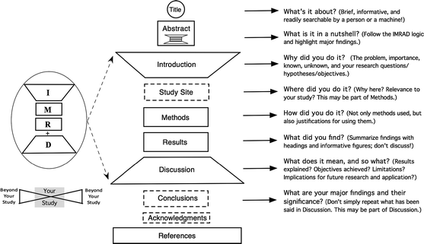
Generic stucture: IMRaD
Source: http://download.springer.com/static/pdf/830/art%253A10.1007%252Fs10980-011-9674-3.pdf?auth66=1392958068_8f06fd01d1f9b0079ebb716810a9af91&ext=.pdf

Slide 5
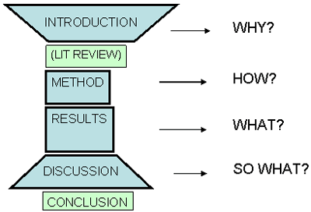
Generic stucture: IMRaD
Taken: http://www.study-habits.com/imrad-format-explanation
Source: Swales, J and C. Feak (2000) English in Today’s Research World: a Writing Guide, Michigan: Ann Arbor

Slide 6
Introduction must...
begin with a very general statement about the subject, then gradually narrows down to the specific thesis statement
provide background knowledge for your reader so that they can appreciate your work
What is important for the reader (from the sea of literature) ➔ be concise and clear please ☺
Act as a clear road map for understanding your work/paper/thesis/TA

Slide 7
Introduction ala Trzeciak and Mackay (1994)
a statement of the importance of the subject
mention of previous work on the subject
a justification for dealing with the subject
a statement of your objectives
a statement of the limitations of the work
a mention of some of the differing viewpoints on the subject
a definition of the topic being discussed

Slide 8
Introduction ala Swales and Feak (2004)
Move 1: Establishing a research territory
by showing that the general research area is important, central, interesting, problematic, etc. (optional)
by introducing and reviewing items of previous research in the area (obligatory)
Move 2: Establishing a niche
by indicating a gap in the previous research or by extending previous knowledge in some way (obligatory)
Move 3: Occupying the niche
by outlining purposes or stating the nature of the present research (obligatory)
by listing research questions of hypotheses
by announcing principal findings
by stating the value of the previous research
by indicating the structure of the research paper
Notes:
For full research

Slide 9
Literature review [3]
Ideally before research for justifying the research based on what already know
Focus for literature review
Research outcomes
Research methods
Theories
Applications

Slide 10
Literature review aim [3]
Integrate what others have done and said
Criticize previous study
Build bridges between related topics areas
Identify the central issues in a field

Slide 11
Use of Literature review [4]
In the introduction: to frame the problem
In a separate section: to review the literature
At the end: to compare and contrast findings of the study

Slide 12
Method
The Methodology should contain sufficient detail for readers to replicate the work done and obtain similar results. [1]
Another important thing of method for readers is also to understand and accept your procedure
Describe materials/tools/data and/or methods/steps of your research [2]
Complete: refering to literature, your own
Clear and concise : generally no more than 2 steps in one sentence, and in logical order

Slide 13
Why do I need to justify or give reasons for what I did? Isn’t it obvious? [2]
It may be obvious to you, but they are not always obvious to your readers
If you fail to provide justification for what you did, then the reader may not accept the validity of your choices
Will eventually affect the way they evaluate your work
Frequent justification enables the reader to trust the choices you made!!!

Slide 14
Method: The model [1]
1 | PROVIDE A GENERAL INTRODUCTION AND OVERVIEW OF THE MATERIALS/METHODS RESTATE THE PURPOSE OF THE WORK GIVE THE SOURCE OF MATERIALS/EQUIPMENT USED SUPPLY ESSENTIAL BACKGROUND INFORMATION
2 | PROVIDE SPECIFIC AND PRECISE DETAILS ABOUT MATERIALS AND METHODS (i.e. quantities, temperatures, duration, sequence, conditions, locations, sizes) JUSTIFY CHOICES MADE INDICATE THAT APPROPRIATE CARE WAS TAKEN
3 | RELATE MATERIALS/METHODS TO OTHER STUDIES
4 | INDICATE WHERE PROBLEMS OCCURRED

Slide 15
Results [2]
It may be in a separate section (‘Results’) or integrated with the Discussion section (as ‘Results and Discussion’)
Following slides are based on the Results as a separate section
The standard is to present results with little or no interpretation or discussion
The author must ‘show not tell’ the results (will be explained later)

Slide 16
Results [2]
Decide what results are representative
Organize them in a sequence that highlights the answers to the aims, hypotheses or questions
Involve the use of figures and tables,
commented on in the text {‘showing not telling’}
Should also mention any important negative results
Comment them in discussion section!
Reporting your results simply and clearly
If your reviewer cannot understand your results, then your contribution will be lost

Slide 17
“Showing not telling’ the results [2]
“Rather than telling the reader that a result is interesting or significant, show them how it is interesting or significant … show the reader that they need to know to come to their own conclusion about the result.“ Professor of ecology Ken Lertzman of the Simon Fraser University
Example
“S1. *The large difference in mean size between population C and population D is particularly interesting.” ➔ the adjective interesting may be not definite for the reader
“S2. While the mean size generally varies among populations by only a few cm, the mean size in populations C and D differed by 25 cm. Two hypotheses could account for this, …” ➔ the author gave the readers sufficient information to find that the result is interesting

Slide 18
“Showing not telling’ the results: tables and figures [2]
“When writing Results sections you should use the tables and figures to illustrate points in the text, rather than making them the subject of your text.“ Professor of ecology Ken Lertzman of the Simon Fraser University
Example (S1 should be rewritten as S2)
“S1. *Figure 4 shows the relationship between the numbers of species A and species B.”
➔ just telling, readers can already see in the figure
➔ reader will make their own interpretation, which may be wrong interpretation
“S2. The abundances of species A and B were inversely related (Figure 4).”
➔ focus on the meaning that can be inferred from the figure
➔ guide the readers towards the interpretation that you want them to have

Slide 19
Difference between reporting and interpreting [2]
In (a separated) Result section, the interpretations are limited to highlight the importance of the data for the readers without adding any subjective/personal comments
Example for Result section (S1) and Result and Discussion section (S2)
S1. The duration of exposure to running water had a pronounced effect on cumulative seed germination percentages (Fig. 2). Seeds exposed to the 2-day treatment had the highest cumulative germination (84%), 1.25 times that of the 12-h or 5-day groups and four times that of controls. ➔ objective reporting
S2. The results of the germination experiment (Fig. 2) suggest that the optimal time for running-water treatment is 2 days. This group showed the highest cumulative germination (84%), with longer (5 d) or shorter (12 h) exposures producing smaller gains in germination when compared to the control group. ➔ subjective/personal interpretation
Notes:
In S1 the authors highlight the trend / difference that they want the reader to
focus on, no subjective interpretation is given. On the other hand, in S2 the
reference to optimality is a conceptual model to which the observed result is
then tied.
This differentiation between objective reporting and subjective interpretation is not
an easy skill to acquire. If you are worried that your Results section may contain
elements of subjectivity that are not appropriate (in terms of your field of study, or
the requirements of your journal), then you should consider showing it to someone
with considerable experience in writing who can certainly be someone of the same
nationality as this is not essentially a language issue.
However, if your Results and Discussion are combined into one section, then S2
would be perfectly acceptable.

Slide 20
Discussion [1][2]
Sound both convincing and credible at the same time.
by being positive about your own limitations
by being constructive when discussing what you believe to be the limitations of others.
Interpret your results without repeating them
The Discussion/Conclusion moves away from that narrow section to a wider, more general focus.
The Discussion looks back at the points made in the Introduction to answers to the aims, hypotheses or questions

Slide 21
Structure of the discussion [2]
Do my data support what I set out to demonstrate at the beginning of the paper?
What is my personal interpretation of my findings?
What other possible interpretations are there?
What are the limitations of my study? What other factors could have influenced my findings?
Have I reported everything that could make my findings invalid?

Slide 22
Conclusion [2]
a very brief revisit of the most important findings
suggestions for improvements
recommendations for future work

Slide 23
Conclusion compared to introduction and abstract [2]
does not provide background details
gives more emphasis to the findings
must add value (typically contained in the recommendations, implications and areas for future research)

Slide 24
Abstract: Definition
“An abstract is a succinct summary of a longer piece of work, usually academic in nature, which is published in isolation from the main text and should therefore stand on its own and be understandable without reference to the longer piece. It should report the latter's essential facts, and should not exaggerate or contain material that is not there.”
http://www.emeraldinsight.com/authors/guides/write/abstracts.htm

Slide 25
When should I write the Abstract?
Usually experienced writers always write the Abstract
Notes:
Usually experienced writers always write the Abstract (and often the Introduction too) last, i.e. When they have finished the rest of the paper. This reflects the research process itself – the first thing you write about is what you found, then how this can be interpreted.

Slide 26
Type of abstract [2]
Unstructured abstract
A single paragraph of between 100–250 words containing a very brief summary of each of the main sections of your paper
Structured abstract
The same as above but divided into several short sections
Extended abstract
A mini paper organized in the same way as a full paper (e.g. Introduction, Methods, Discussion …), but substantially shorter (two to four pages). The extended abstract may or may not include an abstract – for example, it may begin directly with an introduction
Conference abstract
Designed to help conference organizers to decide whether they would like you to make an oral presentation at their conference. It may be of any of the three forms above.

Slide 27
Structured abstract
Structure
Background
Method
Result
Conclusion
https://www.nlm.nih.gov/bsd/policy/structured_abstracts.html
Structure
Purpose
Method
Findings
Research limitations/implications (if applicable)
Practical implications (if applicable)
Social implications (if applicable)
Originality/value
http://www.emeraldinsight.com/authors/guides/write/abstracts.htm

Slide 28
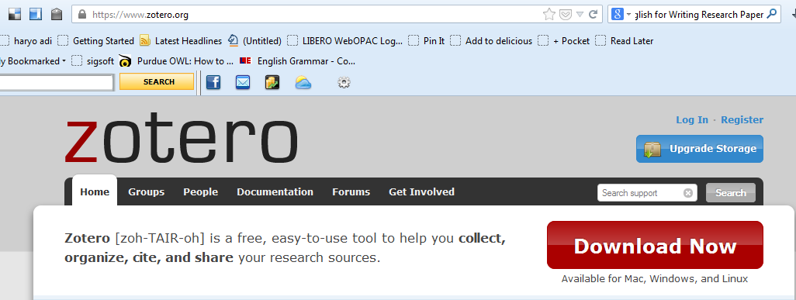
Reference Management Tools
Zotero (www.zotero.org)
Desktop-based application
Firefox plugg-in
Both must also download Microsoft Doc (also other Office Doc application) plug-in

Slide 29
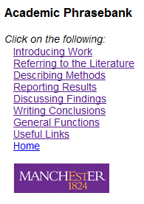
Academic Phrasebank
http://phrasebank.manchester.ac.uk/
The Academic Phrasebank is a general resource for academic writers. It aims to provide you with examples of some of the phraseological "nuts and bolts" of writing organised according to the main sections of a research paper or dissertation (see the menu on the left).

Slide 30
How to used this slide for proposal writing
Proposal is a plan but this slide is for reporting research (usually finished research)
So, in proposal
Still need introduction, method, literature review, expected results/outcomes and tentative conclusion
Does not need results and discussion

Slide 31
Concluding remark
Please be consistent from Introduction-(literature review)-Method-Results-and-Discussion
Put it before them briefly so they will read it, clearly so they will appreciate it, picturesquely so they will remember it and, above all, accurately so they will be guided by its light. Joseph Pulitzer

Slide 32
References
[1] Glasman-Deal, Hilary, Science Research Writing: A Guide for Non-Native Speakers of English, 1st edition, 2009, Imperial College Press
[2] Wallwork, Adrian, English for Writing Research Paper, 2011 edition, Springer
[3] Hall, Ralph, Applied Social Science, UNSW, 2006
[4] Creswell, J.W., Research Design: Qualitative, Quantitative, and Mixed Methods Approaches, Third edition, Sage Publisher

Slide 33
Part II Milestones

Slide 34
Time Table Pelaksanaan Mata Kuliah IF412 Tugas Akhir I (Seminar Proposal)
Minggu 1 | Minggu 2-4 | Minggu 4 s/d Minggu 7, Minggu 9 -10
Kuliah Pembekalan: Penjelasan Aturan TA | Materi Plagiarisme (Minggu 2) Metodologi penelitian (Minggu 3) Penulisan ilmiah (Minggu 4) | Bimbingan Proposal dan Penawaran tema TA oleh Kelompok Keahlian (KK): Pembuatan dan Penulisan Proposal TA dengan dosen calon pembimbing Penawaran tema TA oleh KK (ada kemungkinan lebih cepat)
Awal minggu 10 | Minggu 10-11 | Minggu 11-12 | Minggu 13 | Minggu 14
Pengumpulan Proposal Tugas Akhir di Admin IF | Penjadwalan Desk Evaluation proposal oleh KK | Desk Evaluation | Seminar sesi 1 | Seminar sesi 2
For all: Proposal TA1 akan dikumpul awal minggu 10
Bagi yang mengambil TA1+TA2, proses Desk Evaluation dan Seminar akan selesai maksimal minggu ke-12

