Slide 1
CIG4I3 SISTEM REKOGNISI Pertemuan 2: Computer Vision
Author-Tim Dosen
KK ICM

Slide 2
Resume Materi Pertemuan 1
Definisi Sistem Rekognisi
Penerapan Sistem Rekognisi

Slide 3
Materi Pertemuan 2
Definisi Computer Vision
Block Process
Sistem Visual Manusia
Representasi Data Digital

Slide 4
Computer Vision [1]: Field Area

Slide 5
Computer Vision [2] vs Sistem Rekognisi
A theme in the development of this field has been to duplicate the abilities of human vision by electronically perceiving and understanding an image.^{[4]}
This image understanding can be seen as the disentangling of symbolic information from image data using models constructed with the aid of geometry, physics, statistics, and learning theory.^{[5]}
Computer vision has also been described as the enterprise of automating and integrating a wide range of processes and representations for vision perception.^{[6]}
[4] Milan Sonka, Vaclav Hlavac and Roger Boyle (2008). Image Processing, Analysis, and Machine Vision. Thomson. ISBN 0-495-08252-X.
[5] David A. Forsyth and Jean Ponce (2003). Computer Vision, A Modern Approach. Prentice Hall. ISBN 0-13-085198-1.
[6] Dana H. Ballard and Christopher M. Brown (1982). Computer Vision. Prentice Hall. ISBN 0-13-165316-4.

Slide 6
Materi Pertemuan 2
Definisi Computer Vision
Block Process
Sistem Visual Manusia
Representasi Data Digital

Slide 7
Generic Process Block
Akuisisi Data
Representasi Data
Result Analysis
Recognition Process
Transformasi
Pre-Processing
Data Properti/Descriptor
Ektraksi Ciri
Knowledge Based
Model
Clasifier
Matching/Similarity
Used training Result
Performance : accuration, precission, recall
etc
Primary
Secondary

Slide 8
Materi Pertemuan 2
Definisi Computer Vision
Block Process
Sistem Visual Manusia
Representasi Data Digital

Slide 9
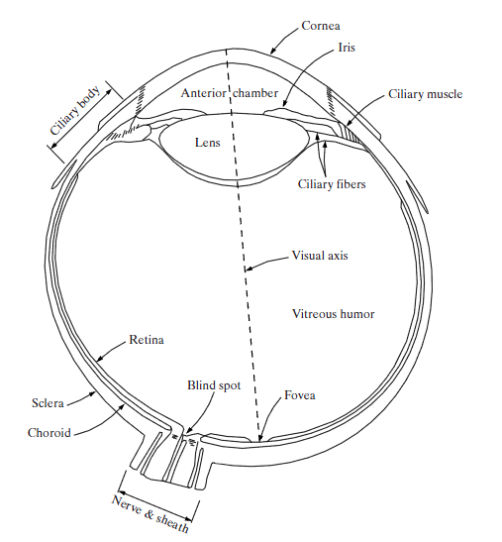
Sistem Visual Manusia
Pembentukan Citra oleh Sensor Mata
Intensitas cahaya ditangkap oleh diagram iris dan diteruskan ke bagian retina mata.
Bayangan obyek pada retina mata dibentuk dengan mengikuti konsep sistem optik dimana fokus lensa terletak antara retina dan lensa mata.
Mata dan syaraf otak dapat menginterpretasi bayangan yang merupakan obyek pada posisi terbalik.
. A cross section of the human eye
(Gonzalez & Woods, 2002)

Slide 10
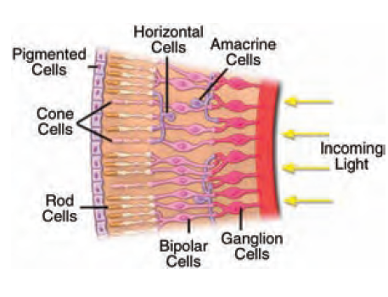
Sistem Visual Manusia
Fovea di bagian retina terdiri dari dua jenis receptor:
Sejumlah cone receptor (sel kerucut), sensitif terhadap warna, visi cone disebut photocopic vision atau bright light vision
Sejumlah rod receptor (sel batang), memberikan gambar keseluruhan pandangan dan sensitif terhadap iluminasi tingkat rendah, visi rod disebut scotopic vision atau dim-light vision

Slide 11
Sistem Visual Manusia
Blind Spot
adalah bagian retina yang tidak mengandung receptor sehingga tidak dapat menerima dan menginterpretasi informasi

Slide 12
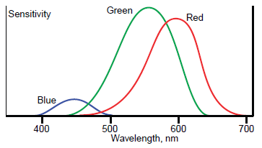
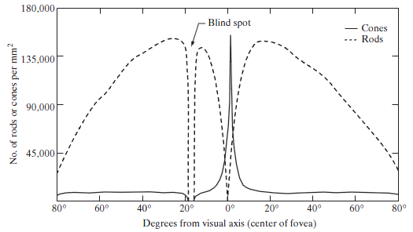
Sistem Visual Manusia
Distribution of rods and cones in retina. (Gonzalez & Woods, 2002)

Slide 13
Materi Pertemuan 2
Definisi Computer Vision
Block Process
Sistem Visual Manusia
Representasi Data Digital

Slide 14
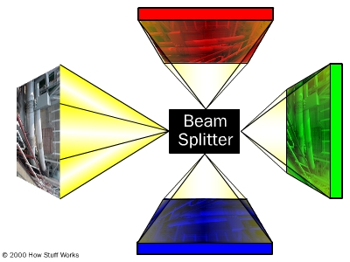
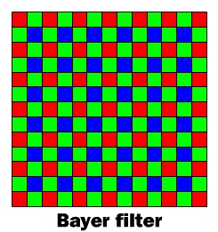
Akuisisi Data: Kamera Digital
Image Spiltter/Filter
CCD or CMOS Sensor

Slide 15
Representasi Data Citra [1]
Data digital pada umumnya diperoleh dengan cara melakukan proses kuantisasi dan sampling terhadap sinyal analog
Digitalisasi
Citra analog Citra Digital

Slide 16
Representasi Data Citra [2]
Sinyal analog => countinous
Sinyal digital => bersifat diskrit

Slide 17
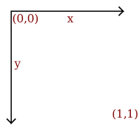
Digital image representation
Vector image
draw circle
center 0.5, 0.5
radius 0.4
fill-color yellow
stroke-color black
stroke-width 0.05
draw circle
center 0.35, 0.4
radius 0.05
fill-color black
draw circle
center 0.65, 0.4
radius 0.05
fill-color black
draw line
start 0.3, 0.6
end 0.7, 0.6
stroke-color black
stroke-width 0.1

Slide 18
Representasi Data Citra [3]
Data citra dalam bentuk digital pada umumnya menyimpan informasi mengenai data intensitas dengan rentang nilai 0-255
Citra digital disimpan dengan struktur berbentuk matrik atau array
55 | 56 | 56 | 45 | 46 | 46
55 | 56 | 57 | 45 | 38 | 54
56 | 58 | 59 | 47 | 46 | 55
57 | 58 | 60 | 48 | 48 | 56
… | … | … | … | … | …

Slide 19
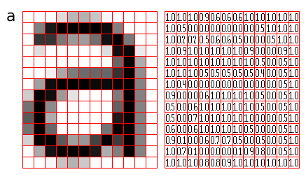
Digital image representation
Bitmap (raster) image
Bitmap image is an array of pixels
The value of each array element corresponds to the color of the appropriate pixel

Slide 20
Representasi Data Citra [4]
Pengolahan citra digital ≈ operasi matrik
Data yang tersimpan dapat direpresentasikan dalam tipe data bilangan bulat 0 s/d 255 atau dalam bentuk bilangan real 0 s/d 1

Slide 21
Sampling citra (2D)

Slide 22
Kuantisasi Sinyal 1D

Slide 23
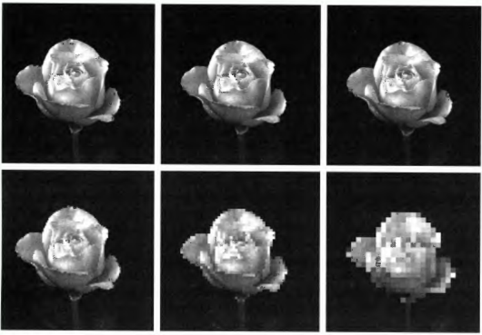
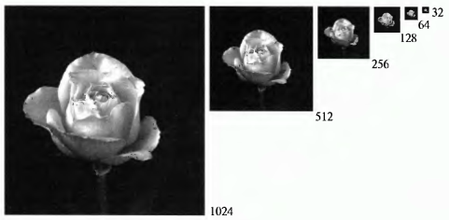
Digital image representation
Bitmap (raster) image
Important parameters of raster image:
Raster dimensions
Resolution (ppi)
Sample depth (usually 2^{k})
Fixed resolution, varying dimension
Fixed dimensions, varying resolution

Slide 24
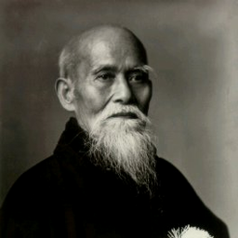
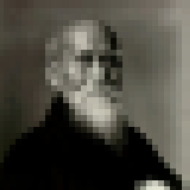
Contoh sampling:

Slide 25
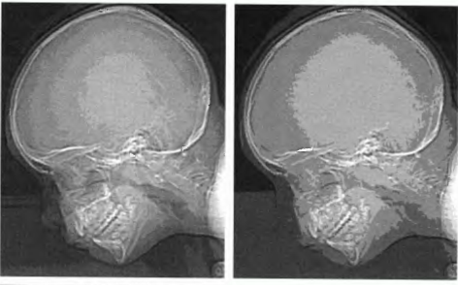
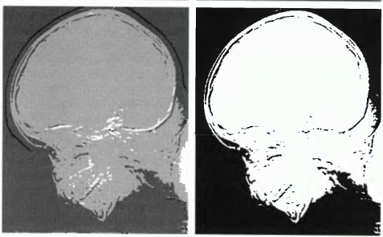
Digital image representation
Bitmap (raster) image
The same image with varying sample depths:
16 levels
8 levels
4 levels
2 levels
Typical levels: 8 bit (256 levels), 16 bit – png, tiff

Slide 26
Contoh kuantisasi
24-bit
8-bit
4-bit
1-bit

Slide 27
Digital image representation
Bitmap (raster) image: color
RGB – the most common color model (CRT monitors, LCD screens/projectors)
Each pixel represented by 3 values: red, green, blue
RGB bands: color image built up of bands of red, green and blue color

Slide 28
Digital image representation
Bitmap (raster) image: color
Pixel-interleaved format (chunky) – is a common one
Color-interleaved format (planar)

Slide 29
Citra Hyperspectral:
Diambil dengan perangkat khusus dengan menggunakan pedoman λ (panjang gelombang)

Slide 30
Tugas
Baca dan mulai membuat kode matlab:
1. Buat sebuah GUI untuk membuka file image

Slide 31
Sumber
Russian Summer School In Information Retrieval: CBIR, Natalia Vassilieva , HP Labs Russia, 2008

