Slide 1
CIG4I3 SISTEM REKOGNISI
Pertemuan 11: Ekstraksi Ciri Texture [2]
Author-Tim Dosen
KK ICM

Slide 2
Resume Materi
Extraksi Ciri
  Warna : Color Moment, Histogram
  Bentuk : Chain Code, Moment

Slide 3
Generic Process Block
Akuisisi Data
Representasi Data
Result Analysis
Recognition Process
Transformasi
Pre-Processing
Data Properti/Descriptor
Ektraksi Ciri
Knowledge Based
Model
Clasifier
Matching/Similarity
Used training Result
Performance : accuration, precission, recall
etc
Primary
Secondary

Slide 4
Materi Pertemuan 11
Ciri Texture:
  Statistical
    GLCM
    Local Binary Pattern, Directional Feature
    Local Directional Pattern
  Spectral
    Gabor Filter,ICA

Slide 5
Texture features

Slide 6
Local Binary Pattern
For each pixel p, create an 8-bit number b1 b2 b3 b4 b5 b6 b7 b8, where bi = 0 if neighbor i has value less than or equal to p’s value and 1 otherwise.
Represent the texture in the image (or a region) by the histogram of these numbers.
100 | 101 | 103
40 | 50 | 80
50 | 60 | 90
1 1 1 1 1 1 0 0

Slide 7
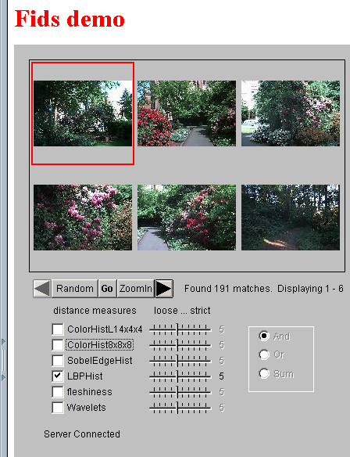
Local Binary Pattern
Fids (Flexible Image Database System) is retrieving images similar to the query image using LBP texture as the texture measure and comparing their LBP histograms

Slide 8
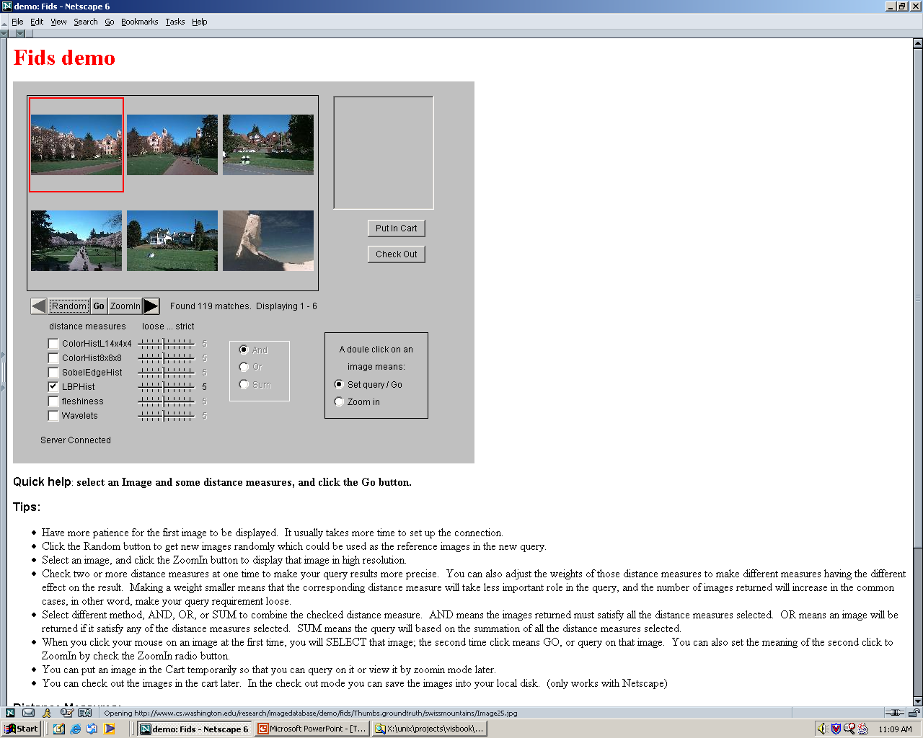
Local Binary Pattern
Low-level measures don’t always find semantically similar images.

Slide 9
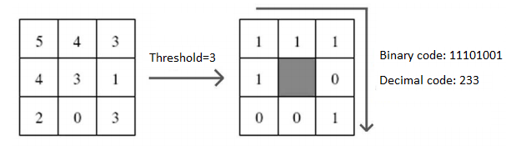
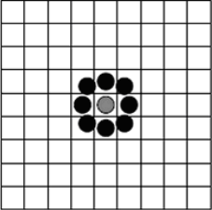
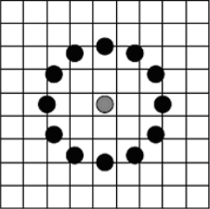
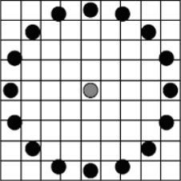
LBP-Variance
Original LBP filter
Advanced LBP filters

Slide 10
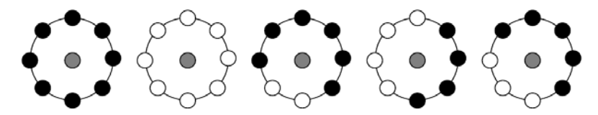
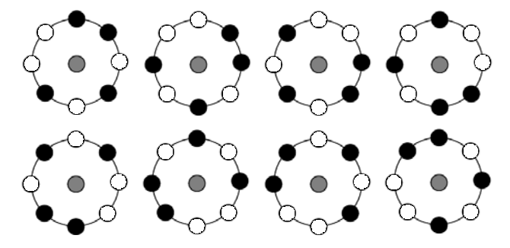
LBP-Variance
Uniform codes
(patterns)
Rotation invariant
codes

Slide 11
Materi Pertemuan 11
Ciri Texture:
  Statistical
    GLCM
    Local Binary Pattern, Directional Feature
    Local Directional Pattern
  Spectral
    Gabor Filter,ICA

Slide 12
Local Directional Pattern
Local Directional Pattern merupakan salah satu metode ekstrasi fitur yang menggunakan pendekatan berbasis appearance (Jabid, Kabir, & Chae, October 2010).
Fitur LDP mengandung data kurva, dan sudut dari sebuah citra.
  Fitur LDP didapatkan dengan cara mengalikan nilai intensitas tiap pixel tetangga dengan 8 kernel arah (Kirsch edge masks)
  Hasilnya disebut sebagai nilai respon tepi dan ditransformasikan menjadi bilangan desimal -> Kode LDP
  Dilakukan pembangunan histogram LDP

Slide 13
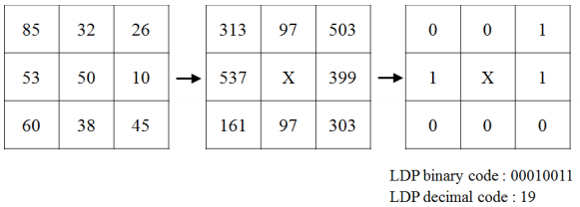
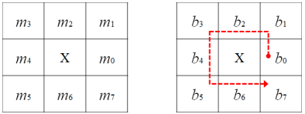
Kode LDP
K=3
Kirsch Compass Kernel
Posisi hasil konvolusi
Arah biner

Slide 14
Kode LDP
Kemungkinan nilai kode LDP
Misal k=3
7 | 11 | 13 | 14 | 19 | 21 | 22 | 25 | …
56 kombinasi

Slide 15

7 | 11 | 13 | 14 | 19 | 21 | 22 | 25 | …
10 | 5 | 7 | 6 | 1 | 25 | 32 | 11 | n
Kode LDP
Jumlah
7 | 11 | 13 | 14 | 19 | 21 | 22 | 25 | …
10 | 5 | 7 | 6 | 1 | 25 | 32 | 11 | n
7 | 11 | 13 | 14 | 19 | 21 | 22 | 25 | …
10 | 5 | 7 | 6 | 1 | 25 | 32 | 11 | n
10 | 5 | 7 | 6 | 1 | 25 | 32 | 11 | n
10 | 5 | 7 | 6 | 1 | 25 | 32 | 11 | n
10 | 5 | 7 | 6 | 1 | 25 | 32 | 11 | n
Histogram LDP

Slide 16
Parameter dalam LDP
K= jumlah kode respon tepi maksimal yang digunakan dalam pembentukan histogram LDP
Region = pembagian citra menjadi region-region
Misalkan dalam sebuah citra yang diproses diatur:
  K=3 -> 56 kode LDP (kombinasi 3 dari 8)
  Region = 5 x 5 (citra dibagi menjadi 5 region)
  Maka diperoleh sebanyak 25 histogram LDP , dimana setiap histogram mengandung nilai sebanyak 56 -> total diperoleh vektor ciri dengan ukuran 25x56

Slide 17
Materi Pertemuan 11
Ciri Texture:
  Additional: Laws’ Texture Energy Features
  Topology and Relasional

Slide 18
Laws’ Texture Energy Features
Signal-processing-based algorithms use texture filters applied to the image to create filtered images from which texture features are computed.
The Laws Algorithm
  Filter the input image using texture filters.
  Compute texture energy by summing the absolute value of filtering results in local neighborhoods around each pixel.
  Combine features to achieve rotational invariance.

Slide 19
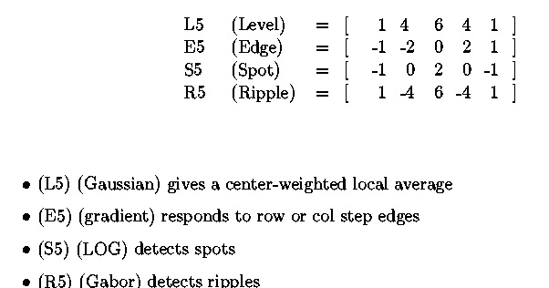
Laws’ Texture Energy Features

Slide 20
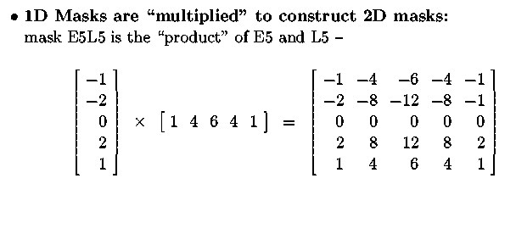
Laws’ Texture Energy Features
Mask Creation

Slide 21
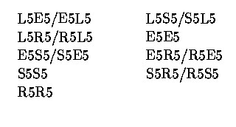
Laws’ Texture Energy Features
Mask Creation: 9D feature vector for pixel
  Subtract mean neighborhood intensity from pixel
  Dot product 16 5x5 masks with neighborhood
  9 features defined as follows:

Slide 22
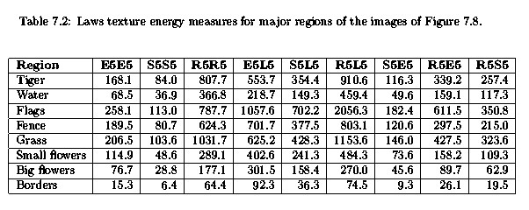
Laws’ Texture Energy Features

Slide 23
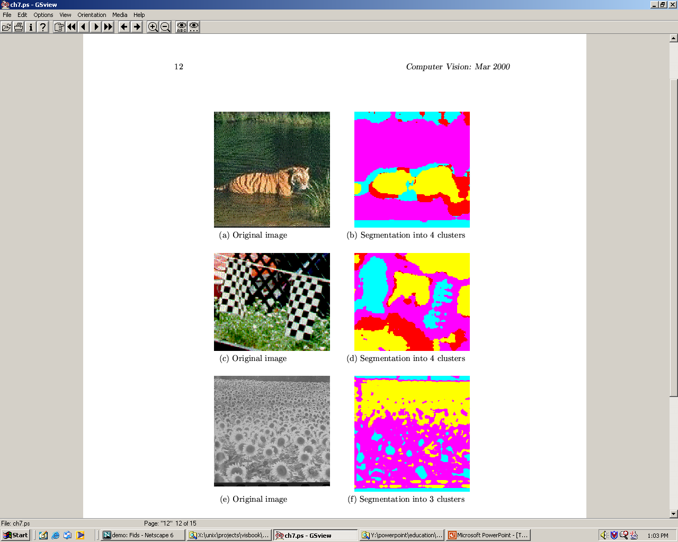
Laws’ Texture Energy Features
water
tiger
fence
flag
grass
small flowers
big flowers

Slide 24
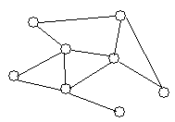
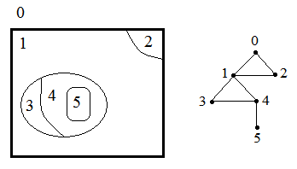
Topological Data Structures
Images are described as a set of elements and
Their relations.
Graph: G(V, E), where
V: set of nodes, E: set of arcs
Attributed (or weighted) graph: values are
assigned to nodes, arcs, or both.
Region adjacency graph:

Slide 25
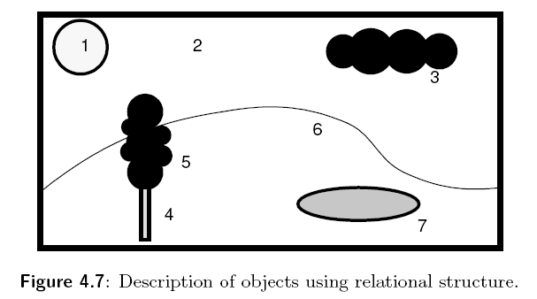
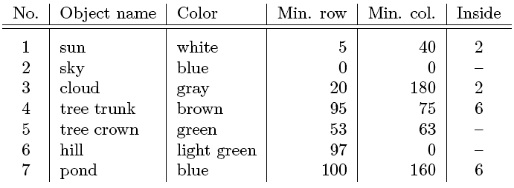
Relational Structures
Table

Slide 26
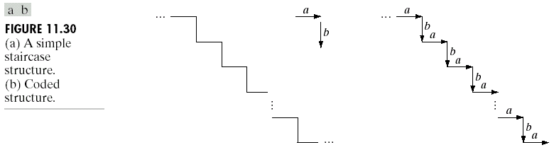
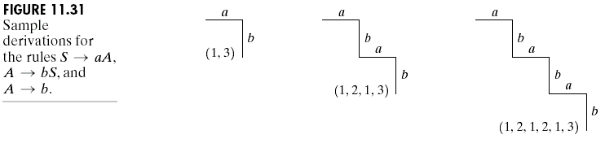
Relational Structures

Slide 27
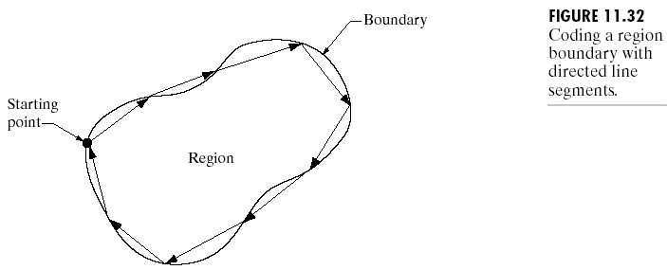
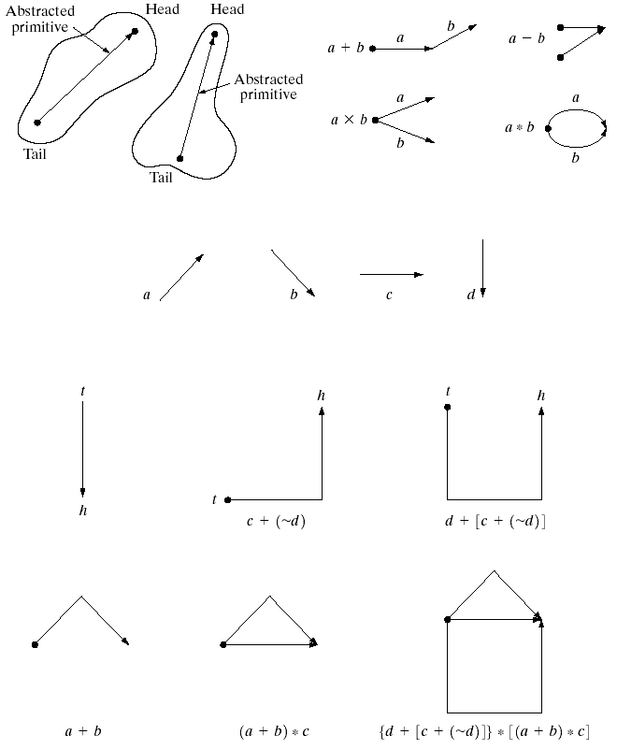
Relational Structures

Slide 28
Sumber
Russian Summer School In Information Retrieval: CBIR, Natalia Vassilieva , HP Labs Russia, 2008
Bahan Slide dapat diakses di Nawapak Eua-anant:gear.kku.ac.th/~nawapak
www.cse.msu.edu/~cse803/Lectures/week06-texture-LS.ppt
www.csie.ntnu.edu.tw/.../Ch4-Data_Structure_ for_Image_Analysis

