Slide 1
CIG4I3 SISTEM REKOGNISI
Pertemuan 10: Ekstraksi Ciri Texture [1]
Author-Tim Dosen
KK ICM

Slide 2
Resume Materi
Extraksi Ciri
  Warna : Color Moment, Histogram
  Bentuk : Chain Code, Moment

Slide 3
Generic Process Block
Akuisisi Data
Representasi Data
Result Analysis
Recognition Process
Transformasi
Pre-Processing
Data Properti/Descriptor
Ektraksi Ciri
Knowledge Based
Model
Clasifier
Matching/Similarity
Used training Result
Performance : accuration, precission, recall
etc
Primary
Secondary

Slide 4
Materi Pertemuan 10
Ciri Texture:
  Statistical
    GLCM
    Local Binary Pattern, Directional Feature
    Local Directional Pattern
  Spectral
    Gabor Filter,ICA

Slide 5
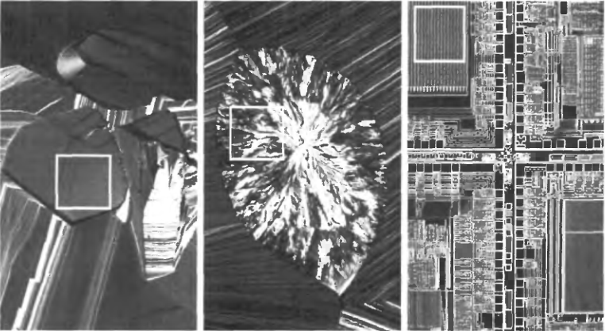
Texture features
What is texture?
Smooth
Rough
Regular

Slide 6
Texture features
Texture is a description of the spatial arrangement of color or
intensities in an image or a selected region of an image.
Structural approach: a set of texels in some regular or repeated pattern

Slide 7
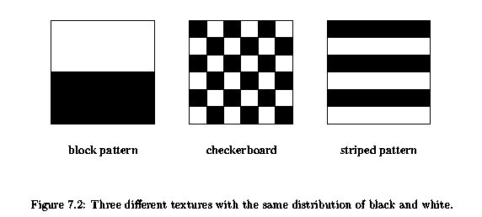
Texture features
Why Texture Analysis?

Slide 8
Aspects of texture
Size or granularity (sand versus pebbles versus boulders)
Directionality (stripes versus sand)
Random or regular (sawdust versus woodgrain; stucko versus bricks)
Concept of texture elements (texel) and spatial arrangement of texels

Slide 9
Problem with Structural Approach
How do you decide what is a texel?
Ideas?

Slide 10
Texture features

Slide 11
Texture features
Texture is a description of the spatial arrangement of color or intensities in an image or a selected region of an image.
Mark Nixon, dan Alberto Aguado, pada bukunya yang berjudul Feature Extraction & Image Processing[7],
  Pendekatan Struktural atau Spektral memiliki tingkat detail yang baik karena diekstraksi melalui komponen frekuensi, tetapi kekurangannya domain ini sangat rentan terhadap noise.
Alternatif pendekatan lain yang juga memiliki detail baik adalah dengan memperhitungkan statistika dari citra.

Slide 12





Texture features
General statistics
Based on intensity histogram of the whole image or its regions:
– histogram of intensity, L – number of intensity levels.
– central moment of order n.
– average intensity.
– variance, is a measure of contrast.
, R=0 where intensity is equal.
– a measure of histogram assimetry.

Slide 13


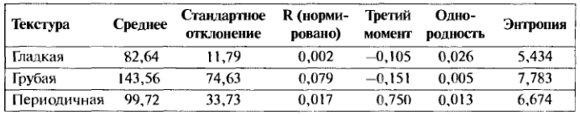
Texture features
General statistics (2)
– a measure of contrast of homogeneity
(max for homogeneous areas ).
– entropy, a measure of variability
(0 for homogeneous areas ).
Texture
Average
Deviation
R
μ₃
Uniform
Entropy
Smooth
Rough
Regular

Slide 14
Texture features-GLCM
GLCM: Salah satu teknik untuk memperoleh ciri statistik adalah dengan menghitung kemunculan hubungan ketetanggaan antara dua intensitas piksel pada orientasi sudut dan jarak atau range tertentu.
Pendekatan ini bekerja dengan membentuk sebuah matriks kookurensi yang disebut Gray Level Co-occurrence Matrix (GLCM) dari citra grayscale.

Slide 15
Texture features-GLCM
Kookurensi berarti kejadian bersama, yaitu jumlah kejadian satu level nilai intensitas piksel bertetangga dengan satu level nilai intensitas piksel lain dalam jarak (d) dan orientasi sudut (θ) tertentu.
  Orientasi pada umumnya dibentuk dalam empat arah sudut dengan interval sudut 45°, yaitu 0°, 45°, 90°, dan 135°.
  Jarak ditetapkan dalam ukuran pixel

Slide 16
Texture features-GLCM
Grey Level Co-occurrence Matrices (GLCM):
GLCM - matrix of frequencies at which two pixels, separated by a certain vector, occur in the image.
– separation vector;
I(p,q) – intensity of a pixel in position (p, q).

Slide 17
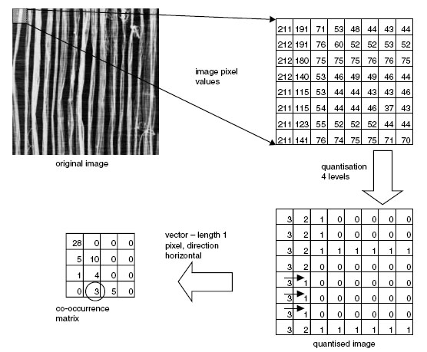
GLCM – an example

Slide 18
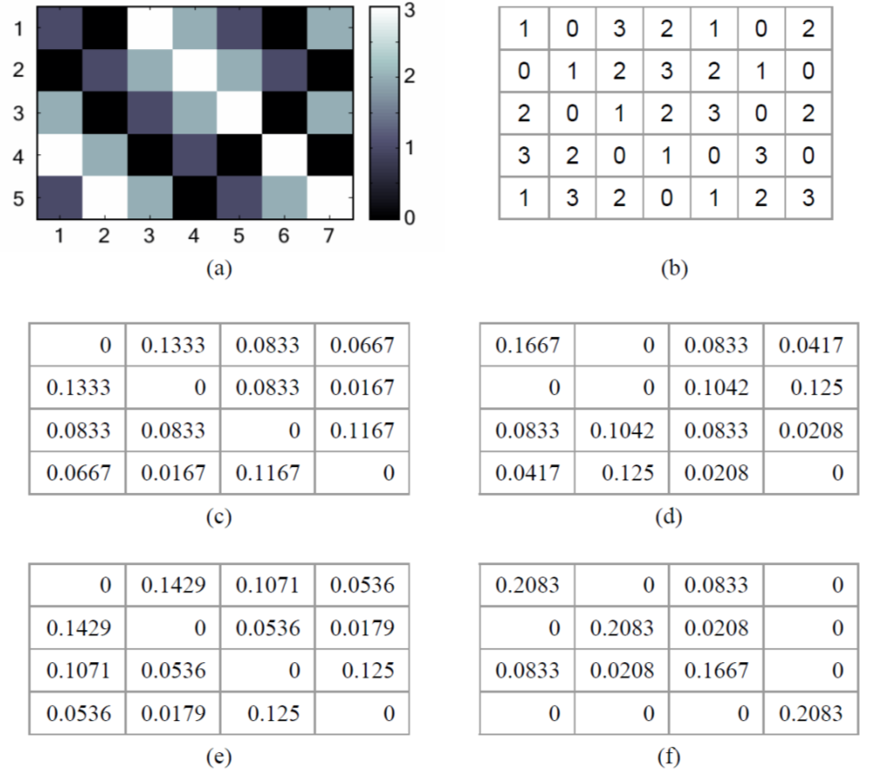
GLCM – an example

Slide 19
GLCM – descriptors
Matrik GLCM diproses lebih lanjut dengan menghitung ciri statistik yang merepresentasikan citra yang diamati
Robert M. Haralick, K. Shanmugam, dan Its’hak Dinstein dalam penelitian mengenai tekstur pada paper yang berjudul Textural Features for Images Classification[15], mengusulkan 14 jenis ciri tekstural yang dapat diekstraksi dari matriks kookurensi,
  Angular Second Moment, Contrast, Correlation, Variance, Inverse Difference Moment, Sum Average, Sum Variance, Sum Entropy, Entropy, Difference Variance, Difference Entropy, Information Measures of Correlation, dan Maximal Correlation Coefficient.

Slide 20
GLCM – descriptors
Statistical parameters calculated from GLCM values:
– is minimal when all elements are equal
– a measure of chaos,
is maximal when all elements are equal
– has small values when big elements are
near the main diagonal
– has small values when big elements are
far from the main diagonal
Notes:
См. Стр. 952 чудо-книги

Slide 21



GLCM – descriptors
Statistical parameters calculated from GLCM values:
– ASM = Angular Second Moment, menunjukkan ukuran sifat homogenitas dari citra (makin tinggi makin seragam).
– Correlation =menunjukkan ukuran ketergantungan linear derajat keabuan citra sehingga dapat memberikan petunjuk adanya struktur linear dalam citra
– Variance = VAR menunjukkan variasi atau dispersi elemen-elemen matriks kookurensi. Citra dengan dispersi derajat keabuan kecil akan memiliki variansi yang kecil pula.
Notes:
См. Стр. 952 чудо-книги

Slide 22
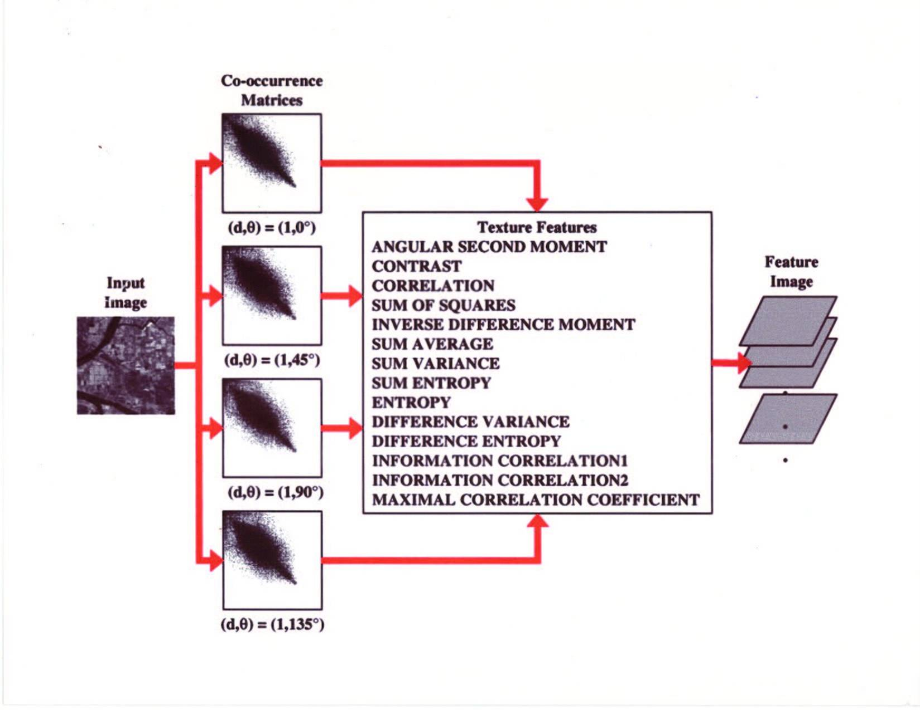
GLCM Descriptor

Slide 23
Texture features: Tamura features
Features, which are important for visual perception:
Coarseness
Contrast
Directionality
Line-likeness
Regularity
Roughness
Tamura image:
Coarseness-coNtrast-Directionality – points in 3-D space CND
Features:
Euclidean distance in 3D (QBIC)
3D histogram (Mars)

Slide 24
Texture features: spectral

Slide 25
Texture features: wavelet based
Wavelet analysis – decomposition of a signal:
Basis functions:
– scaling function
– mother wavelet
A set of basis functions – filters bank
Image
Filter 1
Energy 1
Filter 2
Energy 2
Feature vector
Filter N
Energy N

Slide 26
Texture features: Gabor filters
Mother wavelet: Gabor function
Filters bank:
К – a number of directions,
S – a number of scales,
U_{h}, U_{l} – max and min of frequencies taken into consideration.

Slide 27

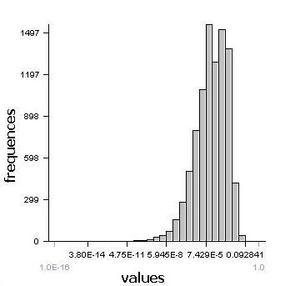
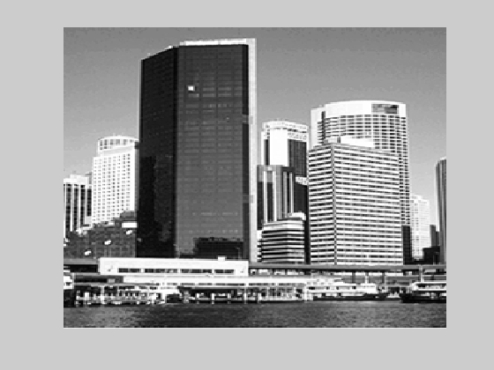
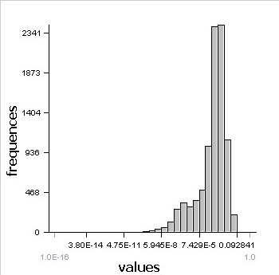
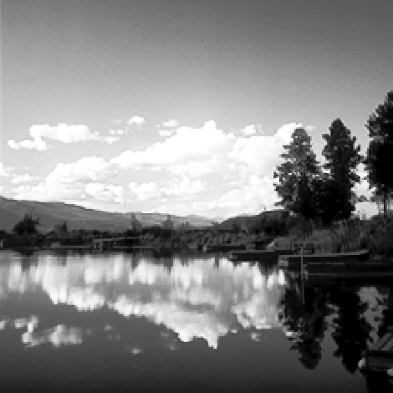

Texture features: ICA filters
Filters are obtained using Independent Component Analysis
dist(I₁,I₂) = KL_{H}(H_{1i} , H_{2i})
I₁
N
Σ
i=1
H. Borgne, A. Guerin-Dugue, A. Antoniadis. Representation of images for classification with independent features. Pattern Recognition Letters, vol. 25, p. 141-154, 2004
…
I₂
N filters

Slide 28
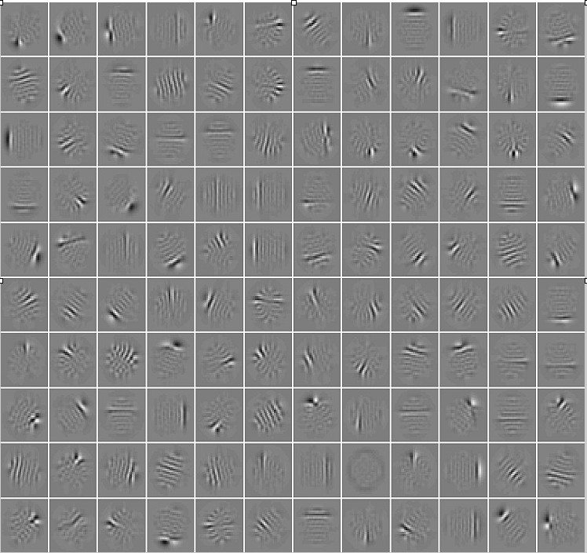
ICA Filters

Slide 29
Texture features: comparison
In the context of image retrieval!
P. Howarth, S. Rüger. Robust texture features for still image retrieval.
In Proc. IEE Vis. Image Signal Processing, vol. 152, No. 6, December 2006

Slide 30
Texture features: comparison (2)
Gabor filters v. s. ICA filters
Image classification task:
Collection of angiographic images
  ICA filters performs better by 13%
Brodatz texture collection
  ICA filters perform better by 4%
Snitkowska, E. Kasprzak, W. Independent Component Analysis of Textures in Angiography Images. Computational Imaging and Vision, vol. 32, pages 367-372, 2006.

Slide 31
Sumber
Russian Summer School In Information Retrieval: CBIR, Natalia Vassilieva , HP Labs Russia, 2008
Bahan Slide dapat diakses di Nawapak Eua-anant:gear.kku.ac.th/~nawapak
www.cse.msu.edu/~cse803/Lectures/week06-texture-LS.ppt
www.csie.ntnu.edu.tw/.../Ch4-Data%20Structure%20for%20Image%20A...

