Slide 1
Pengantar Teknik Informatika (HUG1M2) Pertemuan 3
Sistem Komputer
Author : Tjokorda Agung Budi Wirayuda
Program Studi S1 Teknik Informatika
Fakultas Informatika
Universitas Telkom
Semester Ganjil 2015/2016

Slide 2
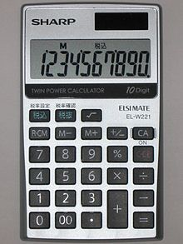
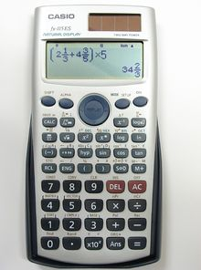
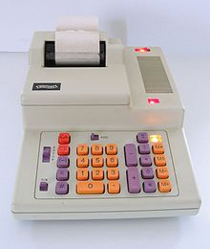
Electronic Calculator
http://en.wikipedia.org/wiki/Calculator

Slide 3
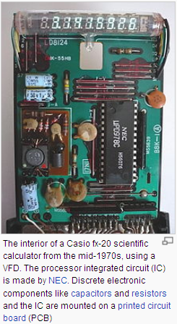
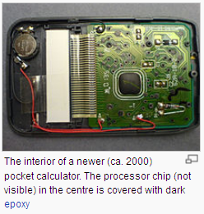
http://en.wikipedia.org/wiki/Calculator

Slide 4

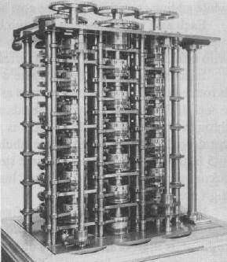
Difference Engine (1820)
Charles Babbage
proofreading a set of tables prepared for astronomical calculations . In a moment of exasperation with the errors they found, Babbage remarked, "I wish to God these calculations had been executed by steam."

Slide 5
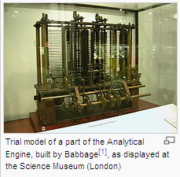
Analytical Engine (1834…1837)
Difference Engine: each storage axis is also an adder.
Analytical Engine: there is a separate "store" for numbers and a "mill," or arithmetic unit, where calculations are made
  Never built
In its logical design the machine was essentially modern, anticipating the first completed general-purpose computers by about 100 years. (wikipedia)

Slide 6
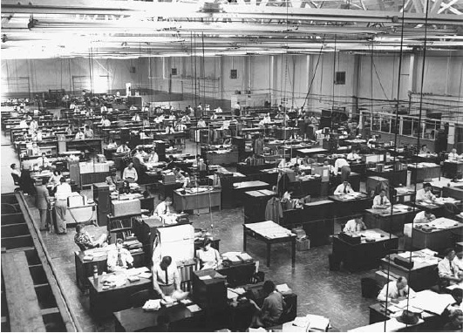
Human ‘‘computers’’ at work at North American Aviation, Los Angeles, in the early 1950s

Slide 7
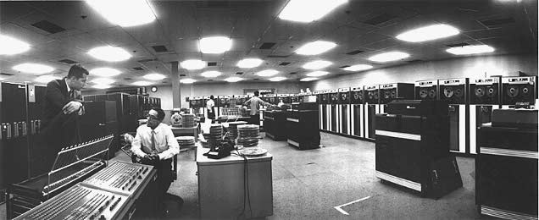
Ten years later…
A pair of IBM 7090 computers assist in the design and testing of the rocket engines that will later take men to the Moon and back
of the four men visible here, two are employees of IBM, not NAV

Slide 8
1940s – 1990s
the computer’s transformation in the late 1940s from a specialized instrument for science to a commercial product,
the emergence of small systems in the late 1960s
the advent of personal computing in the 1970s
the spread of networking after 1985.

Slide 9
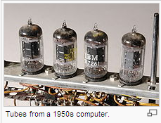
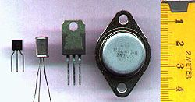
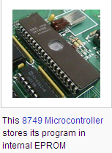
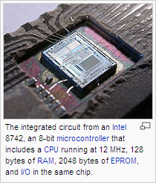
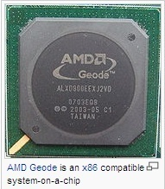
3 generations
Vacuum tubes
Transistors
Integrated Circuits

Slide 10
Common threads that have persisted
internal design of the computer
Despite the changes in implementation from vacuum tubes to integrated circuits, the flow of information within a computer, at one level at least, has not changed.
This design is known as the ‘‘von Neumann Architecture,’’ after John von Neumann (1903–1957)

Slide 11
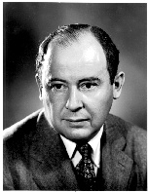
von Neumann Architecture
‘‘First Draft of a Report on the EDVAC,’’ by John von Neumann, dated June 30, 1945, is often cited as the founding document of modern computing
internal storage of programs
the units that process information are separate from those that store it.
typically there is only a single channel between these two units

Slide 12
Von Neumann (cont’d)
instructions and data are stored in the same memory device, from which any datum can be retrieved as quickly as any other
  one may treat a coded instruction as a piece of data and perform an operation on it, thus changing it into another instruction

Slide 13
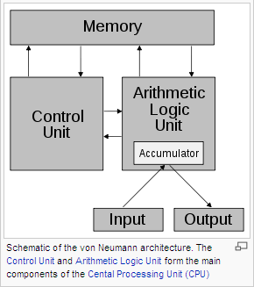
Von Neumann (cont’d)

Slide 14
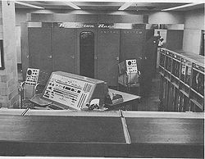
von Neumann: first implementation
UNIVAC main store could hold up to 1,000 ‘‘words,’’ which could either be
  numbers (11 digits plus sign),
  characters (12 characters per word), or
  instructions (6 characters per instruction; 2 in each word)

Slide 15
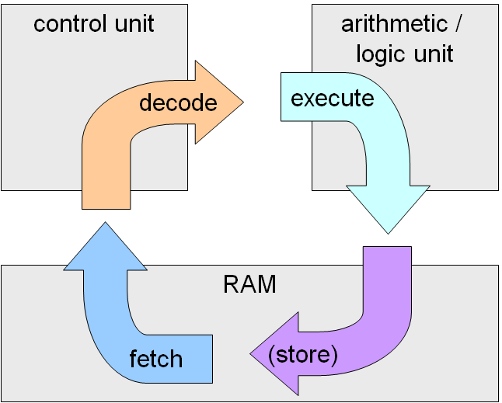
von Neumann: the basic cycle
transfer an instruction from the store to the processor (fetch),
decode that instruction, and
execute it, using data retrieved from that same store or already present in the processor
Except when explicit branch instructions are encountered, the flow through the instructions stored in the memory was sequential and linear

Slide 16
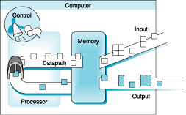
Major Components of a Computer
Notes:
That is, any computer, no matter how primitive or advance, can be divided into five parts:
1. The input devices bring the data from the outside world into the computer.
2. These data are kept in the computer’s memory until ...
3. The datapath request and process them.
4. The operation of the datapath is controlled by the computer’s controller.
All the work done by the computer will NOT do us any good unless we can get the data back to the outside world.
5. Getting the data back to the outside world is the job of the output devices.
The most COMMON way to connect these 5 components together is to use a network of busses.
Workstation Design Target: 25% of cost on Processor, 25% of cost on Memory (minimum memory size), rest on I/O devices, power supplies, box

Slide 17
Fungsi Komputer
Fungsi apa saja yang terdapat di dalam komputer ?
  Data processing
    Penjumlahan, pengurangan, konversi terhadap data, dll
  Data storage
    Penyimpanan data hasil pemrosesan
    Pengambilan data yang telah disimpan
  Data movement (I/O, komunikasi data, ...)
    Pergerakan data internal (di dalam komputer)
    Pergerakan data eksternal (komputer dengan peralatan lain)
  Control
    Pengendalian ke-3 proses di atas

Slide 18
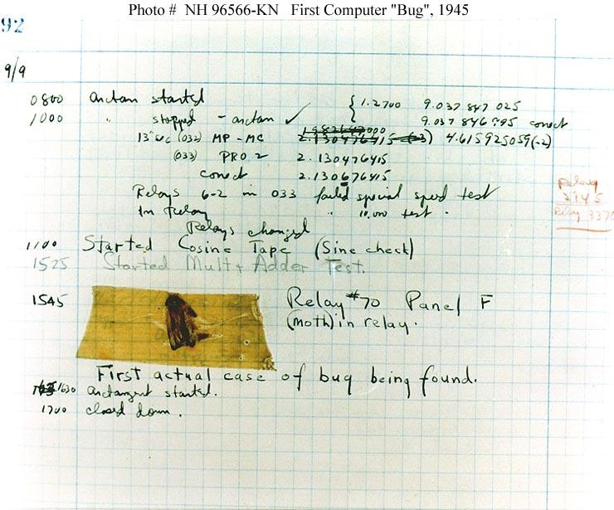
1945 - Working on a prototype of the Mark II, in the summer Grace Murray Hopper finds the first computer “bug,” a moth that had caused a relay failure

Slide 19
Representasi Informasi

Slide 20
Non positional number system
XXVII
III
----- x

Slide 21
Positional number system
d_{n}d_{n-1}d_{n-2}...d₃d₂d₁d₀ =
d_{n}r^{n} + d_{n-1}r^{n-1} + d_{n-2}r^{n-2} .. d₃r³ + d₂r² + d₁r¹ + d₀r⁰
  d = nilai bilangan;
  r = radix (basis bilangan) = jumlah simbol maksimum
  n = posisi bilangan, LSB = posisi ke-0

Slide 22
Mana saja yang tidak benar?
1 + 1 = 10
6 + 7 = 15
10 + 24 = 34
18 + 18 = 30

Slide 23
Masih ada yang tidak benar?
1₍₂₎ + 1₍₂₎ = 10₍₂₎
6₍₈₎ + 7₍₈₎ = 15₍₈₎
10₍₁₀₎ + 24₍₁₀₎ = 34₍₁₀₎
18₍₁₆₎ + 18₍₁₆₎ = 30₍₁₆₎

Slide 24
Representasi Informasi (1)
Converter
Internal Representation
External Representation
Representasi Eksternal adalah suatu cara untuk merepresentasikan dan memanipulasi informasi oleh programmer dengan suatu bahasa pemrograman atau notasi bahasa perintah lainnya ̶ > Agar nyaman bagi programmer (user).
Representasi Internal adalah suatu cara untuk menyimpan dan memanipulasi informasi secara aktual di dalam sistem komputer ̶ > Agar mudah dalam membangun perangkat keras.
Informasi ≈ program & data ≈ deretan bit
→ akses/manipulasi terhadap informasi ≈ akses/operasi (arithmetic/logic) terhadap deretan bit

Slide 25
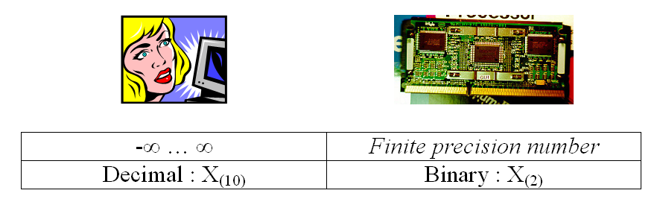
Representasi Informasi (2)
Bilangan berpresisi terbatas berpeluang memunculkan ‘kesalahan’ (dari segi matematika klasik), tetapi bisa menjadi ‘kebenaran’ sebagai konsekuensi logis dari keterbatasan mesin tersebut
Kesalahan yang dapat terjadi:
  overflow error
  underflow error
  unrepresentable

Slide 26
Bit dan Byte
Decimal
Hex
Binary
0
0
0000
1
1
0001
2
2
0010
3
3
0011
4
4
0100
5
5
0101
6
6
0110
7
7
0111
8
8
1000
9
9
1001
A
10
1010
B
11
1011
C
12
1100
D
13
1101
E
14
1110
F
15
1111
Apa bedanya antara bit dan byte ?
1 byte = 8 bit (binary digit)
  Range Binary: 00000000₂ - 11111111₂
  Range Decimal: 0₁₀ - 255₁₀
  Range Hexadecimal: 00₁₆ - FF₁₆
    representasi bilangan basis 16
    Menggunakan karakter ‘0’ - ‘9’ dan ‘A’ - ‘F’
  Range Octal: ... - ...
    000₈ – 377₈

Slide 27
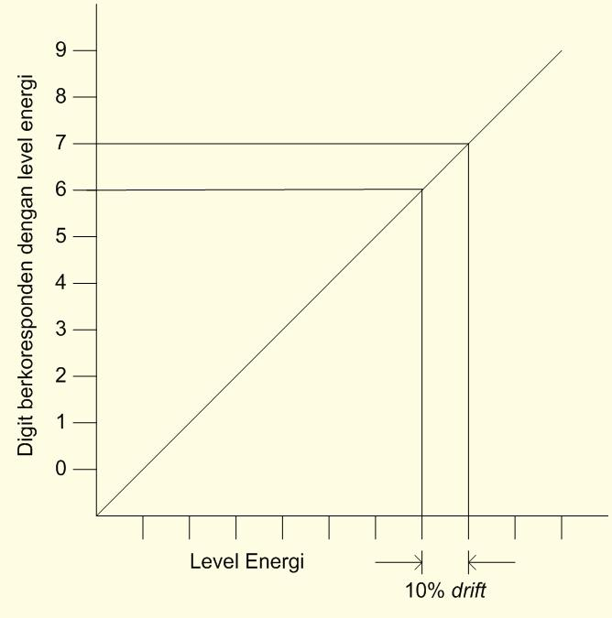
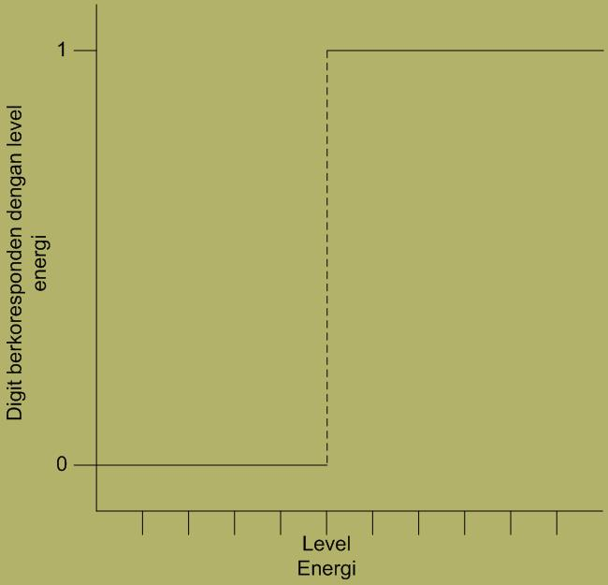
Bilangan Desimal & Biner
Desimal
Biner

Slide 28
Bilangan Biner
0
1
0
3.3V
2.8V
0.5V
0.0V
Representasi bilangan basis 2
  Representasi 15213₁₀ = 11101101101101₂
  Representasi 1,20₁₀ = 1,0011001100110011[0011]…₂
  Representasi 1,5213 X 10⁴ = 1,1101101101101₂ X 2¹³
Implementasi Elektronik
  Mudah untuk disimpan sebagai elemen yang bistable (hanya ada 2 nilai yang berbeda jauh)
  Lebih handal pada wire yang ber-noise dan inaccurate
  Mudah diimplementasikan pada fungsi logika digital

Slide 29
Jenis-Jenis Bilangan Biner
Bilangan bulat biner tak bertanda (unsigned integer)
Bilangan bulat biner bertanda (signed integer)
  Sign/magnitude
  Komplemen 2 (radix complement)
  Komplemen 1 (diminished radix complement)
  Binary Coded Decimal (BCD)
Bilangan pecahan biner (floating point)

Slide 30
Konversi Bilangan: Desimal → Biner
Desimal ke biner
43₁₀ = ...₂
43 : 2 = 21 ; sisa 1 → d₀ (LSB)
21 : 2 = 10 ; sisa 1 → d₁
10 : 2 = 5 ; sisa 0 → d₂
5 : 2 = 2 ; sisa 1 → d₃
2 : 2 = 1 ; sisa 0 → d₄
1 : 2 = 0 ; sisa 1 → d₅
Jadi 43₁₀ = 101011₂
Bagaimana cara konversi dari satu basis bilangan ke basis yang lain?
→ Basis 2, 8, 10, 16

Slide 31
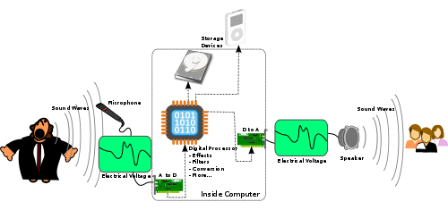
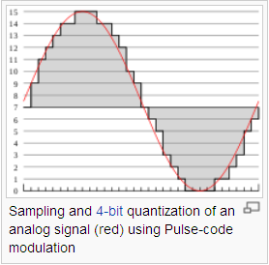
Contoh: digital audio
http://en.wikipedia.org/wiki/Digital_audio

Slide 32
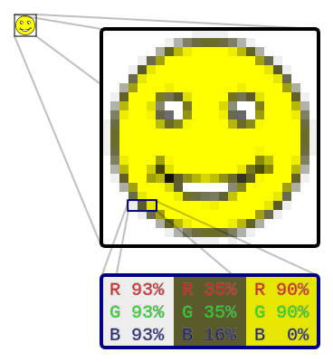
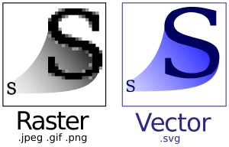
Contoh: raster image
http://en.wikipedia.org/wiki/Raster_image
http://en.wikipedia.org/wiki/Scalable_Vector_Graphics

Slide 33
Sistem Operasi

Slide 34






Thank God there are
Operating Systems!
etc.

Slide 35
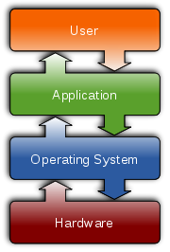
Operating System is…
an interface between hardware and user
responsible for the management and coordination of activities and the sharing of the limited resources of the computer

Slide 36
OS as an…
Extended Machine
  Program that hides the truth about the hardware
  Present nice and simple ‘machine’ to program
  Encapsulate the detail of different physical machines
Resource Manager
  Manage all the pieces of a complex system
  Provide orderly and controlled allocation of resources among various programs (keep track of usage, grant request, mediate conflicting request etc. )

Slide 37
OS Services
OSs offer a number of services to application programs and users.
Applications access these services through application programming interfaces (APIs) or system calls.
The application can request a service from the operating system, pass parameters, and receive the results of the operation.

Slide 38
System call
1. User program traps to the Kernel
2. Operating System determines service number required
3. Operating System locates and calls service procedure.
4. Control is returned to user program

Slide 39
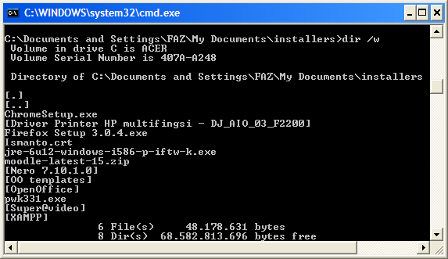
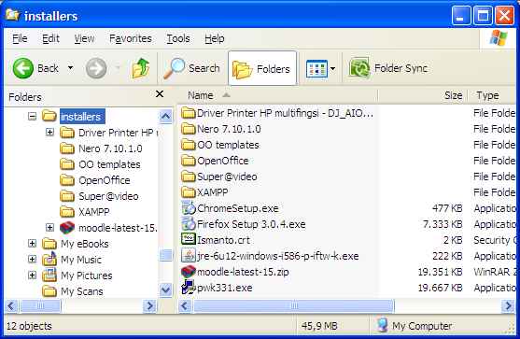
OS-User interaction
Users may also interact with the operating system with some kind of software user interface (UI)
  typing commands by using command line interface (CLI)
  using a graphical user interface (GUI)

Slide 40
OS History
The first computers did not have operating systems
early 1960s → batch processing
Early OS on mainframes & microcomputer → only supported one program at a time
Multitasking OS
…

Slide 41
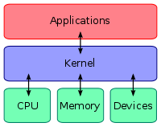
Kernel
Core part (mandatory and common to all other software) of the operating system comprising the minimal set of functionalities
  process management
  memory management
  device management
  inter-process communication
  system calls
  protection
Is always kept in main memory

