Slide 1
Pengantar Teknik Informatika (HUG1M2) Pertemuan 1 dan 2:
Pengantar Kuliah, Overview Informatika
Author : Tjokorda Agung Budi Wirayuda
Program Studi S1 Teknik Informatika
Fakultas Informatika
Universitas Telkom
Semester Ganjil 2015/2016

Slide 2
Pengenalan Mata Kuliah [1]
Deskripsi Mata Kuliah:
  Mata Kuliah Pengantar Teknik Informatika memberikan pengenalan menyeluruh mengenai bidang Informatika yang meliputi: body of knowledge, aplikasi terapan Informatika dalam berbagai bidang, peran informatika dalam masyarakat.
  Mahasiswa diajak untuk mengeksplorasi mengenai bidang Informatika untuk memperluas wawasan dan pengetahuan mengenai disiplin Informatika sebagai pedoman dan pijakan dalam masa studi.

Slide 3
Tujuan Pembelajaran
Memahami posisi Informatika (Computer Science) dalam lingkup ilmu Computing.
Mengetahui kompetensi lulusan dan topik bahasan utama (body of knowledge) Informatika.
Memaparkan konsep dasar dan keterhubungan antar basic building blocks dari sistem terkomputerisasi: data-informasi-pengetahuan, sistem komputer, pemrograman, Internet.

Slide 4
Tujuan Pembelajaran
Memaparkan cara kerja beberapa aplikasi populer terkini berikut ilmu Informatika yang terkait dalam pembuatan dan/atau pengoperasiannya.
Mengidentifikasi masalah yang ada di masyarakat dan mengusulkan pemecahannya dengan memanfaatkan ilmu dan teknologi Informatika.

Slide 5

COK: Tjokorda Agung Budi Wirayuda
Office:
  Biometric Lab. Graduate Building
  E Building 1st Floor
Email:
  cokagung@telkomuniversity.ac.id
  cokagung2001@gmail.com
Telephone:
  +62817421833
Research Interest:
  Computer Vision, System Recognition, Biometric, Watermarking and Data Hiding
Web-site:
  http://cokagung.staff.telkomuniversity.ac.id/
Education:
  S.T in Informatics, STT Telkom ,Indonesia, June, 2005
  M.T in Informatics, Bandung Institute of Technology (ITB), Indonesia, June, 2010
Research Grant:
  Palm-Based Biometric for Person Indentification, 2014, Grant from Indonesian Goverment in Hibah Bersaing Scheme
  Bio-Locker Using Palm Vein Biometrics, 2013, Internal Funding from Telkom University
  Alternative Fire Detection System Base On Visual Data, 2012, Grant from Indonesian Goverment in AUPT Scheme
  Application for Guaranty Ownership and Originality of Medical Image Based using Multiple Watermarking Technique, 2011, Internal Funding from Telkom University

Slide 6
Aturan Perkuliahan
Seragam sesuai dengan ketentuan yang berlaku
Maksimal keterlambatan 30 menit
Menjunjung tinggi Budaya Academic
Kontak kelas:
    Rinaldy : 087821138997
    Komunikasi melalui group MK Kelas

Slide 7
Course Grade
Based on Academic Rule
  A>80
  70>AB <80
  65> B <70
  60>BC <65
  50> C <60
  40> D <50
  E < 40 or because of academic dishonest activity done by student
Grading Composition*
  UTS : 25%
  UAS : 25%
  Kuiz / tugas kecil : 15%
  Tugas Besar : 25%
  Kehadiran dan keaktifan : 10%
Note: grading composition can be change by the lecture

Slide 8
Academic Dishonest
Penyontekan (Cheating)
meliputi tindakan secara nyata menerima dan memberi bantuan di luar kewenangan atau memberi dan menerima keuntungan secara tidak sah dalam segala bentuk pekerjaan akademik.
Plagiat (Plagiarism)
meliputi mencuri atau menyalin kalimat, struktur, gagasan dan/atau pemikiran orang lain dan meniru hasil kerja/karya orang lain, atau usahausaha semacam itu, tanpa menyebutkan sumber atau referensi yang disalin.
Pemalsuan (Falsification)
meliputi pernyataan atau perkataan atau penulisan yang tidak benar atau dokumen palsu terhadap segala kondisi yang terkait dengan akademik seseorang. Tindakan pemalsuan meliputi – namun tidak terbatas pada – pemalsuan tanda tangan, mengubah atau merusak data resmi, memberikan dokumen palsu atau menambah atau mengurangi atau menghapus informasi pada dokumen akademik, atau mengubah pernyataan jawaban ujian atau pekerjaan akademik lain setelah periode ujian atau batas waktu yang ditetapkan.

Slide 9
Intro
Apakah anda semasa SMA merupakan kelas IPA? Atau berasal dari SMK terkait Informatika
Mengapa anda memilih Informatika, Informatika merupakan pilihan ke-?
Apa yang anda ketahui tentang Informatika?
Profesi/pekerjaan apa yang anda impikan setelah lulus kuliah di Informatika?
Jawab pertanyaan tersebut pada link berikut: http://goo.gl/forms/LP7J62J7yl

Slide 10
Renungkan Hal Berikut:
Anda merupakan anak ke- ... Dari ......
Menurut perkiraan anda, berapa pengeluaran sebagai mahasiswa dalam 1 bulan.
Hitung perkiraan biaya yang dikeluarkan orang tua anda agar anda dapat menikmati pendidikan di Perguruan Tinggi
Syukuri jalan yang anda pilih dan berikan yang terbaik serta kerahkan seluruh potensi anda.

Slide 11
Materi Awal:
1. Mengenal Informatika / Computer Science
2. Computing Discipline

Slide 12
Makna Informatika dan Computer Science
Saat ini Informatika ~ Computer Science
  Namun jika dirunut dari “akarnya” keilmuan maka terdapat perbedaan mendasar
  Computer Science : mulai muncul sejak ditemukannya komputer “big goal” memaksimalkan kinerja dan kemampuan komputer dalam melaksanakan suatu pekerjaan
  Informatika = Inform + atika -> sebuah konsep dengan “big goal” meng-automasi informasi yang dibutuhkan oleh manusia. Saat ini komputer merupakan “senjata/tools” utama dalam melakukan automasi.
Untuk selanjutnya Informatika = Computer Science

Slide 13
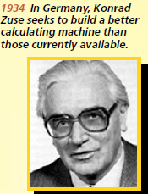
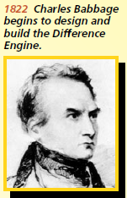
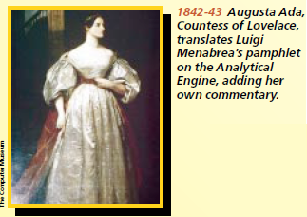
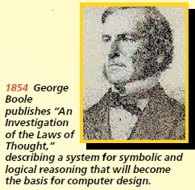
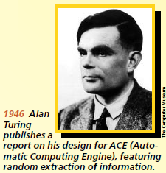
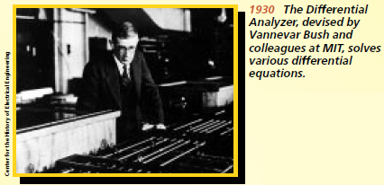
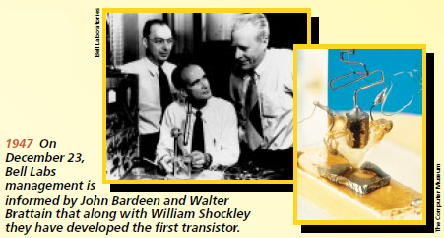
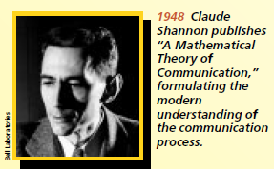
Jika mereka tidak ada …
Source: IEEE-Computer Society, Timeline of Computing History

Slide 14
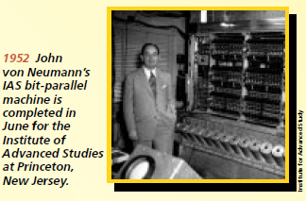
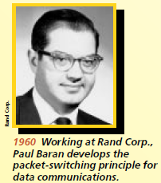
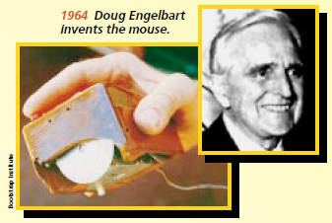
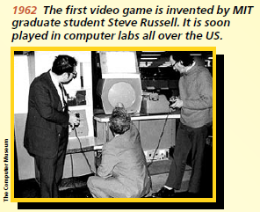
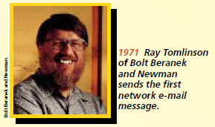
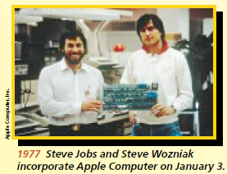
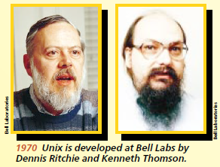
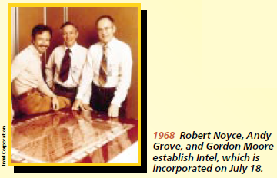
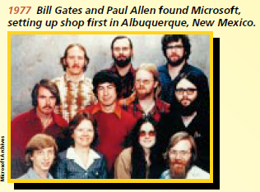

Slide 15
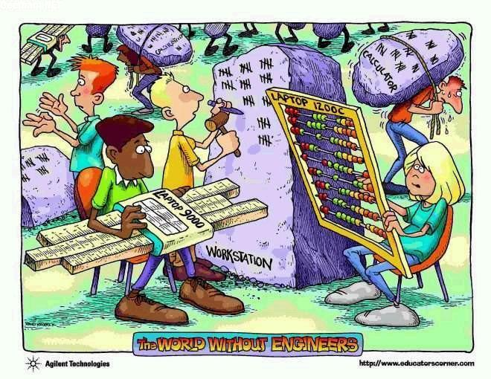

Slide 16
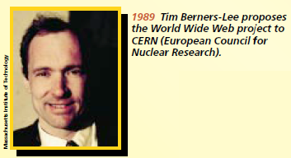
Tim Berners-Lee:
“I think a lot of folks growing up today, when they open a computer, it’s like opening a refrigerator. It’s an appliance, it’s white goods, there’s some stuff in it, if it needs more in it you stock it, you put more music in it, you play it. And If it breaks it’s: ‘Mom, can I have a new one’.”

Slide 17
(still) Tim Berners-Lee:
[http://www.vg247.com/2013/01/28/berners-lee-calls-for-computer-science-education-at-a-younger-age/]
“It’s very important in education with this computer science, which is understanding the philosophy of computer and the mathematics of computing, and learning to really build stuff, it’s very different from the IT class, and I think making that distinction very clear and maybe early on in schools is very important.”

Slide 18
Computing
requiring computers
benefiting from computers
creating computers
goal-oriented activity
Joint Task Force: ACM, AIS, IEEE-CS, Computing Curricula 2005: The Overview Report

Slide 19
Computing includes…
Designing and building hardware and software;
Processing, structuring, and managing various kinds of information;
Doing scientific studies using computers;
Making computer systems behave intelligently;
Creating and using communications and entertainment media;
Finding and gathering information relevant to any particular purpose,
and so on.

Slide 20
Computing as a discipline
Computing also has other meanings that are more specific, based on the context in which the term is used.
  an information systems specialist will view computing somewhat differently from a software engineer
Because society needs people to do computing well, we must think of computing not only as a profession but also as a discipline

Slide 21
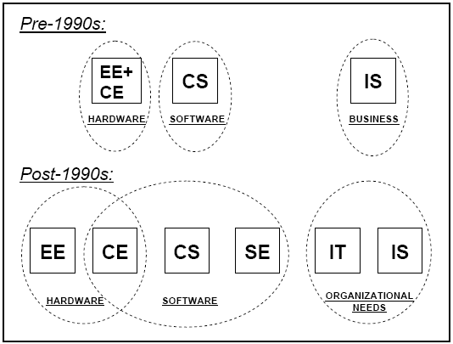
The Landscape of Computing Disciplines

Slide 22
Science & Engineering
Sciences
focuses on creating new knowledge
Engineering
focuses on rigorous methods for designing and building things that reliably do what they’re supposed to do

Slide 23
The emergence of CE
Electrical Eng.
Computer Eng.
Electrical Eng.
the invention of chip-based microprocessors
Electrical Eng.
Computer Eng.
computer chips became basic components of most kinds of electrical devices and many kinds of mechanical devices

Slide 24
The emergence of SE
Computer Science
Software Eng.
Computer Science
producing good software
Computer Science
Software Eng.
SE = CS foundations + human processes + …

Slide 25
The birth of IT
Computers → essential work tools
Networked computer systems → information backbone of organizations
The right mix of knowledge and skills to ensure:
  the organization’s computing infrastructure: suitable & worked reliably
  people in the organization had their computing-related needs met, problems solved, etc.

Slide 26
Let’s describe each of them…
Computer Engineering
Information Systems
Information Technology
Software Engineering
Computer Science
Computing

Slide 27
Computer Engineering
concerned with the design and construction of computers and computer-based systems.
  hardware, software, communications, and the interaction among them
Currently, a dominant area within computing engineering is embedded systems
  devices that have SW and HW embedded in them

Slide 28
Computer Science
spans a wide range
  from its theoretical and algorithmic foundations to cutting-edge developments in robotics, computer vision, intelligent systems, bioinformatics, and other exciting areas
a comprehensive foundation that permits graduates to adapt to new technologies and new ideas

Slide 29
The work of computer scientists
Design and implement software
  programming & supervise other programmers
Devise new ways to use computers
  WWW, data mining, intelligent devices, deciphering DNA etc.
Develop effective ways to solve computing problems
  theoretical background → to determine the best performance possible
  study of algorithms → to develop new approaches that provide better performance

Slide 30
Software Engineering
the discipline of developing and maintaining software systems that:
  behave reliably and efficiently,
  affordable to develop and maintain
  satisfy all the requirements
SE has evolved
  the growing impact of large and expensive software systems in a wide range of situations
  the increased importance of software in safety-critical applications

Slide 31
Information System
Information Technologies
Business Processes
Information needs of business

Slide 32
IS (cont’d)
focuses on the information aspects of information technology
views technology as an instrument for generating, processing, and distributing information

Slide 33
Information Technology
In the broadest sense: often used to refer to all of computing
In academia: undergraduate degree programs that prepare students to meet the computer technology needs of organizations

Slide 34
IT (cont’d)
(Networked) Computer-based systems must work properly, be secure, and upgraded, maintained, and replaced as appropriate.
Graduates: possess the right combination of knowledge and practical, hands-on expertise to take care of both an organization’s information technology infrastructure and the people who use it

Slide 35
The problem space of computing

Slide 36
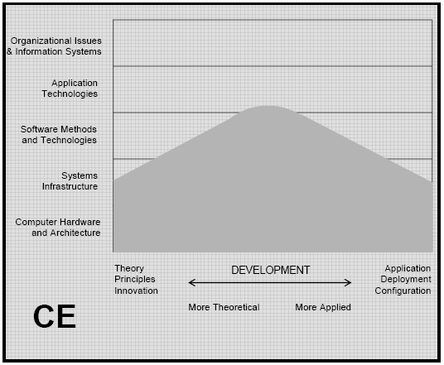
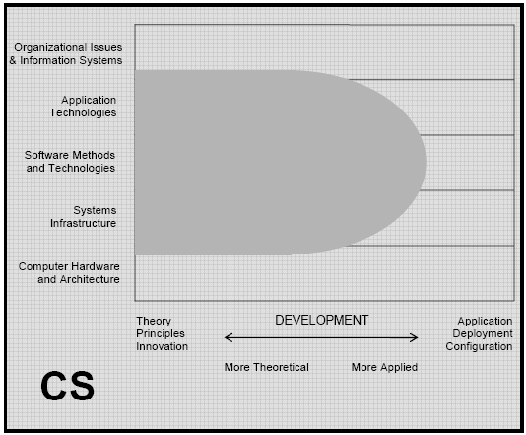
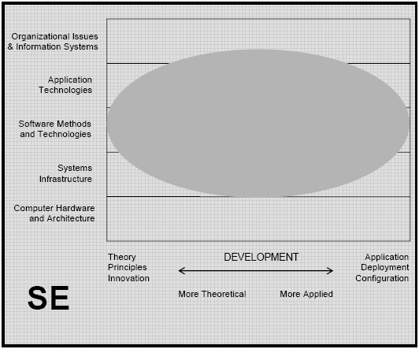
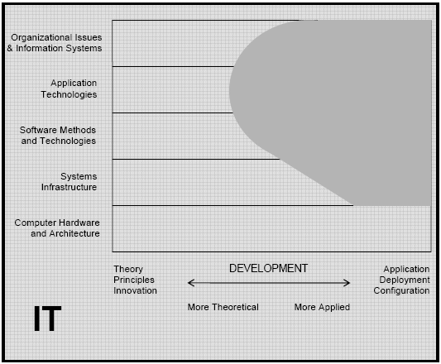
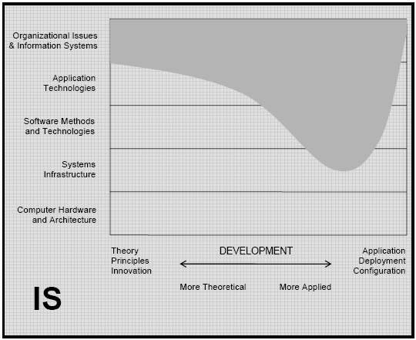
Graphical views: typically do after graduation

Slide 37
Focus on CS
computer scientists:
  care about: down as far as the software that enables devices to work and up as far as the information systems that help organizations to operate
  design and develop all types of software from systems infrastructure (operating systems, communications programs, etc.) to application technologies (web browsers, databases, search engines, etc.)
  create these capabilities but they do not manage the deployment of them & do not select, tailor, or learn to use computing products

Slide 38
Sumber
Slide Pengantar Teknik Informatika, Program Studi S1 Teknik Informatika, Universitas Telkom semester ganjil 2012/2013

