Slide 1
Materi: Cloud computing e-commerce
Telkom University Value : PRIME
Professionalism, Recognition of achievement, Integrity, Mutual respect Entrepreneurship
PROGRAM STUDI S1 TEKNIK INFORMATIKA
FAKULTAS INFORMATIKA
UNIVERSITAS TELKOM
UNIVERSITAS TELKOM

Slide 2
Introduction to Cloud Computing
Prediction in 2020: there will be hundred times more computers in the world than today, many of them will be hundred times more powerfull than now and have hundred times the storage capacity, they will be everywhere, in toys, in books, in clothes, in home electronic etc. This computer will communicate with all their neighbours, mostly without connecting wires, the connection speed will be hundred times faster than now, they will all be controled by software and the software will mostly still be written by people.
Source of article: Grand Challenges for Computing Research, Tony Hoare and Robin Milner, 2005..

Slide 3
Sistematika Penyampaian
Definition of Cloud Computing
Historical of Cloud Computing
Reason using Cloud Computing
Model of Cloud Computing

Slide 4
Cloud Computing Definition [1]
“…computing paradigm where the boundaries of computing will be determined by economic rationale rather than technical limits alone.”
Ramnath Chellappa, 1997
“Cloud computing is the delivery of computing as a service rather than a product, whereby shared resources, software, and information are provided to computers and other devices as a metered service over a network”
Wikipedia
“Model for enabling ubiquitous, convenient, on-demand network access to a shared pool of configurable computing resources (e.g., networks, servers, storage, applications, and services) that can be rapidly provisioned and released with minimal management effort or service provider interaction. “
National Institute of Standards and Technology (NIST)

Slide 5
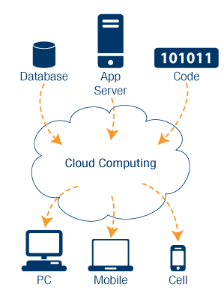
Cloud Computing Definition [2]
is the use of computing resources (hardware and software) that are delivered as a service over a network (typically the Internet).
entrusts remote services with a user's data, software and computation.
End users access cloud-based applications through a web browser or a light-weight desktop or mobile app
while the business software and user's data are stored on servers at a remote location
http://www.syndromic.org/resources/cloud-computing
http://en.wikipedia.org/wiki/Cloud_computing

Slide 6
Historical of Cloud Computing [1]
The idea that computation may be organized as a public utility, like water and electricity, was formulated in 1960s by John McCarthy, a visionary computer scientist who championed mathematical logic in artiﬁcial intelligence. [Cloud Computing: Theory and Practice *, Dan C. Marinescu, 2012]
It is conceivable that August 24, 2006 will go down as the birthday of Cloud Computing, as it was on this day that Amazon made the test version of its Elastic Computing Cloud (EC2) public [Business Week 2006].
This offer, providing flexible IT resources (computing capacity), marks a definitive milestone in dynamic business relations between IT users and providers.
The target of Amazon’s offer were developers, who had no wish to hold their own IT infrastructure, and instead, hired the existing infrastructure from Amazon via Internet.

Slide 7
“Cloud Computing is more an evolution than a revolution.”

Slide 8
Reason using Cloud Computing
Competitive Infrastucture
Cost effective : in electrical cost, equipment cost
Green cloud
Energy saving with higher efficiency on server utility and employe equipment
Collaborate environment without distance limitation
High Peformance Computing
Development of application for mobile environment
More collaborative, intelligence and available

Slide 9
Advantages Cloud Computing for Business [1]
It dramatically lowers the cost of entry for smaller ﬁrms trying to beneﬁt from compute-intensive business analytics that were hitherto available only to the largest of corporations.
It can provide an almost immediate access to hardware resources, with no upfront capital investments for users, leading to a faster time to market in many businesses.
Cloud computing can lower IT barriers to innovation, as can be witnessed from the many promising startups, from the ubiquitous online applications such as Facebook and Youtube to the more focused applications like TripIt (for managing one's travel) or Mint (for managing one’s personal ﬁnances).
Notes:
Cloud computing — The business perspective
Sean Marston, Zhi Li,Subhajyoti Bandyopadhyay, Juheng Zhang, Anand Ghalsasi
University of Florida

Slide 10
Advantages Cloud Computing for Business [2]
Cloud computing makes it easier for enterprises to scale their services – which are increasingly reliant on accurate information – according to client demand.
Cloud computing also makes possible new classes of applications and delivers services that were not possible before. Examples include (a) mobile interactive applications that are location-, environment- and context-aware and that respond in real time to information provided by human users, nonhuman sensors (e.g. humidity and stress sensors within a shipping container) or even from independent information services (e.g. worldwide weather data)
Notes:
Cloud computing — The business perspective
Sean Marston, Zhi Li,Subhajyoti Bandyopadhyay, Juheng Zhang, Anand Ghalsasi
University of Florida

Slide 11
Stake Holder in Cloud Computing
Consumer
Provider
Enabler
Regulator
Comsumer :In a cloud computing environment, the consumers are effectively subscribers, who now only purchase the use of the system from the providers on an operational expense basis.
Provider :Cloud computing service providers own and operate cloud computing systems to deliver service to third parties. The providers will perform the maintenance and the upgrades on the system which consumers were in charge of when they owned the systems. They will
Enabler” We introduce the term ‘enablers’ to describe those organizations that will sell products and services that facilitate the delivery, adoption and use of cloud computing.
Regulator: Pervadesacross the other stakeholders

Slide 12
Model of Cloud Computing: Abstraction

Slide 13
Delivery Model [1]
Software as a Service (SaaS)- In the SaaS layer, the Cloud service provider hosts the software upon their servers. It can be defined as a in model in which applications and softwares are hosted upon the server and made available to customers over a network.
Platform as a Service (PaaS)- PaaS provides the combination of both, infrastructure and application. Hence, organisations using PaaS don’t have to worry for infrastructure nor for services.
Infrastructure as a Service (IaaS)- The IaaS layer offers storage and infrastructure resources that is needed to deliver the Cloud services. It only comprises of the infrastructure or physical resource.

Slide 14
Delivery Model [2]
http://blogs.technet.com/b/yungchou/archive/2010/12/17/cloud-computing-concepts-for-it-pros-2-3.aspx

Slide 15
Delivery Model [3]
SaaS: Microsoft Office 365 , Google Doc, WordPress, Drupal Content Management System
PaaS : Windows Azure Platform, IBM BlueMix, Apache Hadoop, Google App Engine
IaaS : Penyedia layanan data center, web-hosting, dll

Slide 16
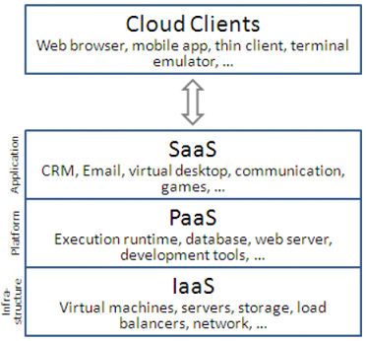
SaaS – PaaS - IaaS
http://en.wikipedia.org/wiki/Cloud_computing
http://kasunpanorama.blogspot.com/2010/07/understanding-cloud-computing-feel-easy.html

Slide 17
Deployment Model [1]
Private Cloud – The cloud infrastructure is operated solely for an organisation. In simple words we can say that such cloud models are dedicated to a third party who wish to use. It may be managed by the Cloud Computing provider or any other third party.
Community Cloud – This cloud infrastructure is shared by several organisations.
Public Cloud – The cloud infrastructure is made available to the general public or a large industry group and is owned by the Cloud providers.
Hybrid Cloud – It’s a combination of two or more clouds (private, community or public).
https://en.wikipedia.org/wiki/Cloud_computing#Infrastructure_as_a_service_.28IaaS.29

Slide 18
Deployment Model [2]

Slide 19
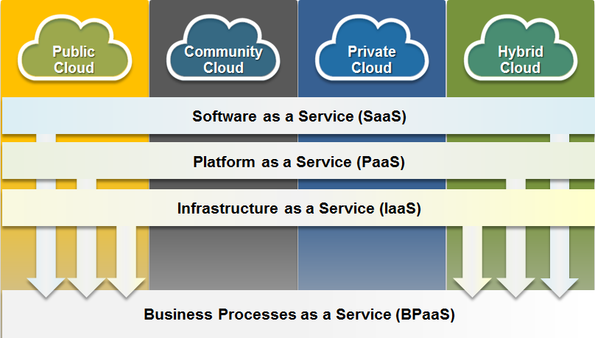
Cloud Computing

Slide 20
Attribute of Cloud Computing [1]
“Pay-Per-Use” Billing Model – Cloud usage policy defines that you will be billed for cloud resources as you use them. This pay-as-you-go model means usage is metered and you pay only for what you consume. Users have to pay only for the resources they use, ultimately helping them keep their costs down. Because this pay-for-what-you-use model resembles the way electricity, fuel and water are consumed, it’s sometimes referred to as utility computing.
Mobility - Userss can access information wherever they are, rather than being dependent on the infrastructure.
Elasticity – The cloud is elastic, meaning resources, softwares and the infrastructure can be scaled up or decreased, depending upon the need.
Service Based Usage Model – Availability of large computing infrastructure and the services on need basis.
www.sourcedigit.com

Slide 21
Attribute of Cloud Computing [2]
On-demand self-service. A consumer can unilaterally provision computing capabilities, such as server time and network storage, as needed automatically without requiring human interaction with each service provider.
Broad network access. Capabilities are available over the network and accessed through standard mechanisms that promote use by heterogeneous thin or thick client platforms (e.g., mobile phones, tablets, laptops, and workstations).
Resource pooling. The provider's computing resources are pooled to serve multiple consumers using a multi-tenant model, with different physical and virtual resources dynamically assigned and reassigned according to consumer demand. ...
Rapid elasticity. Capabilities can be elastically provisioned and released, in some cases automatically, to scale rapidly outward and inward commensurate with demand. To the consumer, the capabilities available for provisioning often appear unlimited and can be appropriated in any quantity at any time.
Measured service. Cloud systems automatically control and optimize resource use by leveraging a metering capability at some level of abstraction appropriate to the type of service (e.g., storage, processing, bandwidth, and active user accounts). Resource usage can be monitored, controlled, and reported, providing transparency for both the provider and consumer of the utilized service.
National Institute of Standards and Technology^{[4]}

Slide 22
Cloud Companies

Slide 23
Pros and Cons of Cloud Computing

Slide 24
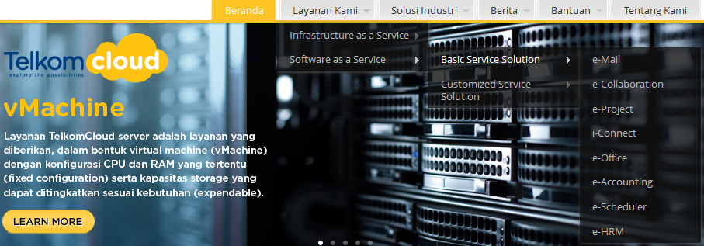
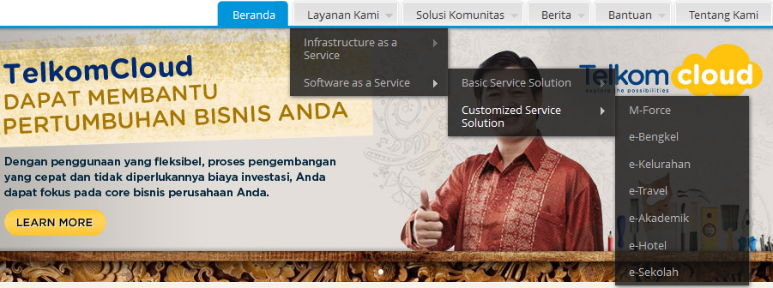
http://www.telkomcloud.com

Slide 25
Reference
[1] Dan C. Marinescu, “Cloud Computing: Theory and Practice ∗”, Computer Science Division, Department of Electrical Engineering & Computer Science, University of Central Florida, Orlando, FL 32816, USA
[2] Sean Marston, Zhi Li,Subhajyoti Bandyopadhyay, Juheng Zhang, Anand Ghalsasi ,” Cloud computing — The business perspective”, University of Florida
[3] White Paper Cloud Computing. Alternative sourcing strategy for business ICT. T System Enterprise Services GmbH, Germany
[4] www.sourcedigit.com
[5] www.wikipedia.org

Slide 26
Introduction to E-Commerce
Imagine if all your needs can be purchased via the internet. Whether it's daily necessities, clothes, cars, houses, health facilities, hotel reservations, etc all you can find on the internet. You will get best deal transaction with the lowest price, fast delivery simply by clicking on a web-site through a smart phone device.

Slide 27
Sistematika Penyampaian
Definition of E-Commerce
Brief Histori of E-Commerce
Reason using E-Commerce
Model of E-Commerce
Future of E-Commerce

Slide 28
Definition of E-Commerce
E-commerce (electronic commerce or EC) is the buying and selling of goods and services, or the transmitting of funds or data, over an electronic network, primarily the Internet.
[http://searchcio.techtarget.com/definition/e-commerce]
Electronic commerce, commonly written as e-commerce, is the trading in products or services using computer networks, such as the Internet.
[https://en.wikipedia.org/wiki/E-commerce]
Electronic commerce (e-commerce): sharing business information, maintaining business relationships, and conducting business transactions through the use of telecommunications networks
[E-Commerce and E-Business The Evolving Internet Economy, Digital World, Beekman]

Slide 29
Brief History of E-Commerce : Time Line
1970’s
1980’s
2000’s
Credit Card
EDI (Electronic Data Interchange),
EFT ( Electronic Fund Transfer)
ATM (Automated Teller Machine)
Telephone Banking, Airline Reservation System
Company Overing Service through World Wide Web
1990’s
“dot-com” era
2010’s
Anything can sale via Internet

Slide 30
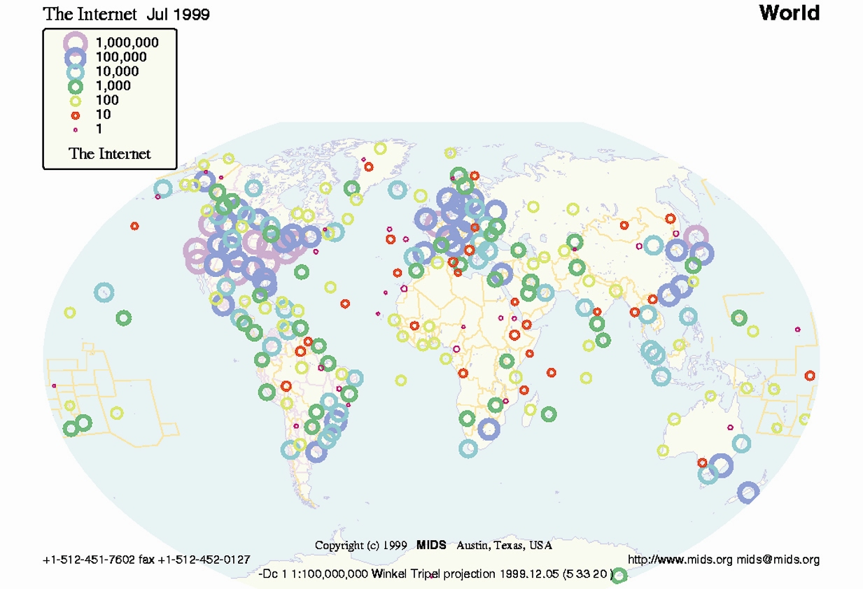
Brief History of E-Commerce [1]
Since the development of the World Wide Web and the beginning of the commercial use of the Internet in the early 1990s, e-commerce has become Internet based.

Slide 31
Brief History of E-Commerce [2]
Jeff Bezos created a business model that leveraged the Internet’s unique ability to deliver huge amounts of information rapidly and efficiently.
He founded Amazon.com, Inc. with high ambitions in 1994.
Amazon opened its virtual doors in July 1995 with a mission to use the Internet to transform book-buying into the fastest, easiest, and most enjoyable shopping experience possible.

Slide 32
Brief History of E-Commerce [3]
The dot-com bust of 2000-2001 has led some people to question the future of e-commerce.
One principal cause of the bust was excessive speculation.
When these start-up companies closed their doors, half a million people lost their jobs.
Despite this e-commerce remains a legitimate way for businesses to make money and to save money.
The term e-business is sometimes interchanged with the term e-commerce to refer to a broader concept, where companies are able to reorganize internal business processes, foster business alliances, and create new consumer-oriented products and services.

Slide 33
Brief History of E-Commerce [4]
Recent surveys indicate that there are several thousand Internet-based companies—dot coms—that make up only 10 to 15 percent of Internet economy revenue and jobs.
E-commerce in the United States and Europe is particularly strong—in the trillions in U.S. dollars.
“E-commerce is all about cycle time, speed, globalization, enhanced productivity,
reaching new customers and sharing knowledge across institutions
for competitive advantage.
—Lou Gerstner, IBM’s CEO

Slide 34
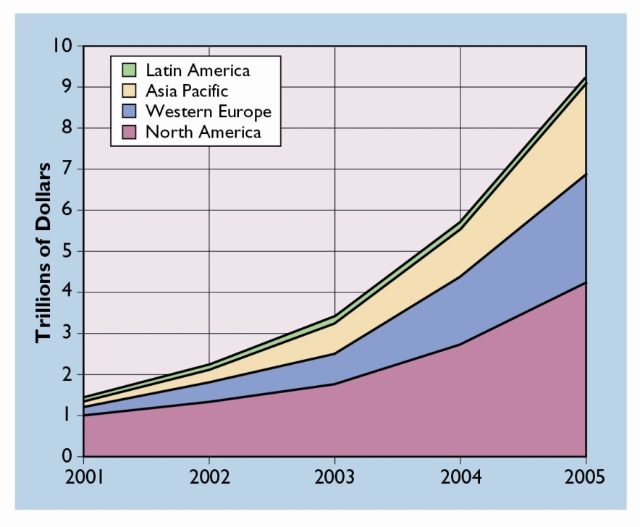
Brief History of E-Commerce [5]
E-commerce currently accounts for about 5 percent of the total U.S. economy.
Internet-related revenue growth is about 20 times the growth rate of the overall U.S economy.
Compared with U.S. business overall, a company selling goods and services over the Internet is:
3 times more likely to see expense reductions;
2.5 times more likely to see productivity gains; and
more than 2.5 times more likely to see market share growth and penetration of new markets.
Historical and projected commerce growth from 2000 to 2006

Slide 35
Reason using E-Commerce
For Organization:
Global Market
Cost Reduction
Extended Operation : 24 / 7 / 365
Improve Customer Relation
For Customer:
More choice of product and service
Lowest Price and Simplicity
Instant Delivery
Information avaibility

Slide 36
Model of E-Commerce [1]
B2B : Business-to-Business
B2B is an interorganizational information system in which a company handles transactions within its own value chain or with other businesses and organizations.
B2B is sometimes referred to as business-to-employee (B2E), when the focus is primarily on handling the activities that take place within an organization.
B2C : Business-to-Customer
Retailing transactions between a company and individual customers are B2C transactions.
B2C is the most visible aspect of e-commerce from a consumer’s point of view.
C2C : Customer-to-Customer
Individuals selling and buying directly with each other via a Web site are using C2C.

Slide 37
Model of E-Commerce [2]

Slide 38
Future of E-Commerce
Slide about Future of E-Commerce reference to presentation slide by Divante
[http://divante.co/company/]
Future Market
Omnichannel
Delivery Strategy
Shopping Mall
Digital Content
Payment, Security, Paltform

Slide 52
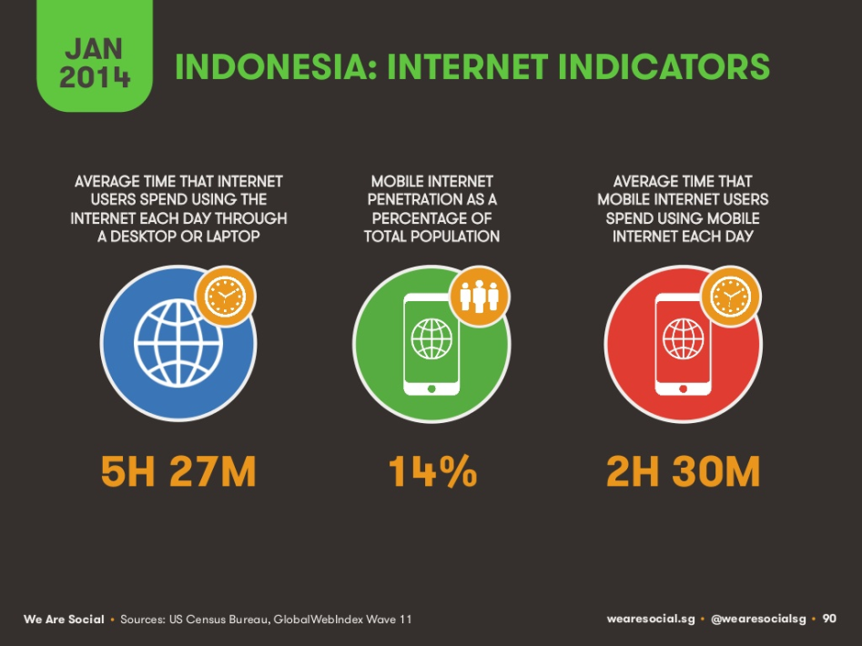
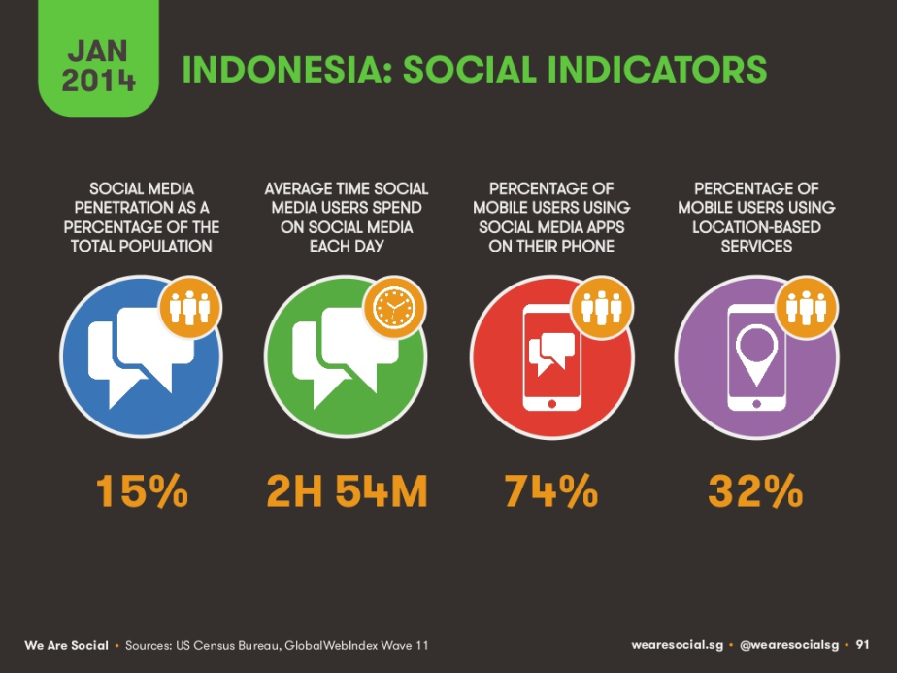
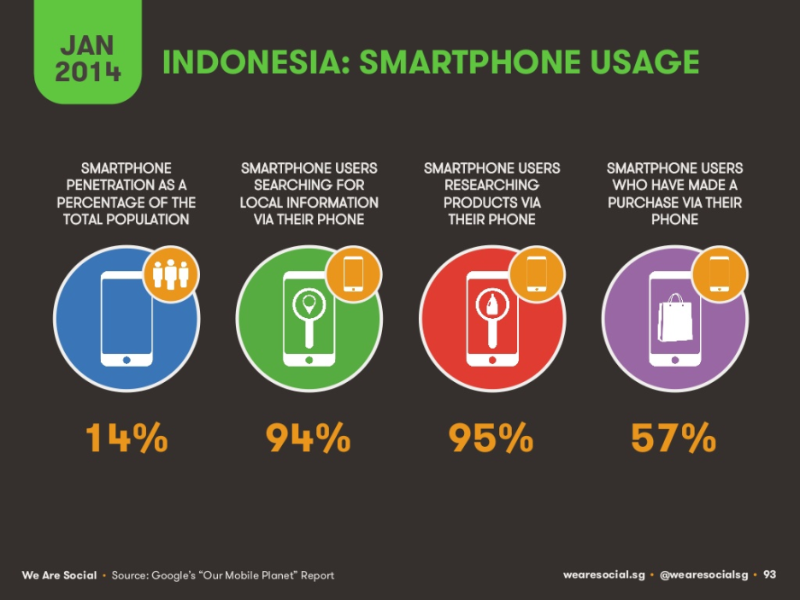
Potensi E-Commerce di Indonesia

Slide 53
Reference
E-Commerce and E-Business The Evolving Internet Economy, Digital World, Beekman http://wps.prenhall.com/bp_beekman_tomtech_10/183/46879/12001253.cw/-/t/index.html
https://id.techinasia.com/statistik-pengguna-internet-di-dunia-dan-indonesia-slideshow/
divanteltd

