Slide 1
HUG1I2 Konsep Pengembangan Sains dan Teknologi Pertemuan 8: Innovation
Author-Tim Dosen
Prodi S1 Teknik Informatika

Slide 2
What is Innovation
Innovation is the process and outcome of creating something new, which is also of value.
Innovation involves the whole process from opportunity identification, ideation or invention to development, prototyping, production marketing and sales, while entrepreneurship only needs to involve commercialization (Schumpeter)

Slide 3
What is innovation
Schumpeter argued that innovation comes about through new combinations made by an entrepreneur, resulting in
a new product,
a new process,
opening of new market,
new way of organizing the business
new sources of supply

Slide 4
Dimensions of innovation
There are several types of innovation
Process, product/service, strategy,
which can vary in degree of newness:
Incremental to radical,
and impact:
- Continuous to discontinuous
Konsep Pengembangan Sains dan Technology

Slide 5
Drivers for innovation
Financial pressures to reduce costs, increase efficiency etc
Increased competition
Shorter product life cycles
Value migration
Stricter regulation
Industry and community needs for sustainable development
Increased demand for accountability
Demographic, social and maket changes
Rising customer expectations regarding service and quality
Changing economy
Greater availability of potentially useful technologies coupled with a need to exceed the competition in these technologies

Slide 6
New developments in innovation raises new issues and problems
Greater emphasis on commercializing scientific discoveries, particularly in IT and the bio-sciences
Speed and potential value of scientific progress leads to emphasis on solid and well-designed portfolios of research projects
Konsep Pengembangan Sains dan Technplpgy

Slide 7
Universites as active drivers of innovation: Academic entrepreneurship and the entrepreneurial university
University-industry partnerships
Increased search for radical innovation and top-line growth.
Konsep Pengembangan Sains dan Technplpgy

Slide 8
Six Tips yo Help You to Enhance Creativity
Open Your Mind - Have one new experience every day; no matter how small. New experiences stimulate the brain and help you make new and original connections; critical for boosting breakthroughs.
Diversify - Involve others in your problem-solving efforts who bring a different perspective or cultural experience than yours.
Mental Floss – Relax; Stress, exhaustion, boredom and even pain can block our pathways to creativity.

Slide 9
Stop Looking For the Right Answer - Look for many right answers.
Discover Your Creative Rhythm - Start paying attention to when you get your best ideas.
Health Makes Wealth - Regular exercise not only benefits your body, it boosts brain performance as well.
Innovative Thinking: Six Simple

Slide 10
A suggested Innovation Framework
Seek Novelty in Design
Identify Problems and/or Opportunities
Seek Opportunities
Find what you love to do
Open your mind
Mental Floss
Discover your creative rhythm
Health Makes Wealth
Challenge all assumptions
Become an expert in a field you love
Become passionate about your field
Diversify
Stop looking for the right answer; look for many right answers
Just Do It
Seek opportunities to innovate
Seek novelty in design
Set Goals and Objectives
Do not be afraid to fail
Take risks
Move your idea forward
Define clearly your goals and objectives

Slide 11
Examples of Innovations
Instant Coffee Contact Lenses
Cell Phone Toyota’s Hybrid Car
Plasma Screen T.V. Pop-Up Toaster
Tea Bag Band-Aid
Disposable Camera Drive-In Theatre
Roller Blades Barbie Doll
Canned Beer Teddy Bear

Slide 14
SOME SUCCESFUL INNOVATION CASES FROM UNIVERSITY RESEARCH

Slide 15
Mr. Linus Thorvalds developed the Linux system in the University of Helsinki in the early 1990s.
He published Linux by using the GPL, General Public License, and transferred it to Internet free for everybody. Linux has become very popular in the whole world.

Slide 16
ONLINE GAME HABBO HOTEL, FINLAND
Virtual game world attracts young people
Sulake Habbo Hotel is an online game world aimed at young people where multiple users can play simultaneously. In Habbo Hotel, users create virtual characters who experience adventures in the hotel along with other characters.
www.sulake.fi

Slide 17
SOME SUCCESFUL INNOVATION CASES FROM INDUSTRY and UNIVERSITY RESEARCH COLLABORATION

Slide 18
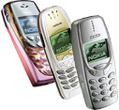
NOKIA
The Finnish Information Technology company.
World leader in mobile phones.

Slide 20
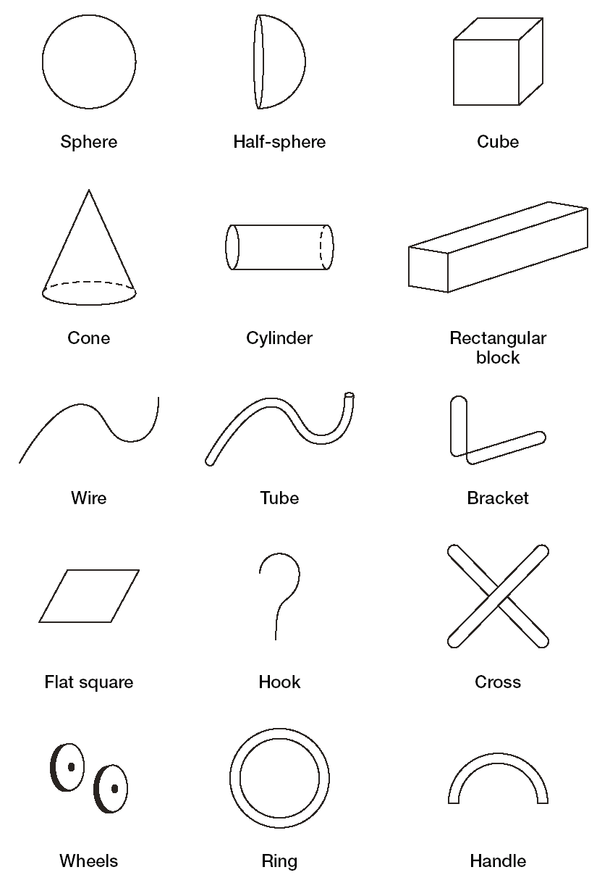
Exercise Creativity for Innovations
Finke’s Object Creation Task

Slide 21
Now, create your own object
Construct a new object using these three parts
Should be interesting and possibly useful
Should NOT correspond to a familiar object
Vary size, position, orientation, and materials of the parts
NOT the shape (except for wire and tube)
When you’re ready, draw a picture of it

Slide 22
You’ve made a preinventive form
For each of these categories, imagine how your object could be used
Furniture
Transportation
Toys or games
Personal items

Slide 23
Object examples

