Slide 1
Konsep Pengembangan Sains dan Teknologi (HUGI12)
07- Metoda Rekayasa

Slide 2
The Engineering Design Process and the Scientific Method
While scientists study how nature works, engineers create new things.
Because engineers and scientists have different objectives, they follow different processes in their work.
Scientists perform experiments using the scientific method; whereas, engineers follow the creativity-based engineering design process.
www.sciencebuddies.org

Slide 3
Analysis problems vs Design problems: an example
“Determine the maximum height of a snowball given an initial velocity and release height.”
an analysis problem; it has only one answer
"Design a device to launch a 1-pound snowball to a height of at least 160 feet“
design problem; the solution is open ended, since there are many possible devices that can launch a snowball to a given height
Seyyed Khandani, ENGINEERING DESIGN PROCESS, 2005, www.saylor.org

Slide 4
Problem solving
The engineering design process is a series of steps that engineers follow to come up with a solution to a problem.
Many times the solution involves designing a product (like a machine or computer code) that meets certain criteria and/or accomplishes a certain task.
Involves designing, building, and testing something
www.sciencebuddies.org

Slide 5
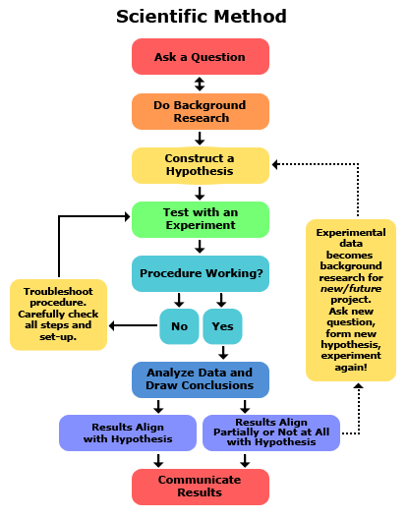
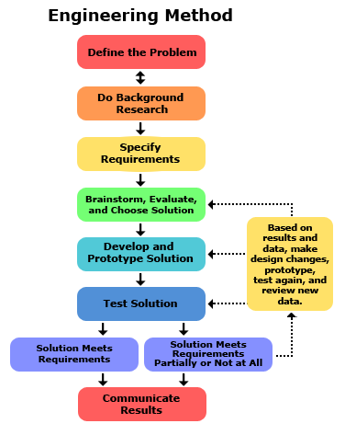
http://www.sciencebuddies.org/engineering-design-process/engineering-design-compare-scientific-method.shtml

Slide 6
Iteration
Engineers do not always follow the engineering design process steps in order, one after another.
It is very common to design something, test it, find a problem, and then go back to an earlier step to make a modification or change to your design.
This way of working is called iteration, and it is likely that your process will do the same!
www.sciencebuddies.org

Slide 7
Iteration: example
The Wright brothers' airplane did not fly perfectly the first time.
They began a program for building an airplane by first conducting tests with kites and then gliders.
Before attempting powered flight, they solved the essential problems of controlling a plane's motion in rising, descending, and turning.
They didn't construct a powered plane until after making more than 700 successful glider flights.
Design activity is therefore cyclic or iterative in nature, whereas analysis problem solving is primarily sequential
Seyyed Khandani, ENGINEERING DESIGN PROCESS, 2005, www.saylor.org

Slide 8
1. Define the Problem
The engineering design process starts when you ask the following questions about problems that you observe:
What is the problem or need?
Who has the problem or need?
Why is it important to solve?
[Who] need(s) [what] because [why].
www.sciencebuddies.org

Slide 9
How to start?
One really great way to start the need-finding process is to make a "bug list."
Think about all of the things that bug you or bug other people around you. Write them down.
They may seem like small and silly problems, but they can spark ideas for a project or lead to larger problems that you may not have noticed otherwise.
Seyyed Khandani, ENGINEERING DESIGN PROCESS, 2005, www.saylor.org

Slide 10
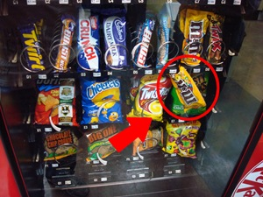
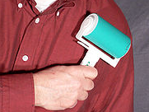
Types of potential problem
Unsolved Problems
Problem: food getting stuck in a vending machine
Need: a product that can be used to remove stuck foods from vending machines or a new vending machine that makes it impossible for food to get stuck
Poorly Solved Problems
Problem: cat or dog hair getting stuck on clothing
Current solution: the lint brush
Need: to make the lint brush more effective at removing hair from clothing or to design something better than the lint brush
whereisant.net/2008/06/gambling-with-an-office-vending-machine/
en.wikipedia.org/wiki/Lint_remover
www.sciencebuddies.org

Slide 11
Develop a Problem Statement
Formulate the problem in clear and unambiguous terms
Example: "Design a better mousetrap“
What is the definition of “better”?
Should be compared with existing mousetrap
Seyyed Khandani, ENGINEERING DESIGN PROCESS, 2005, www.saylor.org

Slide 12
Example (cont’d)
Modify the problem statement:
“A Better Mousetrap: Certain rodents such as the common mouse are carriers and transmitters of an often fatal virus, the Hantavirus. Conventional mousetraps expose people to this virus as they handle the trap and dispose of the mouse. Design a mousetrap that allows a person to trap and dispose of a mouse without being exposed to any bacterial or viral agents being carried on the mouse.”
Seyyed Khandani, ENGINEERING DESIGN PROCESS, 2005, www.saylor.org

Slide 13
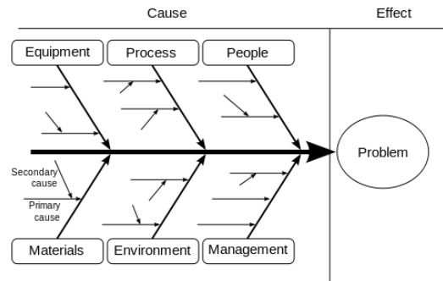
Tool: Ishikawa Diagram
http://en.wikipedia.org/wiki/Ishikawa_diagram

Slide 14
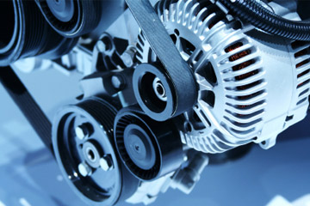
Root cause: 5 whys
The vehicle will not start. (the problem)
Why? - The battery is dead. (first why)
Why? - The alternator is not functioning. (second why)
Why? - The alternator belt has broken. (third why)
Why? - The alternator belt was well beyond its useful service life and not replaced. (fourth why)
Why? - The vehicle was not maintained according to the recommended service schedule. (fifth why, a root cause)
http://auto.howstuffworks.com/under-the-hood/diagnosing-car-problems/
mechanical/5-signs-alternator-problems.htm
http://en.wikipedia.org/wiki/Five_whys

Slide 15
2. Do Background Research
Learn from the experiences of others
this can help you find out about existing solutions to similar problems, and avoid mistakes that were made in the past.
Do background research in two major areas:
Users or customers
Existing solutions
www.sciencebuddies.org

Slide 16
3. Specify Requirements
Design requirements state the important characteristics that your solution must meet to succeed.
One of the best ways to identify the design requirements for your solution is to analyze the concrete example of a similar, existing product, noting each of its key features.
www.sciencebuddies.org

Slide 17
Design requirements
State the important characteristics that your solution must meet to be successful.
Example: you want to design a better grocery store bag.
A successful bag would use less expensive material than existing bags and function properly as a grocery bag.
www.sciencebuddies.org

Slide 18
Examples: the bag needs to …
Have handles so that shoppers can carry multiple bags of groceries.
Hold up to five pounds of food without breaking.
Cost less than five cents to make.
Collapse so that it can be stored in large quantities at grocery stores.
www.sciencebuddies.org

Slide 19
Another example: degradable plastic
www.oxium.net
eco-buddies.com

Slide 20
Effective design requirements are:
Needed to solve your design problem.
If it is not needed, leave it out.
Feasible. A good design requirement is not just a wish.
Ask if you have the time, money, materials, tools, and knowledge to make it happen.
Subject to change as you do more research and design.
Always ask yourself, is this requirement needed and feasible? If your answers to those questions change, it is OK to change the requirement.
www.sciencebuddies.org

Slide 21
4. Brainstorm Solutions
DON'T SETTLE FOR YOUR FIRST IDEA!
There are always many good possibilities for solving design problems.
If you focus on just one before looking at the alternatives, it is almost certain that you are overlooking a better solution.
Good designers try to generate as many possible solutions as they can.
www.sciencebuddies.org

Slide 22
Ideation (idea generation)
The creative process of developing ideas
Methods of ideation include:
Examining existing solutions
Creating and using analogies
Conducting brainstorming sessions
Sketching and doodling
www.sciencebuddies.org

Slide 23
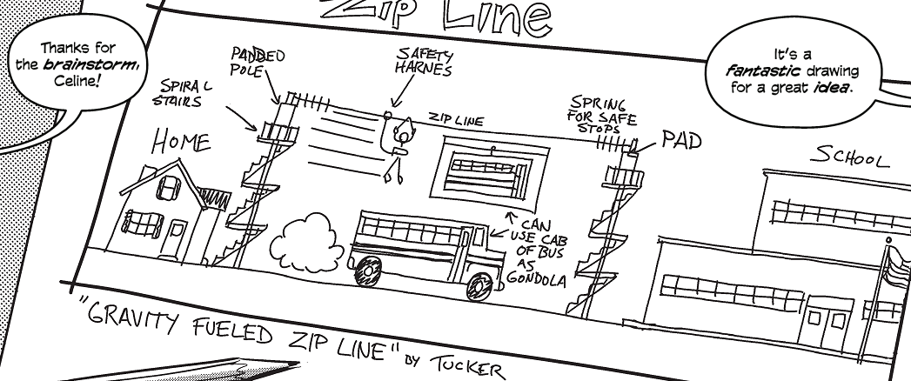
Sketching
Howtoons & The Lemelson-MIT Inventeams, Seeing the Future!: A Guide to Visual Communication, 2010

Slide 24
Ideation (cont’d)
One key rule for successful ideation is NO LIMITS.
Start huge.
Don't confine yourself to only one or two great ideas, and don't be afraid to think outside the box.
No solutions are impossible during the ideation phase, so consider even the craziest of ideas.
www.sciencebuddies.org

Slide 25
Case of Casey
Casey Golden, age 13, did this when he invented the BIOtee.
Casey noticed that discarded and broken wooden golf tees littered golf courses, damaging the blades and tires of lawn mowers.
He decided to design a new biodegradable tee.
After experimenting with different mixtures, he devised a recipe made of recycled paper fiber and food byproducts coated with a water-soluble film. When the film is broken, moisture in the ground breaks down the tee within 24 hours.
As a result of his creative efforts, Casey's family started a company to manufacture BIOtees producing several million tees per year.
Seyyed Khandani, ENGINEERING DESIGN PROCESS, 2005, www.saylor.org

Slide 26
Casey Golden
Inventor & Co-founder Bio Dynamics, Ltd.
Produced our invention of the Bio-degradable golf tee (BioTees (tm)). Designed to save the 40,000+ trees per year that are chopped down to produce the current wooden golf tees. These tees have two patents and are made up of primarily recycled materials (newspaper) and a bonding agent that is a by-product of the beverage industry (a type of sugar).
www.golfimport.ch/en/everythingelse/tees/bio-tees-2-34-0009152/
www.linkedin.com/in/caseygolden

Slide 27
5. Choose the Best Solution
Look at whether each possible solution meets your design requirements.
Some solutions probably meet more requirements than others.
Reject solutions that do not meet the requirements.
www.sciencebuddies.org

Slide 28
How to choose
Requirements
Nice to Haves, Desirables
Universal Design Criteria
Use Decision Matrix
Requirements and Criteria | Solution #1 | Solution #2 | Solution #3 | Solution #4
Your requirement #1 | 1 | 2 | 2 | 1
Your requirement #2 | 1 | 1 | 2 | 1
Your requirement #3 | 2 | 2 | 2 | 2
Other criteria (nice-to-have and universal criteria) | 1 | 1 | 2 | 1
Total Points | 5 | 6 | 8 | 5
www.sciencebuddies.org

Slide 29
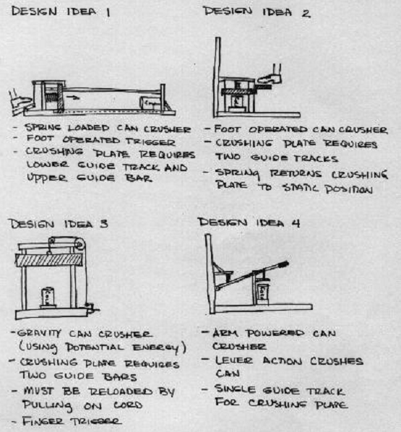
Example: Aluminum Can Crusher
Seyyed Khandani, ENGINEERING DESIGN PROCESS, 2005, www.saylor.org

Slide 30
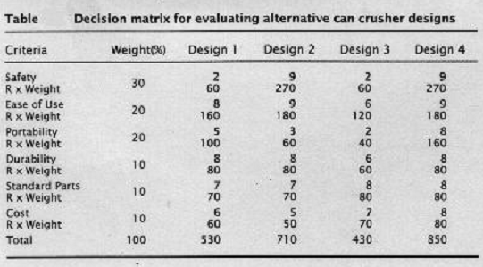
Seyyed Khandani, ENGINEERING DESIGN PROCESS, 2005, www.saylor.org

Slide 31
6. Develop the Solution
Development involves the refinement and improvement of a solution, and it continues throughout the design process, often even after a product ships to customers.
www.sciencebuddies.org

Slide 32
Methods of Development
Drawings
Modeling: scale model, computer model, …
Prototyping
Storyboards
Analysis, Running the Numbers
www.sciencebuddies.org

Slide 33
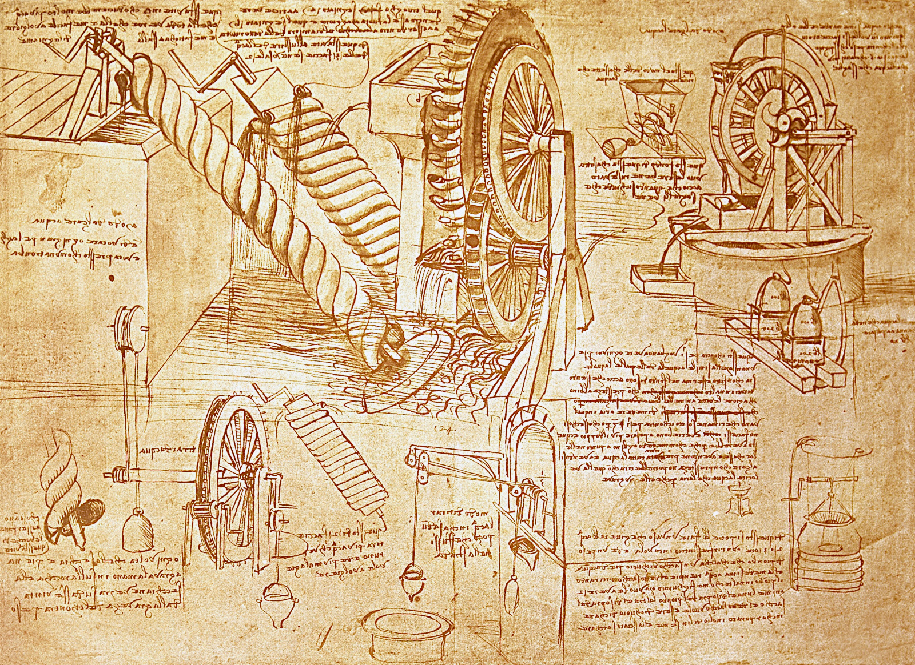
a 1503 page from Leonardo da Vinci's notebooks depicts his work on water wheels and Archimedes pumps
www.sciencebuddies.org

Slide 34
7. Build a Prototype
A prototype is an operating version of a solution.
Often it is made with different materials than the final version, and generally it is not as polished.
Prototypes are a key step in the development of a final solution, allowing the designer to test how the solution will work.
www.sciencebuddies.org

Slide 35
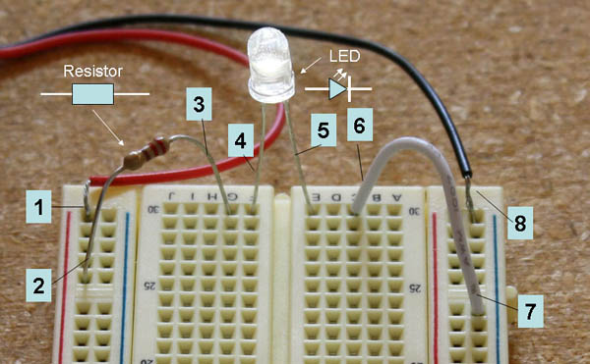
Electronic prototype using breadboard
www.sciencebuddies.org

Slide 36
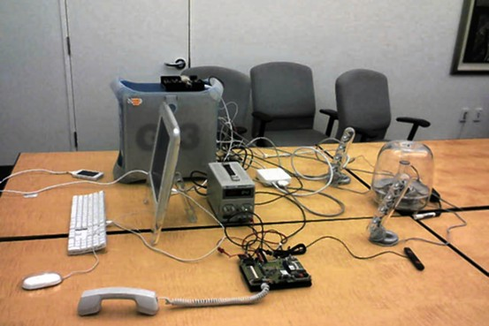
Apple's hardware setup for testing early prototype iPhone software
www.macrumors.com/2014/03/26/secret-ios-room/

Slide 37
8. Test and Redesign
The design process involves multiple iterations and redesigns of your final solution.
You will likely test your solution, find new problems, make changes, and test new solutions before settling on a final design.
www.sciencebuddies.org

Slide 38
9. Communicate Results
To complete your project, communicate your results to others in a final report and/or a display board.
Professional engineers always do the same, thoroughly documenting their solutions so that they can be manufactured and supported.
www.sciencebuddies.org

Slide 39
http://www.sciencebuddies.org/engineering-design-process/engineering-design-compare-scientific-method.shtml

