Slide 1
HUG1I2 Konsep Pengembangan Sains dan Teknologi Pertemuan 4-5: Critical and Creative Thinking
Author-Tim Dosen
Prodi S1 Teknik Informatika

Slide 2
Critical Thinking
Critical thinking is the active, persistent, and careful consideration of a belief or form of knowledge, the grounds that support it, and the conclusions that follow.
It involves analyzing and evaluating one’s own thinking and that of others.
In the context of college teaching and learning, critical thinking deliberately and actively engages students in:
Raising vital questions and problems and formulating these clearly and precisely;
Gathering and assessing relevant information, and using abstract ideas to interpret it effectively;
Reaching well-reasoned conclusions and solutions and testing them against relevant criteria and standards;
Openly considering alternative systems of thought; and
Effectively communicating to others the analysis of and proposed solutions to complex challenges.
Definitions adapted from John Dewey; Richard Paul and Lind Elder; Mihaly Csikszentmihalyi, and M.A. Rosenman and J. S. Gero.)

Slide 3
Creative Thinking
Creative thinking is the generation of new ideas within or across domains of knowledge, drawing upon or intentionally breaking with established symbolic rules and procedures.
It usually involves the behaviors of preparation, incubation, insight, evaluation, elaboration, and communication.
In the context of college teaching and learning, creative thinking deliberately and actively engages students in:
Bringing together existing ideas into new configurations;
Developing new properties or possibilities for something that already exists; and
Discovering or imagining something entirely new.
Definitions adapted from John Dewey; Richard Paul and Lind Elder; Mihaly Csikszentmihalyi, and M.A. Rosenman and J. S. Gero.)

Slide 4
Klasifikasi Springer & Deutsch’s (1993) tentang dominasi lateralisasi otak:
Berpikir otak kiri (Kritis )--analitik, berseri, logis, objektif
ogis, nalar, membandingkan, mengurutkan, membentuk pola, induktif dan deduktif, peramalan, perencanaan, hipotesa
Berpikir otak kanan (kreatif )--global, paralel, emosional, subjektif
Menciptakan sesuatu yang baru (orisinil), fleksible, elaborasi, brainstorming, modifikasi, citra, asosiatif, metaforis, ingin tahu, mengungkapkan perbedaan

Slide 5
Mari melatih kemampuan observasi dan deduksi anda
Buatlah kelompok beranggotakan 4 orang
Kondisikan agar anda duduk berdekatan dengan kelompok anda agar dapat berdiskusi
Posisikan lokasi duduk anda agar dapat melihat tampilan layar dengan cukup jelas

Slide 6
Sample Question
Observe and
Think
Clue
DESERT !

Slide 7
Q 1 Answer
A snail cannot be found in a desert !

Slide 8
Group discussion
Jawab dan pecahkan permasalahan pada lembar yang telah disediakan.
Waktu anda 20 menit.
Permasalahan ini akan menjadi pemanasan untuk 6 soal selanjutnya.
Setiap soal (5-10) hanya akan ditayangkan selama 3 menit

Slide 9
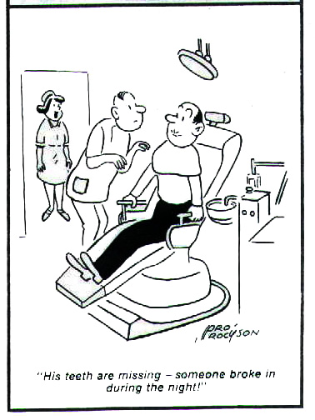
Observations and Inferences
Observations are what you notice.
Inferences are your reactions, thoughts, or explanations.

Slide 10
Resume
Observation:basic step to “growth” new idea on something
Example: Tongsis
Simple tools based-on human behaviour to take a selfie picture. Smart-phone producer already give double-camera (back and front), timer, smile-shoot etc. But still tongsis make selfie more easier and fun ☺

Slide 11
Job Assigment
Persiapkan proposal anda dalam kegiatan PKM (PIMNAS), dapat berupa revisi atau pengayaan proposal yang pernah anda buat dan belum disubmit dalam lomba/kompetisi lain.
Tipe kegiatan PKM AI dan PKM GT
Upload proposal ke IDEA sesuai dengan jadwal yang diberikan

