Slide 1
Sumber utama: timkastelle.org/theblog/

Slide 2
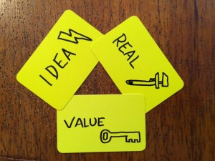
Innovation is about making ideas real to create value for people.

Slide 3
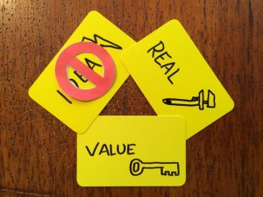
Trigger #1: Fear
This trigger happens when we have systems for doing things that are real, and they create value for people – but then the environment changes.
At this point, the old ways stop working – and if we don’t have new ideas, then we we’re left with fear.

Slide 4
Example
In the 1970s, they were one of the most dominant companies in the world – their mainframes were everywhere.
Then, technological innovation changed their environment – and it became apparent that personal computers would become big. This forced IBM to innovate their business model – a transition that most of their competitors in the mainframe business failed to make.
Then they had to do it all again in late 90s – the internet shifted their environment once more, and they moved from selling hardware to selling software, services and consulting.

Slide 5
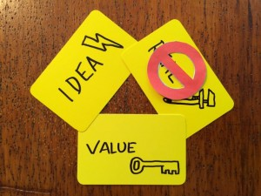
Trigger #2: Fantasy
Lots of people get stuck here. They have the great idea, and they see the problem that it can solve, but they can’t make it real.
At that point, it was nowhere near being an innovation. They had a great idea, and they were working out how to make it real, but it wasn’t there yet. It was still a fantasy.

Slide 6
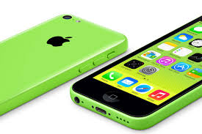
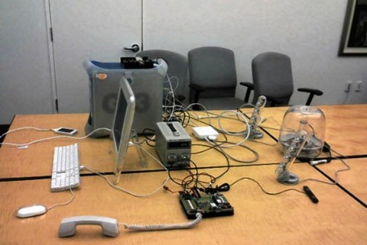
Example
Jobs's Ultimatum: Lay Out a Vision Fast or Lose the Project
It’s from 2006, and shows the early prototype of the iPhone: a touch screen interface, tethered to a Mac, with an ACTUAL phone, speakers, and a rat’s nest of cables.

Slide 7
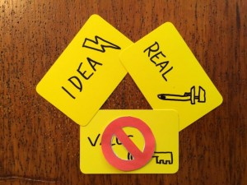
Trigger #3: Frustration
you have a great new idea, and you’ve made it real. But no one’s buying – you are missing the value that you create for people – this causes frustration.

Slide 8
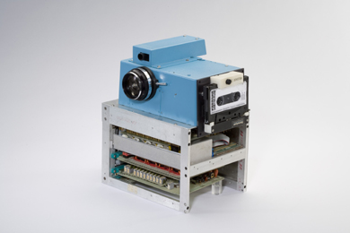
Example: 1975 Kodak’s digital camera
If they invented the digital camera, why didn’t they end up dominating the market?
The big problem in 1975 is that memory was very expensive, and very big. So you couldn’t actually record many pictures at all on a digital camera, and even then it cost a bunch.
There was no way that digital cameras could work in 1975.
The right idea at the wrong time is still wrong.

Slide 9
Is canned air an “Innovation”?
vudesk.com
http://www.nutrisijiwa.com/udara-kota-mancanegara-dikemas-dalam-kaleng/
http://tobeeinspired.blogspot.com/2014/03/udara-segar-kemasan-di-china.html

Slide 10
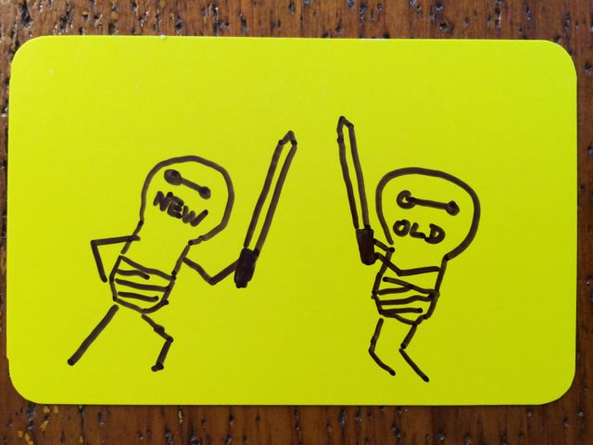
To Create the Future, We Must Understand the Past

Slide 11
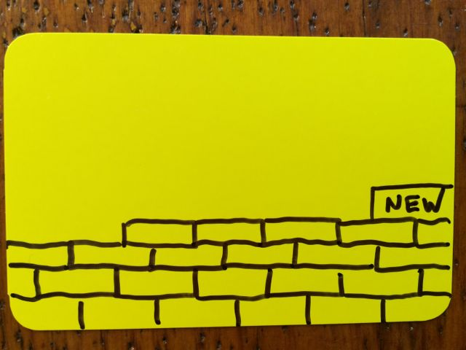
No matter how revolutionary your idea is, it has to work in the real world to create value, and both of those depend on understanding the present and the past.
As new ideas spread, some older ideas lose strength. ... it’s more productive to think about ideas building up on each other
When we look at the history of innovation, it becomes clear that we can’t create valuable new ideas without building on old ones.

Slide 12
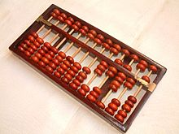
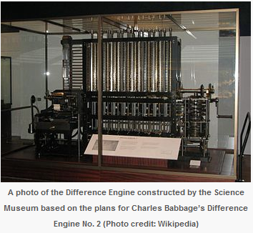
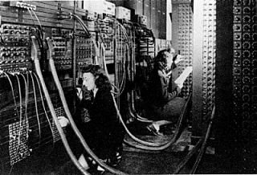
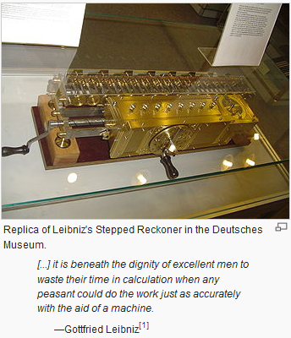
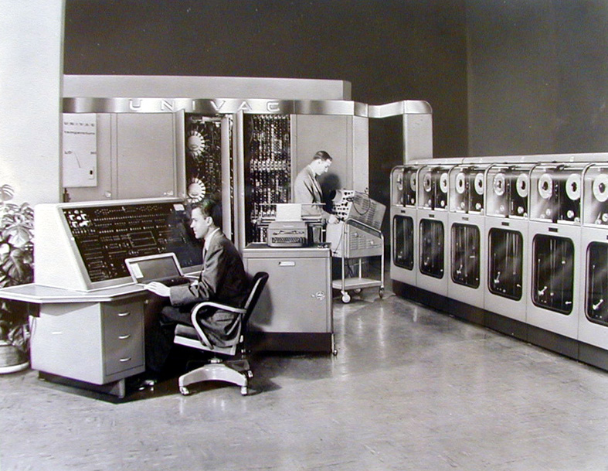
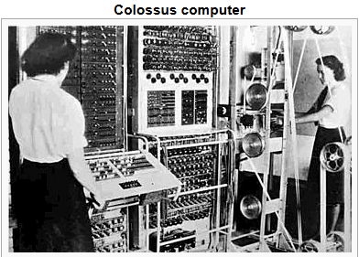
Who Invented the Computer?
ENIAC
UNIVAC

Slide 13
Lesson #1: the new always builds on the old
We can trace the history of the computer back thousands of years.
If we hadn’t had the abacus, or something that performed the same function, we would not have computers now.
Even though few people use an abacus now, or a slide rule, those technologies (technics!) are embodied in computers, just as Leibniz’ binary notation runs everything we use today.
Innovation is a story of combination.

Slide 14
Lesson #2: great ideas always have multiple authors
We like to think about the hero that triumphs against all odds, but this is a deeply misleading story.
Innovation is nearly always triggered by brilliance, but it is usually collective brilliance, not individual brilliance.
Even though Flowers, Eckert and Mauchly designed Colossus and ENIAC, they worked closely with people like Alan Turing, John von Neumann and John Nash. And hundreds of people contributed to designing and building those two machines.
This means that we have to not just cultivate brilliant people in our organisations, but brilliant teams.

Slide 15
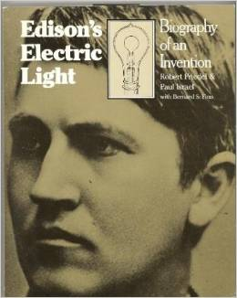
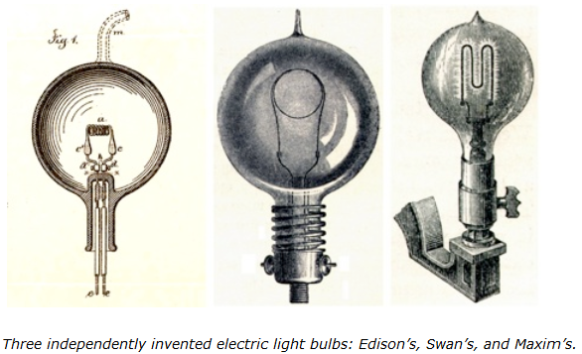
Edison invented the light bulb, right?
One problem: at least 23 other people invented working light bulbs before Edison did.

Slide 16
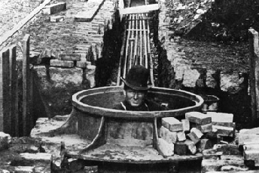
Why does Edison get credit for the light bulb then?
Because he was the first one to build power stations and distribution cables so that everyone could use his light bulb.
He did it by paying people to dig up New York to put in the copper wires to carry the electricity from his Pearl Street Power Station.

Slide 18
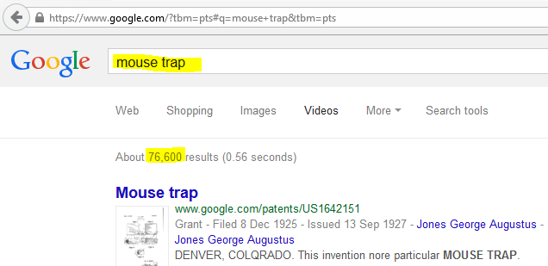

Slide 20
Innovation is about making ideas real to create value for people.

Slide 21
http://www.pbs.org/idealab/2012/03/the-difference-between-invention-and-innovation086/
In its purest sense, “invention“ can be defined as the creation of a product or introduction of a process for the first time.
“Innovation,” on the other hand, occurs if someone improves on or makes a significant contribution to an existing product, process or service.
Consider the microprocessor. Someone invented the microprocessor. But by itself, the microprocessor was nothing more than another piece on the circuit board.
It’s what was done with that piece — the hundreds of thousands of products, processes and services that evolved from the invention of the microprocessor — that required innovation.

Slide 22
http://www.wired.com/2015/01/innovation-vs-invention/
Invention is about creating something new, while innovation introduces the concept of “use” of an idea or method.
Patents are evidence of inventions, of having thought of something first, and documenting the new invention through a legal process.
The usefulness of those inventions is not proven, so “inventions” do not always equate to “innovations.” There are many patents which really do not have a use or have influenced no products or industries. Patents without a “use” are not innovation.
if innovations infer the “use” of a new idea or method, then an invention that leads to innovation is really qualified by how much it changes the behaviors of the users, the businesses, and the processes around it.

