Slide 1
CSG3G3 Kercerdasan Mesin dan Artifisial Pertemuan 11: Latihan:Naive Bayes-Decession Tree Learning
Author-Tim Dosen
KK ICM

Slide 2
Outline
Materi Learning yang disampaikan dalam perkualiahan meliputi:
Naive Bayes
Decision tree learning
Jaringan Syaraf Tiruan
Materi Pengayaan (opsional)

Slide 3
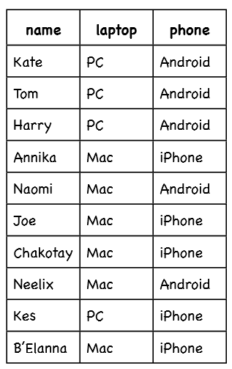
Latihan Naive Bayes:
What is the probability that a random selected person uses a iPhone?
What is the prob that a randomly selected person uses an iPhone given that person uses a mac laptop
John has Android phone and also john has laptop. Guess what is the type of laptop (PC or Mac)?
Notes:
P(iphone)

Slide 4
Latihan:Decission Tree Learning
Determine The Clasifier Tree Rule from data set.
Determine the first attribute that became root in Decission Tree.

