Slide 1
CSG3G3 Kercerdasan Mesin dan Artifisial Pertemuan 11: Learning (Decision Tree)
Author-Tim Dosen
KK ICM

Slide 2
Outline
Materi Learning yang disampaikan dalam perkualiahan meliputi:
Naive Bayes
Decision tree learning
Jaringan Syaraf Tiruan
Materi Pengayaan (opsional)

Slide 3
Review: Naive Bayes
Derived from Bayes Theorem’s, drop the P(D) as the probability of the data is constant (and independent of the hypothesis).
Maximum a posterior.
Maximum likelihood hypothesis
In some-case it need smoothing process.
Desirable Properties of Bayes Classifier:
Incrementally, Combines prior knowledge and observed data, Probabilistic hypothesis

Slide 4
Perhatikan Tabel Berikut, Bagaimana menemukan aturan bahwa seorang pelamar diterima atau tidak?
Pelamar | IPK | Psikologi | Wawancara | Diterima
P1 | Bagus | Tinggi | Baik | Ya
P2 | Bagus | Sedang | Baik | Ya
P3 | Bagus | Sedang | Buruk | Tidak
P4 | Bagus | Rendah | Buruk | Tidak
P5 | Cukup | Tinggi | Baik | Ya
P6 | Cukup | Sedang | Baik | Ya
P7 | Cukup | Sedang | Buruk | Tidak
P8 | Cukup | Rendah | Buruk | Tidak
P9 | Kurang | Tinggi | Baik | Ya
P10 | Kurang | Sedang | Baik | Ya
P11 | Kurang | Sedang | Buruk | Tidak
P12 | Kurang | Rendah | Buruk | Tidak

Slide 5
Wawancara
Baik
Buruk
Ya
Tidak
Kenapa kesimpulan diatas dapat kita ambil??

Slide 6
Perhatikan Tabel Berikut (terdapat modifikasi P4, P8 dan P10), Bagaimana menemukan aturan bahwa seorang pelamar diterima atau tidak?
Pelamar | IPK | Psikologi | Wawancara | Diterima
P1 | Bagus | Tinggi | Baik | Ya
P2 | Bagus | Sedang | Baik | Ya
P3 | Bagus | Sedang | Buruk | Ya
P4 | Bagus | Rendah | Buruk | Tidak
P5 | Cukup | Tinggi | Baik | Ya
P6 | Cukup | Sedang | Baik | Ya
P7 | Cukup | Sedang | Buruk | Ya
P8 | Cukup | Rendah | Buruk | Tidak
P9 | Kurang | Tinggi | Baik | Ya
P10 | Kurang | Sedang | Buruk | Tidak
P11 | Kurang | Rendah | Baik | Ya

Slide 7
Wawancara
Sekali lagi, Kenapa kesimpulan diatas dapat kita ambil??
Baik
Buruk
Ya
Psikologi
Tinggi
Sedang
Rendah
Tidak
IPK
Tidak
Bagus
Cukup
Kurang
Ya
Ya
Tidak

Slide 9
Decision Tree Learning (DTL)
Berusaha menemukan fungsi-fungsi pendekatan yang umumnya bernilai diskrit
Tahan terhadap data-data yang terdapat kesalahan
Mampu mempelajari ekspresi-skspresi disjunctive (ekspresi OR).
Metode DTL:
Interactive Dychotomizer version 3 (ID3)
ASSISTANT
C4.5
C5.0

Slide 10
Your idea to do Decision Tree?
Pelamar | IPK | Psikologi | Wawancara | Diterima
P1 | Bagus | Tinggi | Baik | Ya
P2 | Bagus | Sedang | Baik | Ya
P3 | Bagus | Sedang | Buruk | Tidak
P4 | Bagus | Rendah | Buruk | Tidak
P5 | Cukup | Tinggi | Baik | Ya
P6 | Cukup | Sedang | Baik | Ya
P7 | Cukup | Sedang | Buruk | Tidak
P8 | Cukup | Rendah | Buruk | Tidak
P9 | Kurang | Tinggi | Baik | Ya
P10 | Kurang | Sedang | Baik | Ya
P11 | Kurang | Sedang | Buruk | Tidak
P12 | Kurang | Rendah | Buruk | Tidak

Slide 11
General Structure of Hunt’s Algorithm
Let D_{t} be the set of training records that reach a node t
General Procedure:
If D_{t} contains records that belong the same class y_{t}, then t is a leaf node labeled as y_{t}
If D_{t} is an empty set, then t is a leaf node labeled by the default class, y_{d}
If D_{t} contains records that belong to more than one class, use an attribute test to split the data into smaller subsets. Recursively apply the procedure to each subset.
D_{t}
?

Slide 12
Hunt’s Algorithm
Refund
Don’t
Cheat
Yes
No
Don’t
Cheat
Don’t
Cheat
Refund
Refund
Yes
No
Yes
No
Don’t
Cheat
Marital
Status
Don’t
Cheat
Marital
Status
Single,
Divorced
Married
Single,
Divorced
Married
Taxable
Income
Don’t
Cheat
Cheat
Don’t
Cheat
< 80K
>= 80K
Don’t
Cheat
Cheat

Slide 13
Review The Process
Basic Idea:
Determine the attribute used for n-level Tree -> how to choose the best attribute?
In Hunt’s it can’t guarantee the best attribute
Issues:
Determine how to split the records
How to specify the attribute test condition?
How to determine the best split?
Determine when to stop splitting

Slide 14
How to specify the attribute test condition?
Depends on attribute types:
Nominal -> categorical data, qualitative data
Ordinal -> can be ranked based on term and condition
Continuous
Depends on number of ways to split: 2-way split, Multi-way split
Multi-way split: Use as many partitions as distinct values
Binary split: Divides values into two subsets. -> Need to find optimal partitioning.

Slide 15
Find the example
Nominal Attribute:
Ordinal Attribute:
Continous Attribute:

Slide 16
Splitting Based on Nominal Attributes
Multi-way split: Use as many partitions as distinct values.
Binary split: Divides values into two subsets. Need to find optimal partitioning.
CarType
Family
Luxury
Sports
CarType
CarType
{Sports, Luxury}
OR
{Family, Luxury}
{Family}
{Sports}

Slide 17
Splitting Based on Ordinal Attributes
Multi-way split: Use as many partitions as distinct values.
Binary split: Divides values into two subsets. Need to find optimal partitioning.
What about this split?
Size
Small
Large
Medium
Size
Size
{Small, Medium}
OR
{Medium, Large}
{Large}
{Small}
Size
{Small, Large}
{Medium}

Slide 18
Splitting Based on Continuous Attributes
Different ways of handling
Discretization to form an ordinal categorical attribute
Static – discretize once at the beginning
Dynamic – ranges can be found by equal interval bucketing, equal frequency bucketing (percentiles), or clustering.
Binary Decision: (A < v) or (A ≥ v)
consider all possible splits and finds the best cut
can be more compute intensive

Slide 19
Splitting Based on Continuous Attributes

Slide 20
Tree Induction
Greedy strategy.
Split the records based on an attribute test that optimizes certain criterion.
Issues
Determine how to split the records
How to specify the attribute test condition?
How to determine the best split?
Determine when to stop splitting

Slide 21
How to determine the Best Split
Before Splitting: 10 records of class 0, 10 records of class 1
Which test condition is the best?

Slide 22
How to determine the Best Split
Greedy approach:
Nodes with homogeneous class distribution are preferred
Need a measure of node impurity:
Non-homogeneous,
High degree of impurity
Homogeneous,
Low degree of impurity

Slide 23
Homogeneus / Impurity
Homogeneus vs Impurity vs Heterogenity
Measures of Node Impurity
Gini Index
Entropy:
Misclassification error

Slide 24
How to Find the Best Split
Before Splitting:
Gain = M0 – M12 vs M0 – M34
M0
A?
B?
Yes
No
Yes
No
Node N1
Node N2
Node N3
Node N4
M1
M2
M3
M4
M12
M34

Slide 25
How to Find the Best Split
The basis concept: Find the attribute that give better Information Gain
Information Gain
Gain (S,A)= measurement (S) – measurement (A)
measurement (S) = nilai impurity / homogeneus / hetergoneus data awal
measurenment (S,A) nilai impurity / homogeneus / hetergoneus bila data dipecah berdasarkan seluruh attribute (A)
measurement (A) = Σmeasurenment (Ai) -> dihitung paling awal
Measuement(A) merupakan akumulasi measurenment (Ai), dimanan measurenment (Ai) = nilai impurity / homogeneus / hetergoneus bila data dipecah berdasarkan seluruh attribute (A) kemudian dipecah kembali berdasarkan Ai

Slide 26
Measure of Impurity: GINI
Gini Index for a given node t :
(NOTE: p( j | t) is the relative frequency of class j at node t).
Maximum (1 - 1/n_{c}) when records are equally distributed among all classes, implying least interesting information
Minimum (0.0) when all records belong to one class, implying most interesting information

Slide 27
Examples for computing GINI
P(C1) = 0/6 = 0 P(C2) = 6/6 = 1
Gini = 1 – P(C1)² – P(C2)² = 1 – 0 – 1 = 0
P(C1) = 1/6 P(C2) = 5/6
Gini = 1 – (1/6)² – (5/6)² = 0.278
P(C1) = 2/6 P(C2) = 4/6
Gini = 1 – (2/6)² – (4/6)² = 0.444

Slide 28
Splitting Based on GINI
Used in CART, SLIQ, SPRINT.
When a node p is split into k partitions (children), the quality of split is computed as,
where, n_{i} = number of records at child i,
n = number of records at node p.

Slide 29
Alternative Splitting Criteria based on INFO
Entropy at a given node t:
(NOTE: p( j | t) is the relative frequency of class j at node t).
Measures homogeneity of a node.
Maximum (log n_{c}) when records are equally distributed among all classes implying least information
Minimum (0.0) when all records belong to one class, implying most information
Entropy based computations are similar to the GINI index computations

Slide 30
Examples for computing Entropy
P(C1) = 0/6 = 0 P(C2) = 6/6 = 1
Entropy = – 0 log 0 – 1 log 1 = – 0 – 0 = 0
P(C1) = 1/6 P(C2) = 5/6
Entropy = – (1/6) log₂ (1/6) – (5/6) log₂ (1/6) = 0.65
P(C1) = 2/6 P(C2) = 4/6
Entropy = – (2/6) log₂ (2/6) – (4/6) log₂ (4/6) = 0.92

Slide 31
Splitting Based on INFO...
Gain Ratio:
Parent Node, p is split into k partitions
n_{i} is the number of records in partition i
Adjusts Information Gain by the entropy of the partitioning (SplitINFO). Higher entropy partitioning (large number of small partitions) is penalized!
Used in C4.5
Designed to overcome the disadvantage of Information Gain

Slide 32
Splitting Criteria based on Classification Error
Classification error at a node t :
Measures misclassification error made by a node.
Maximum (1 - 1/n_{c}) when records are equally distributed among all classes, implying least interesting information
Minimum (0.0) when all records belong to one class, implying most interesting information

Slide 33
Examples for Computing Error
P(C1) = 0/6 = 0 P(C2) = 6/6 = 1
Error = 1 – max (0, 1) = 1 – 1 = 0
P(C1) = 1/6 P(C2) = 5/6
Error = 1 – max (1/6, 5/6) = 1 – 5/6 = 1/6
P(C1) = 2/6 P(C2) = 4/6
Error = 1 – max (2/6, 4/6) = 1 – 4/6 = 1/3

Slide 34
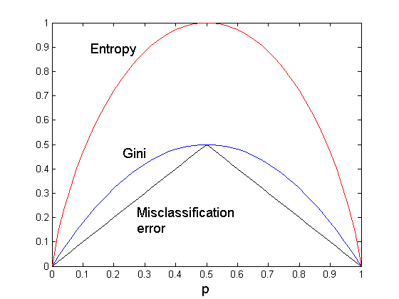
Comparison among Splitting Criteria
For a 2-class problem:

Slide 35
Contoh Perhitungan
DTC Menggunakan ID3

Slide 36
Data Penerimaan Pegawai
Pelamar | IPK | Psikologi | Wawancara | Diterima
P1 | Bagus | Tinggi | Baik | Ya
P2 | Bagus | Sedang | Baik | Ya
P3 | Bagus | Sedang | Buruk | Ya
P4 | Bagus | Rendah | Buruk | Tidak
P5 | Cukup | Tinggi | Baik | Ya
P6 | Cukup | Sedang | Baik | Ya
P7 | Cukup | Sedang | Buruk | Ya
P8 | Cukup | Rendah | Buruk | Tidak
P9 | Kurang | Tinggi | Baik | Ya
P10 | Kurang | Sedang | Buruk | Tidak
P11 | Kurang | Rendah | Baik | Ya

Slide 37
Metode ID3
Membangkitkan Decision Tree secara otomatis
Menggunakan perhitungan Entropy dan IG
Prosedur Iteratif yang sangat Sederhana

Slide 38
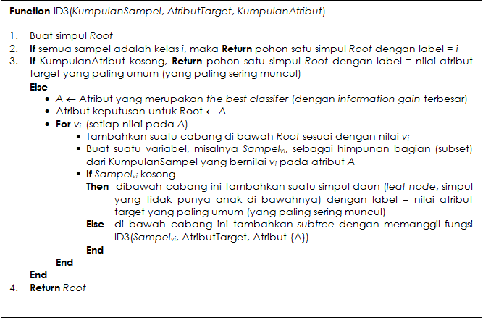
Metode ID3

Slide 39
Rekursi level 0 iterasi ke-1
Memanggil fungsi ID3 dengan masukan:
KumpulanSampel = semua sampel data [8+,3-]
AtributTarget = ’Diterima’
KumpulanAtribut = {IPK, Psikologi, Wawancara}
Entropi awal data
[8+, 3 -] =

Slide 40
Information Gain (IG)
Values(IPK) = Bagus, Cukup, Kurang
S = [8+, 3-], |S| = 11
S_{Bagus} = [3+, 1-], |S_{Bagus}| = 4
S_{Cukup} = [3+, 1-], |S_{Cukup}| = 4
S_{Kurang} = [2+, 1-], |S_{Kurang}| = 3

Slide 41
IG untuk IPK

Slide 42
IG untuk Psikologi
Values(Psikologi) = Tinggi, Sedang, Rendah
S = [8+, 3-], |S| = 11
S_{Tinggi} = [3+, 0-], |S_{Tinggi}| = 3, Entropy(S_{Tinggi}) = 0
S_{Sedang} = [4+, 1-], |S_{Sedang}| = 5, Entropy(S_{Sedang}) = 0, 7219
S_{Rendah} = [1+, 2-], |S_{Rendah}| = 3, Entropy(S_{Rendah}) = 0,9183

Slide 43
IG untuk Psikologi

Slide 44
IG untuk Wawancara
Values(Wawancara) = Baik, Buruk
S = [8+, 3-], |S| = 11
S_{Baik} = [6+, 0-], |S_{Baik}| = 6, Entropy(S_{Baik}) = 0
S_{Buruk} = [2+, 3-], |S_{Buruk}| = 5, Entropy(S_{Buruk}) = 0,9710

Slide 45
IG untuk Wawancara

Slide 46
The Best Classifier
Gain(S,IPK) = 0,0049
Gain(S,Psikologi) = 0,2668
Gain(S,Wawancara) = 0,4040

Slide 47
Daftar Pustaka
Tan, Steinbach, Kumar , Lecture Notes for Chapter 4, Introduction to Data Mining
Eamonn Keogh, Naive Bayes Classifier, UCR
Wellesley.edu, Lecture_16, Text Classification and Naïve Bayes, http://cs.wellesley.edu/~cs315/315_PPTs/L16-NaiveBayes/lecture_16.ppt
Temple.edu, Lecture Naive Bayes Classifier, http://www.cis.temple.edu/~latecki/Courses/RobotFall08/Talks/bayesNaive.ppt

